Slide 1


Enviroway Annual Conference
Dragon Slayer for TOC & Chlorine Demand
Kentucky Division of Water
Ken Lake State Park
October 17, 2016

Slide 2

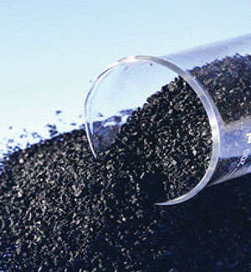
Take Home Message
Filtration Systems are an important part of overall treatment scheme and water quality
Filters are mechanical pieces of equipment
Filtration media is what does the work
Media maintenance can reduce chlorine demand
Operations and Testing can Improve Removal & Reduce Demand
GAC can remove up to 100% of TOC
Reduction in Chlorine means less DBP’s

Slide 3
Multiple Barrier Concept for Microbial Contaminant Protection
Turbidity
Goal
<1.0 NTU
Coagulant
Addition
Achieve
Inactivation
Goal
Turbidity
Goal
<.10 NTU
Disinfection
Addition
Variable
Quality
Source
Water
Flocculation/Sedimentation
Barrier
Filtration
Barrier
Disinfection
Barrier
Finished
Water

Slide 4
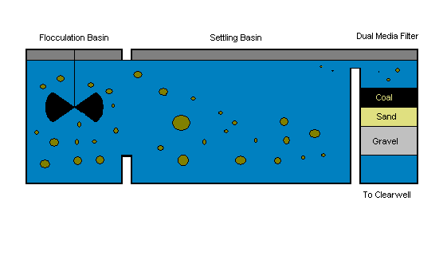

Conventional Filtration at Work
CL2 Demand

Slide 5
Filtration
Filtration removes particles and floc that were not completely settled out during the sedimentation process.
Water passes through materials such as a bed of fine sand, coal, or other granular substance. Particles will be removed through adsorption, absorption, and straining.

Slide 6
Filtration Has Two Mechanisms
Mechanical
Adsorption
Large particles become lodged and cannot continue downward through media
Particles stick to the media and cannot continue downward through media

Slide 7
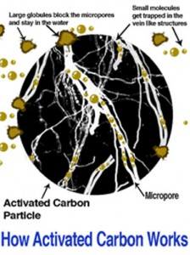
How GAC Works

Slide 8
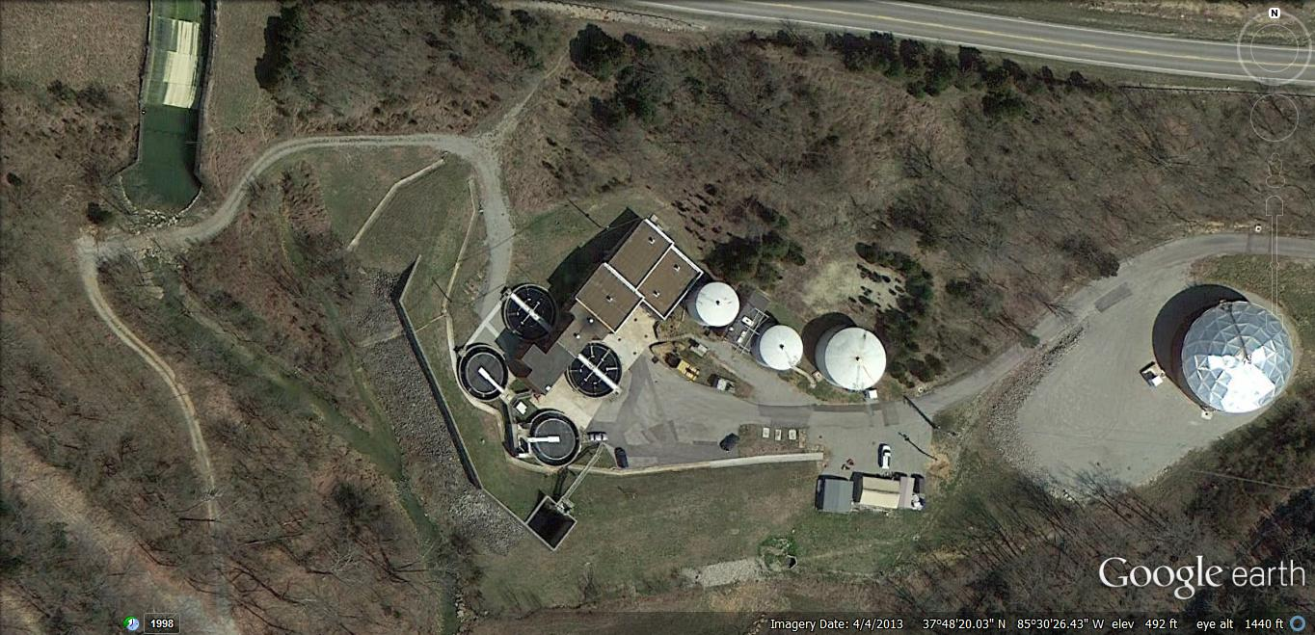
Bardstown Water Treatment
Case History

Slide 9

Sympson
Lake
Reservoir
WTP Schematic
HS Pumps
CL2 Demand
1
KMNO4
East #1
West
#2
Clearwell
Actiflo
Post Actiflo CL2
2
3
Activated Carbon
WTP
1
2
HFS
4
4
TOF CL2
Clearwell
5
6
7
3
4
4
Bardstown WTP- GAC Trial
PWSID # KY0900017
Treatment Plant Schematic
Bob Cashion, CWT 4-16
PO4
Post Filter CL2
Filter # 4 GAC Cap Location

Slide 10
Raw Water Profile
Daily Test
Best Source to Treat
Manage TOC & Chlorine Demand Issues
Improved Lake Management & Treatment
Improved Pretreatment, Actiflo Treatment and chlorination
Improved Filtration Operations

Slide 11
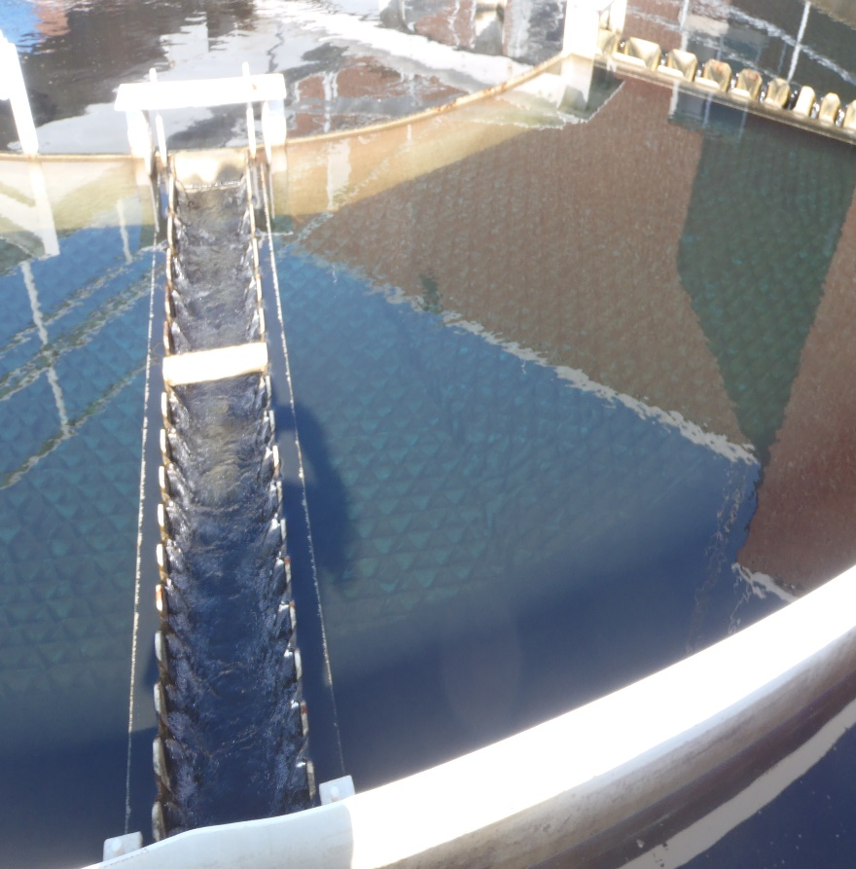
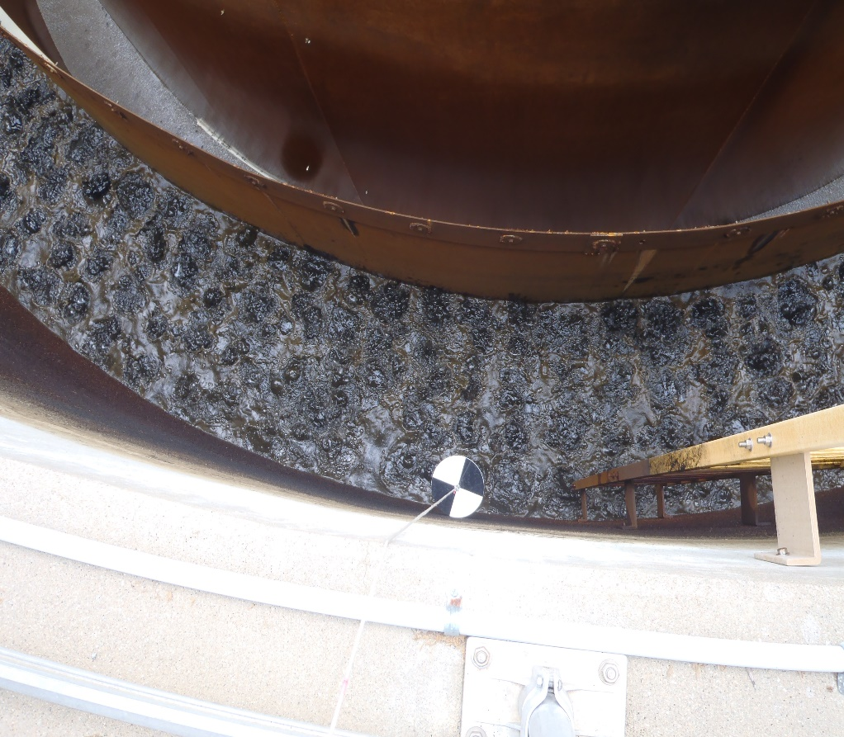
Clarification & Filtration in One Unit

Slide 12
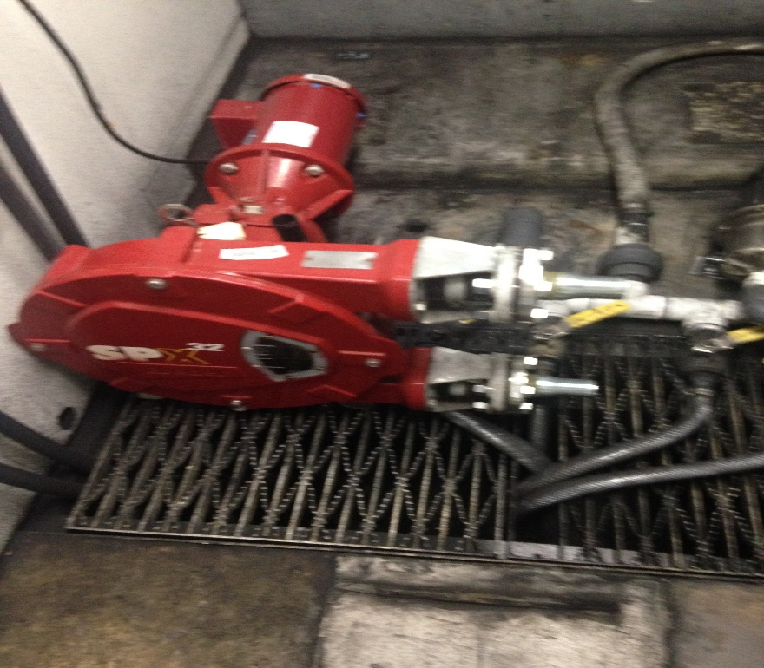
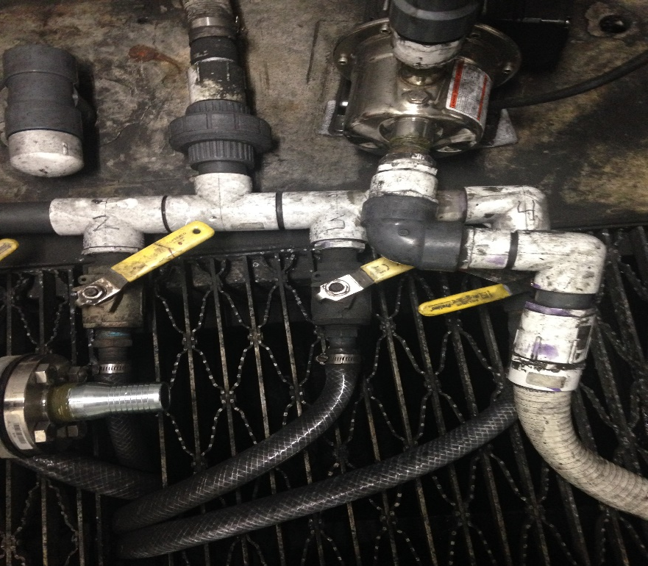
Improvements and Special Studies
All Carbon is Not the Same
Carbon Feed Split
PAC Study

Slide 13
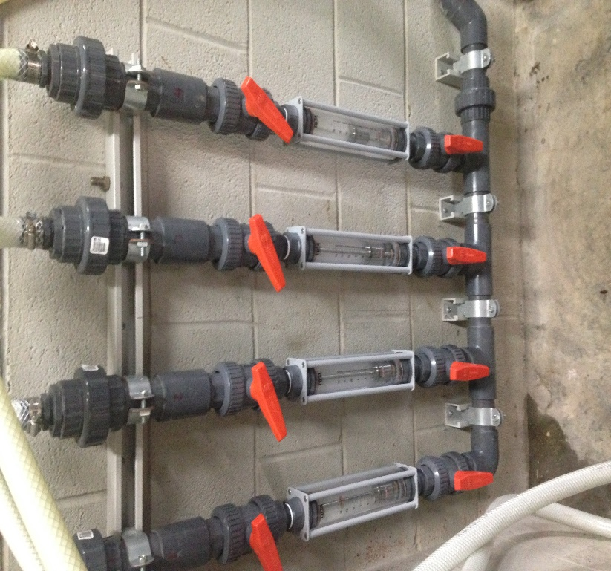
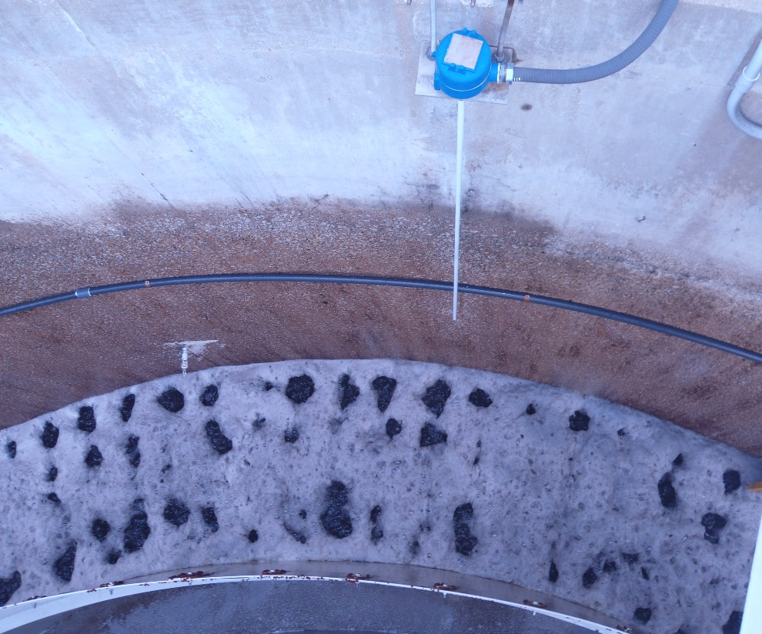
Improved Chlorine Feed

Slide 14
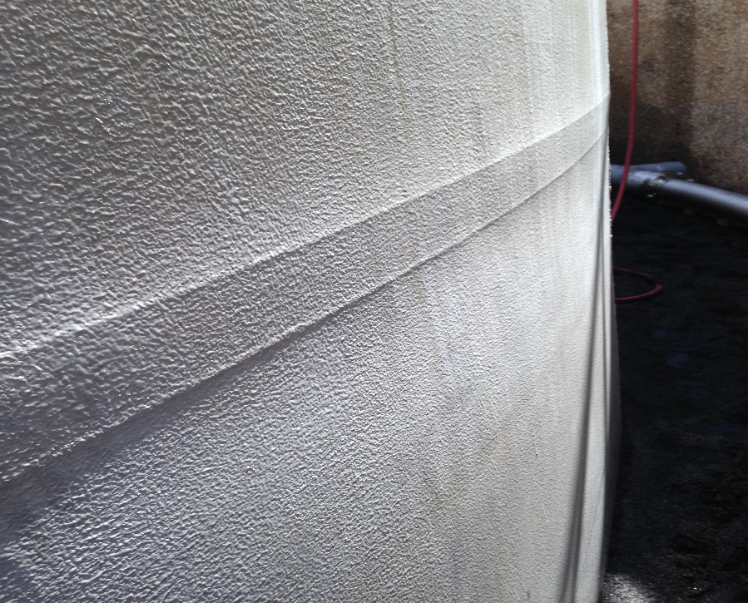
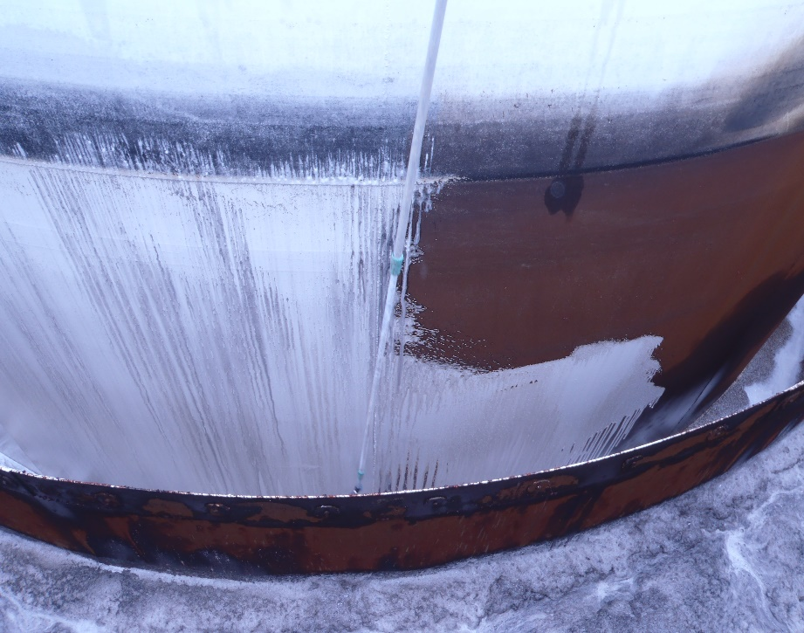
Wetted Surface Cleaning
Inorganic & Organic Removal

Slide 15
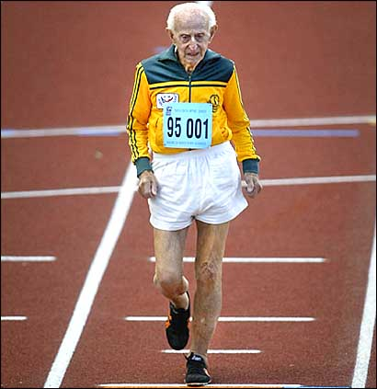
Signs and symptoms of filter deterioration
Filters don’t run like they used to….
Short filter runs
Lower quality output
High Head Loss
Chlorine Demand

Slide 16

Dual Media Filter Assessment
City of Bardstown Utilities
Bardstown Water Treatment Plant
Bardstown, Kentucky 40004
DUAL MEDIA FILTRATION UNITS
June 2015
Bob Cashion, CWT
Business Development Manager
S⁴ Water Sales and Service, LLC
160 Vanderbilt Court
Bowling Green, KY 42103

Slide 17
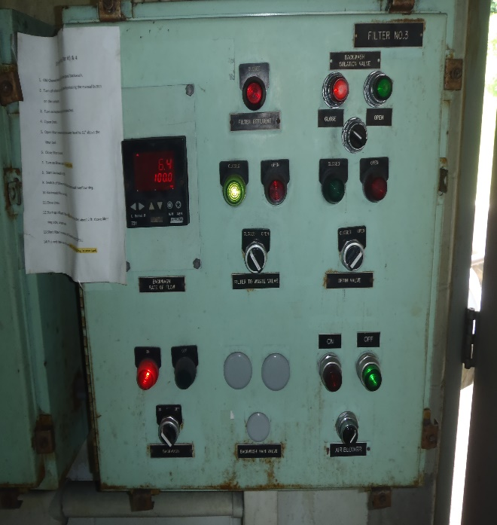
TABLE OF CONTENTS
Executive Summary…………………………………………Preface
Table of Contents 2
Introduction 3
Filter Assessment Sequence 5
Ten State Standard Design……………………………… 6
Filter Valve Integrity Check 8
Filter Backwash Turbidity Profile 9
Floc Retention Analysis 13
Filter Bed Expansion Test (Disc Method) 16
Trough Level and Freeboard 20
Under-drain Inspection 21
Mud-ball, Media Interface, and Media Depth Inspections 22
Surface Wash Inspection/Cleaning 24
Backwash Rise Test 25
Conclusion & Recommendations 26
Appendix………………………………………………… 29

Slide 18
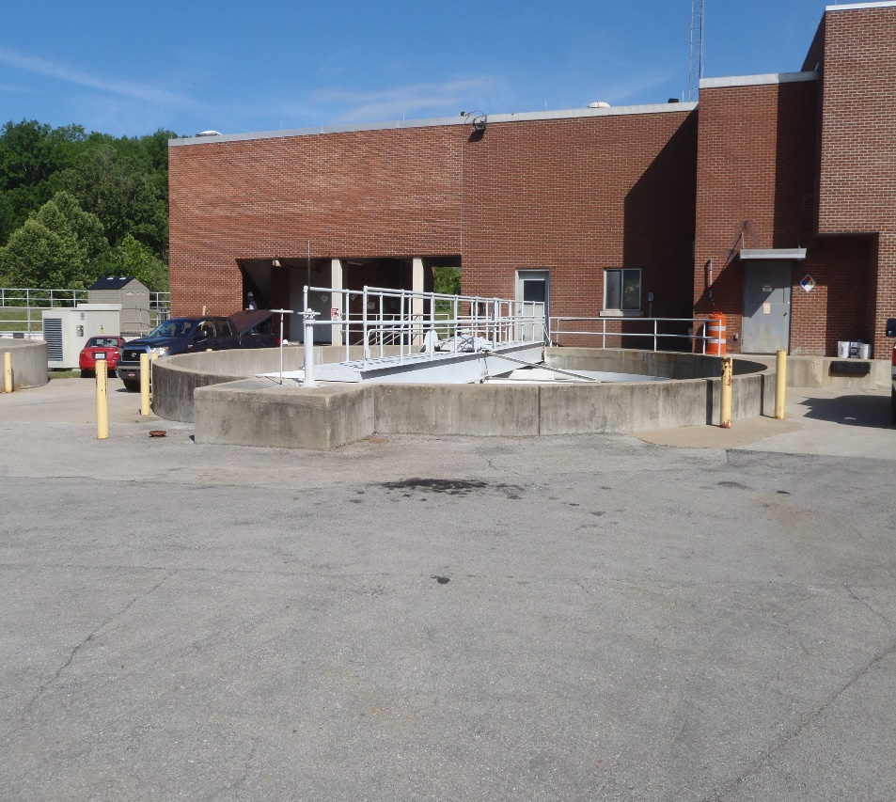
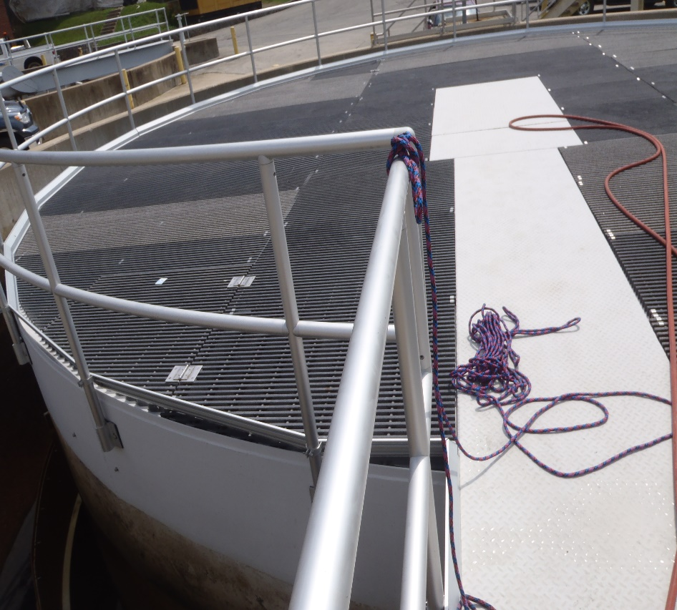
Filter Units

Slide 19
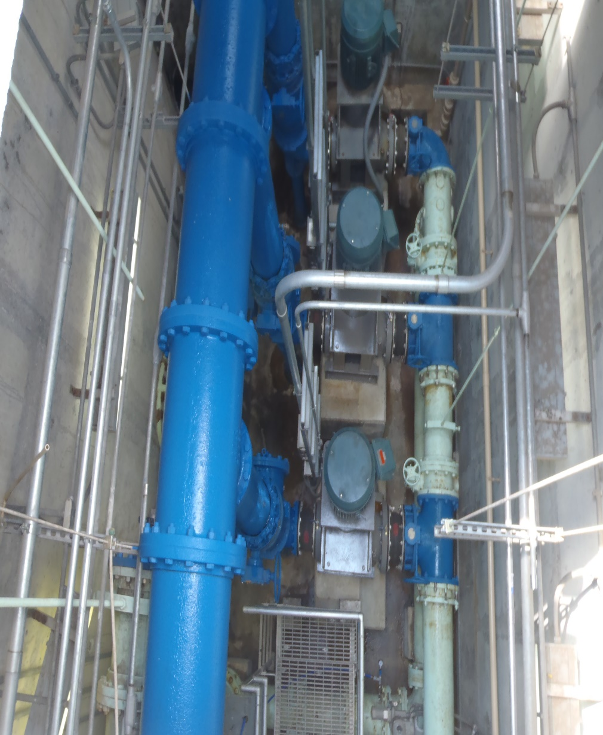
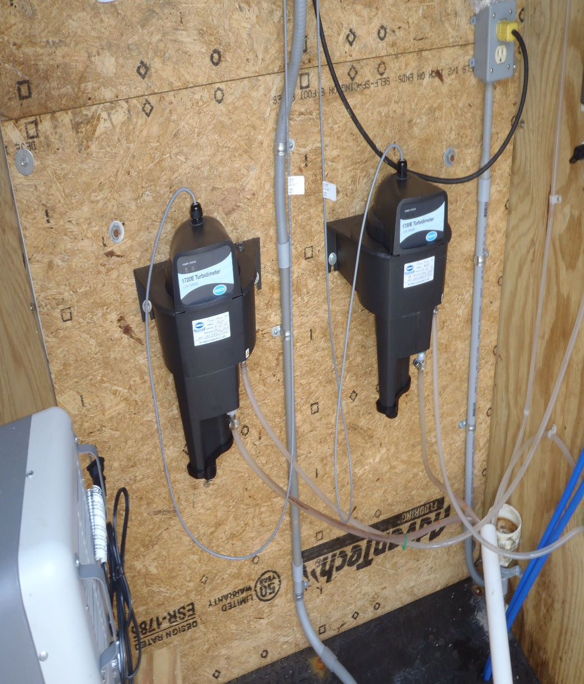
Performance Evaluation

Slide 21
Analysis Is Only as Good as Sample
Sampling Location
INTERFACE

Slide 22
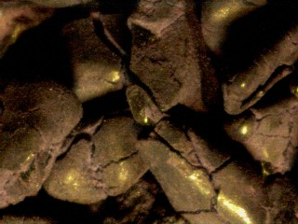
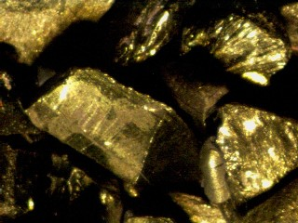
Is my media Worn out?

Slide 23
Sieve Analysis Data
Sieve dia. (mm) | Anthracite % Weight Passing | Sand % Weight Passing
2.800 | 99.7 | 100.00
2.000 | 98.34 | 100.00
1.70 | 96.10 | 100.00
1.40 | 83.43 | 100.00
1.00 | 17.87 | 99.81
0.850 | 6.63 | 97.13
0.710 | 0.96 | 80.28
0.500 | 0.96 | 11.19
0.355 | 0.96 | 0.25
0.25 | 0.96 | 0.02

Slide 24
Sieve Analysis Data
 | Anthracite | Sand
Effective Size (mm) | 0.90 | 0.48
60% Passing (mm) Uniformity Coefficient | 1.26 1.40 | 0.65 1.34

Slide 25
Floc Retention Analysis

Slide 26
What the Numbers Mean
Floc Retention Test Turbidity (after backwash and rewash) | Bed Cleanliness
10-30 NTU | Very clean, not well ripened
30-60 NTU | Clean and partially ripened
60-120 NTU | Reasonably clean, well ripened
120-300 NTU | Dirty Media, well ripened
300-600 NTU | Dirty Media w/ possible mudballs, well ripened
600-1200 NTU | Very dirty media bed, many mudballs
>1200 NTU | Extremely dirty, chemical cleaning or replacement needed

Slide 27
Expansion Rate of Rise

Slide 28
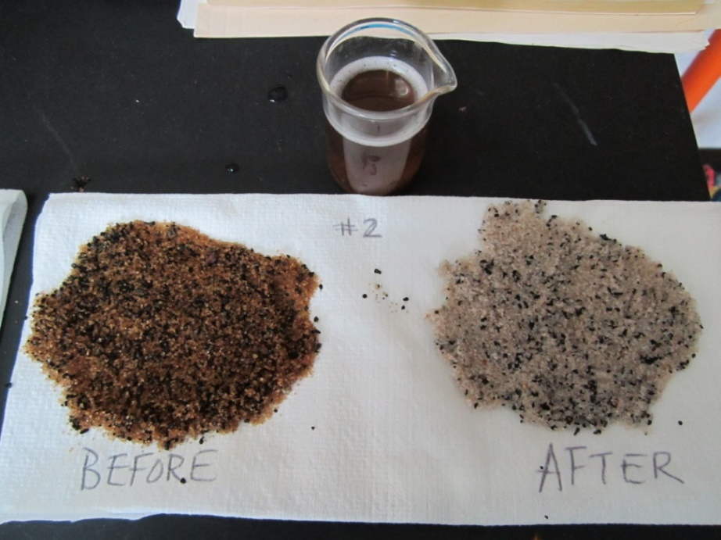
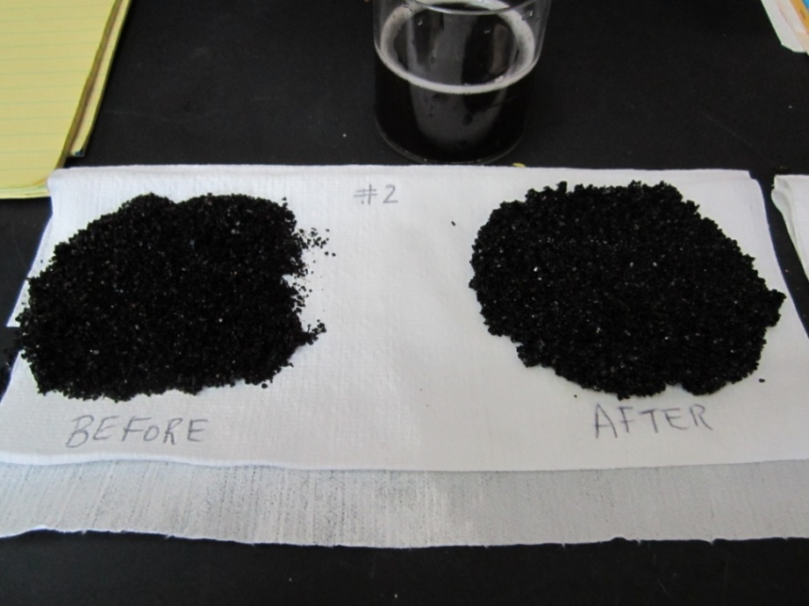
Media Cleaning in Lab

Slide 29
A closer look at an Media Particle – Multiple Layers
1148 Pounds Removed

Slide 30
Aliquot Sample
Deposits Removed 1148 (lbs.)

Slide 31
Constituent Clean-Up
ANTHRACITE
BEFORE Cleaning
AFTER CLEANING

Slide 32
Constituent Clean-Up
SAND
BEFORE Cleaning
AFTER CLEANING

Slide 33
Constituent LOADING

Slide 34
Constituent LOADING
6010 MET ICP
Analytical Method: EPA 6010 Preparation Method: EPA3010
Parameters ICP Results Units Report Limit Wt. %
PARAMETERS | RESULTS | UNITS | REPORT LIMIT |  | WT%
Aluminum | 2100 | Mg/l | 0.075 |  | 71.3 %
Calcium | 364 | Mg/l | 0.1 |  | 12.4 %
Manganese | 77.6 | Mg/l | 0.005 |  | 2.6 %
Phosphorus | 136.8 | Mg/l | 0.1 |  | 4.6 %
Silicon | 139.0 | Mg/l | 0.5 |  | 4.7 %
 |  |  | Total |  | 100.0%

Slide 35
Pre Cleaning Cl2 Data
Free | Total | Difference
1.8 | 3.16 | 1.36
1.54 | 3.02 | 1.48
1.69 | 3.06 | 1.37
1.53 | 2.86 | 1.33
1.8 | 3 | 1.2
1.73 | 2.72 | 0.99
1.7 | 2.9 | 1.2
1.57 | 3.12 | 1.55
1.66 | 3.08 | 1.42
1.3 | 2.72 | 1.42
1.61 | 2.92 | 1.31
1.53 | 3.2 | 1.67
1.75 | 3.3 | 1.55
1.66 | 3.14 | 1.48
1.41 | 2.92 | 1.51

Slide 36
Chlorine Demand
July 2015
Plant Free | Plant Total | Difference
1.17 | 1.47 | 0.3
1.13 | 1.37 | 0.24
0.98 | 1.26 | 0.28
1.08 | 1.31 | 0.23
1.18 | 1.41 | 0.23
1.31 | 1.44 | 0.13
1.1 | 1.34 | 0.24
1.12 | 1.53 | 0.41
1.32 | 1.51 | 0.19
1.15 | 1.49 | 0.34
1.07 | 1.34 | 0.27
1.26 | 1.53 | 0.27
1.49 | 1.69 | 0.2
1.57 | 1.8 | 0.23
1.28 | 1.52 | 0.24
1.14 | 1.48 | 0.34

Slide 37
Chlorine Demand
August 2015
Free | Total | Difference
1.33 | 1.58 | 0.25
1.4 | 1.64 | 0.24
1.23 | 1.48 | 0.25
1.19 | 1.43 | 0.24
1.22 | 1.47 | 0.25
1.23 | 1.49 | 0.26
1.19 | 1.43 | 0.24
1.24 | 1.38 | 0.14
1.09 | 1.33 | 0.24
1.41 | 1.72 | 0.31
1.14 | 1.38 | 0.24
1.05 | 1.31 | 0.26
1.03 | 1.23 | 0.2
1.1 | 1.31 | 0.21
1.04 | 1.36 | 0.32
1.44 | 1.82 | 0.38

Slide 38
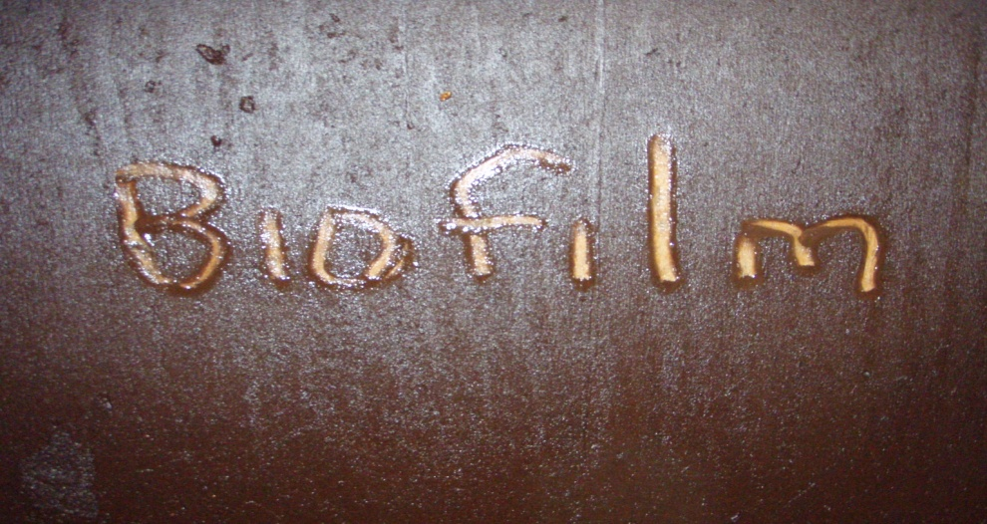
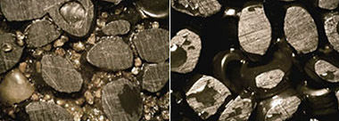
Benefits of Cleaning Process
Less Chlorine Feed
Improved Filtration
Less Backwash Water
Longer Filter Runs
Esthetic Quality
Improved Water Quality

Slide 39
State of Kentucky Approval
First Split GAC Cap Approved in KY- June 24, 2016
Stipulation Based on previous Engineering Specification
2-4 GPM/Square Foot Contact time 528 Square feet with 48 inches GAC- 900 Iodine Number- 10” Sand
Backwash Flow Rate Issue
No TOF Chlorine Feed
HPC bottom of filter control mechanism
Biological Filtration Operation

Slide 40
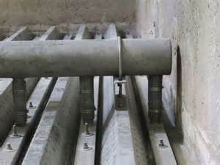
“As Built GAC Cap” Filter # 4
Filter Media Depths
Wall Elev. 483.75
AWI Underdrain
Weir Elev. 476.25
33.125” Free-board at Rest
50% Expansion
Elev. 474.75
476.25
GAC Elev. 472.33
4.833’ of Total Media
48” GAC
Sand Elev. 468.33
AWI Elev. 467.50
10” Sand
AWI Underdrain
Bardstown WTP GAC Project
PWSID # KY0900017
Filters # 4 “ As Built GAC Cap”
Bob Cashion, CWT 7-22-16
Bottom Elev. 464.50
Plenum
6800 gpm BW rate gave 7” Rise Rate @ 12%

Slide 41
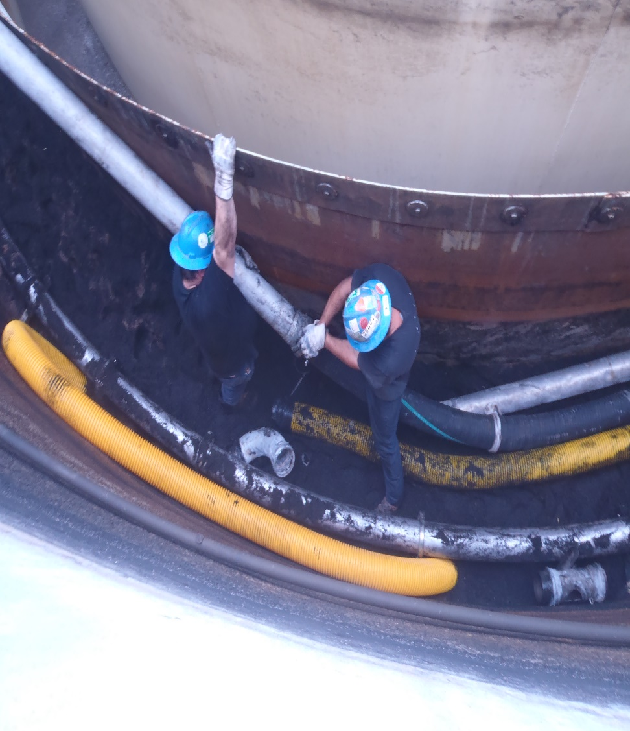
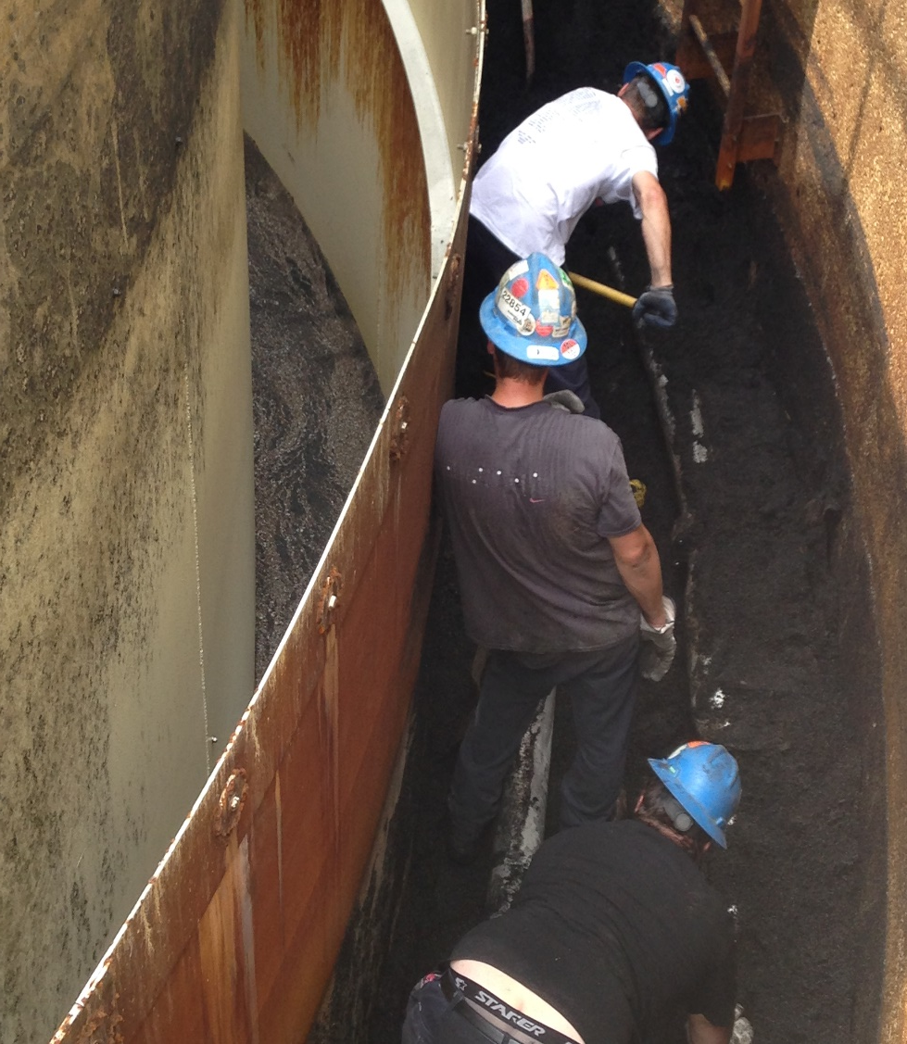
Anthracite Media Removed to Sand Level

Slide 42
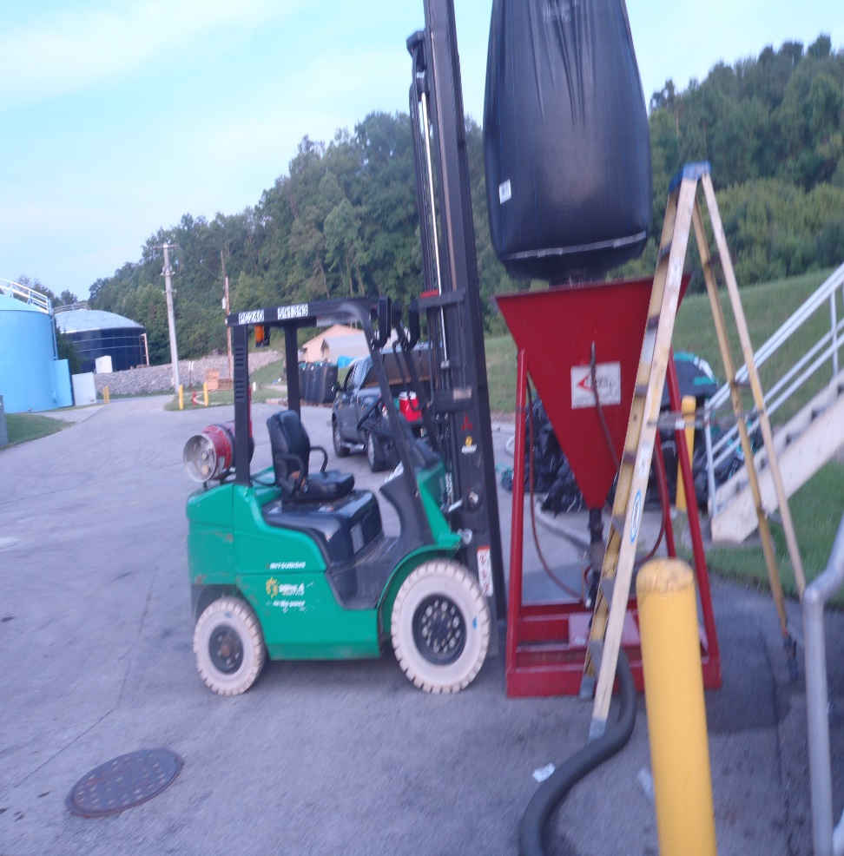
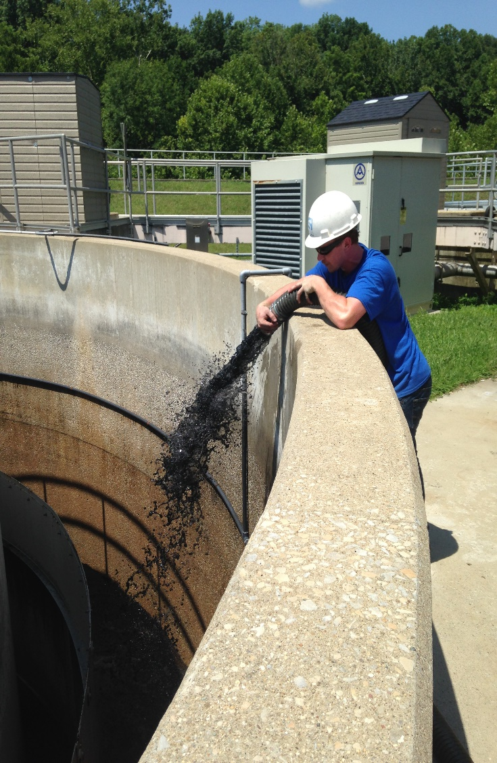
Bardstown GAC Installation

Slide 43
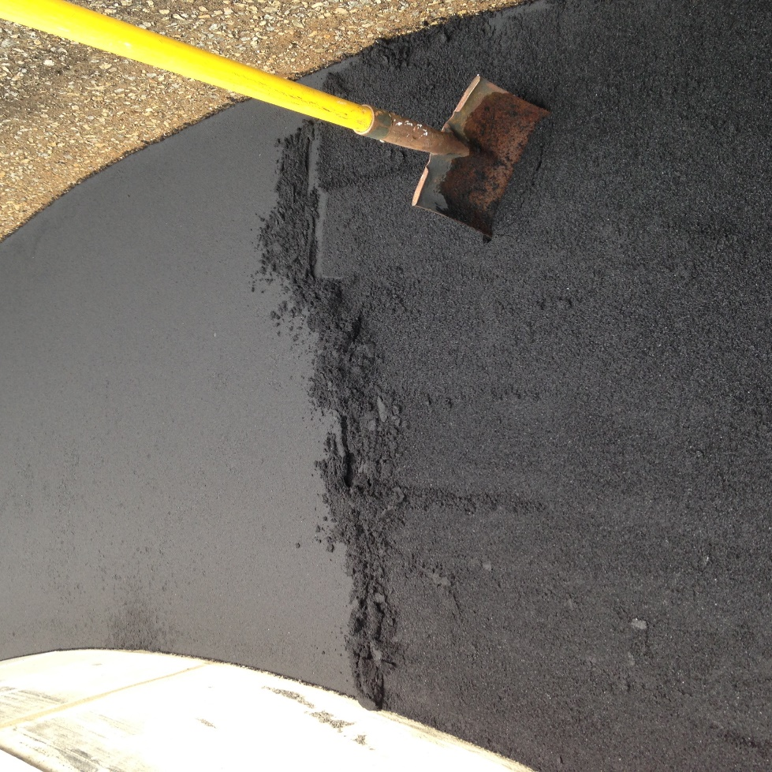
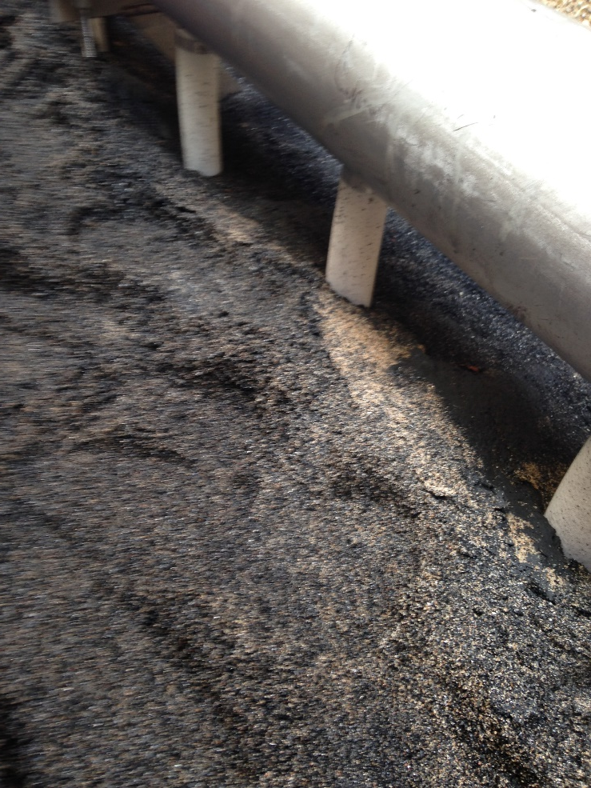
Sand & GAC skimming

Slide 44

“As Built GAC Cap” Filter # 4
Filter Media Depths
Wall Elev. 483.75
AWI Underdrain
Weir Elev. 476.25
50% Expansion
Elev. 474.75
Expansion Elev. 472.91
GAC Elev. 472.33
12 % Expansion at 6800 gpm
48” GAC
Sand Elev. 468.33
AWI Elev. 467.50
10” Sand
AWI Underdrain
Bottom Elev. 464.50
Plenum
Bardstown WTP GAC Project
PWSID # KY0900017
Filters # 4 As Built Drawing
Bob Cashion, CWT 7-16

Slide 45
Unit # 4 TOC Levels
Before & After
Mg/l as Total Organic Carbon- Inline TOC Monitor
Average before Toc Removal Through Dual Media Filtration TOF Verse BOF 17.32%
Average After Gac Installation through Cap Bed Filtration 91.79% Removal
Current Average 95-100 % removal

Slide 46
DPB Data
Lowest 3rd Quarter (Aug-16) numbers in History of the facility
Plant Tap-Haa5- 0.024 ttHM-0.035
N Neson-0.019 0.031
Bloomfield 0.028 0.038
New haven- 0.05 0.058
MCL@ 60ppb MCL @ 80ppb

Slide 47

Summary
  More importance is being place on filtration.
  Media is What Does the Work
  Yearly Inspection & Assessments are necessary.
  Media cleaning is less expensive than complete replacement.
  New technology can put your mind at ease.
  GAC is here to stay
  Improved chlorine demand, more efficient filtration.
  Cleaning is a good thing!

Slide 48

For further information:
Bob Cashion, Business Development Manager
T: 270-790-2726
rkcashion@s4water.net
The information included in this presentation is proprietary and/or confidential, and protected from disclosure. Do not disseminate, distribute or copy this presentation without the express consent of S4 Water Sales & Service, LLC

