Slide 1
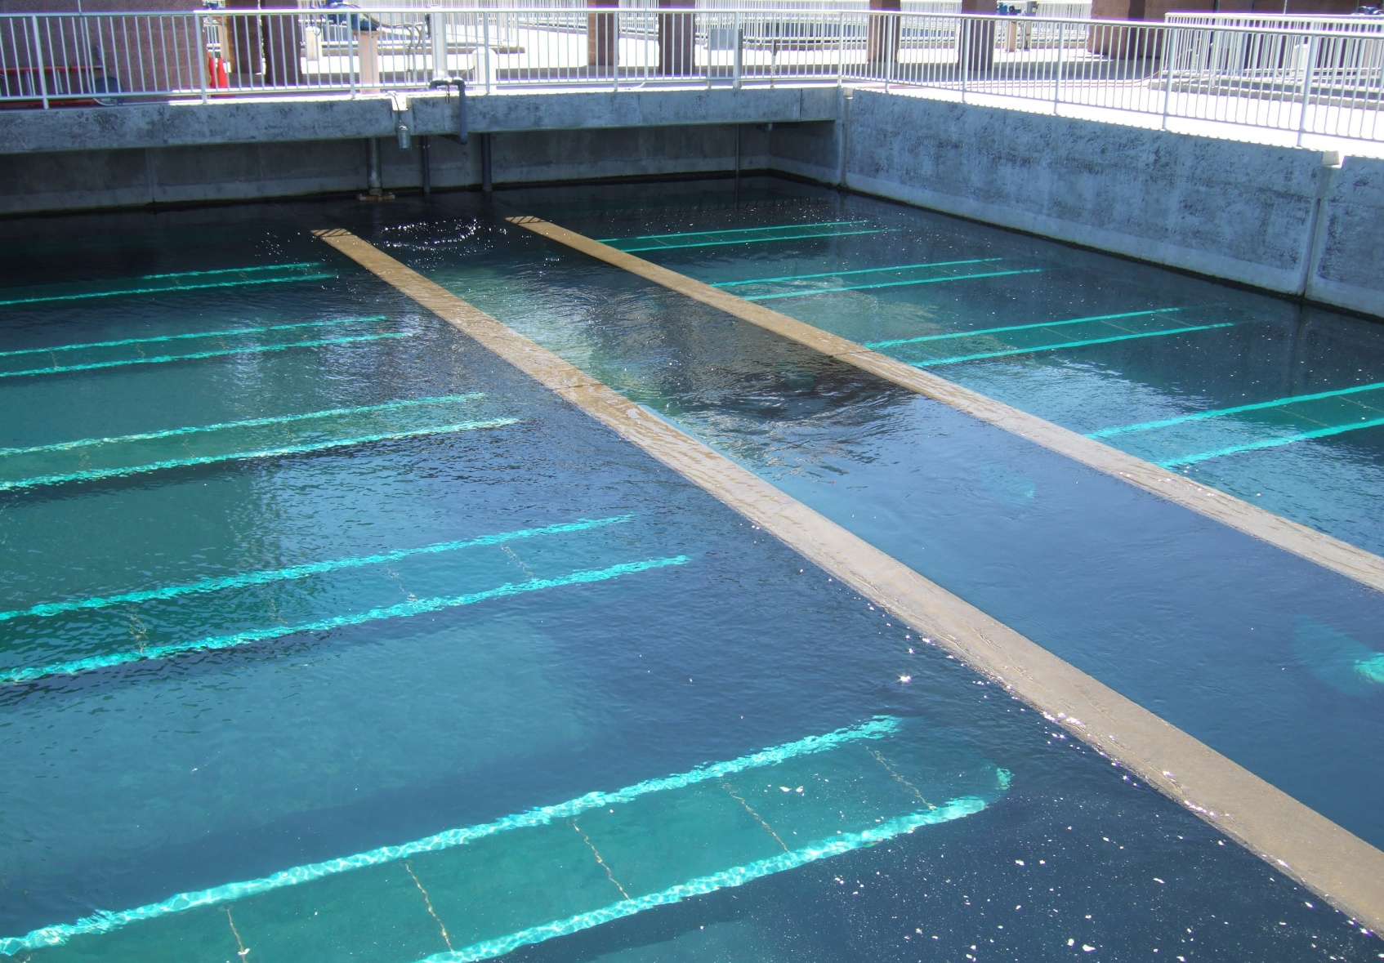
Development of a Filter Surveillance Program Part 1
Brandt Cashion
S4 Water Sales and Service, LLC

Slide 2
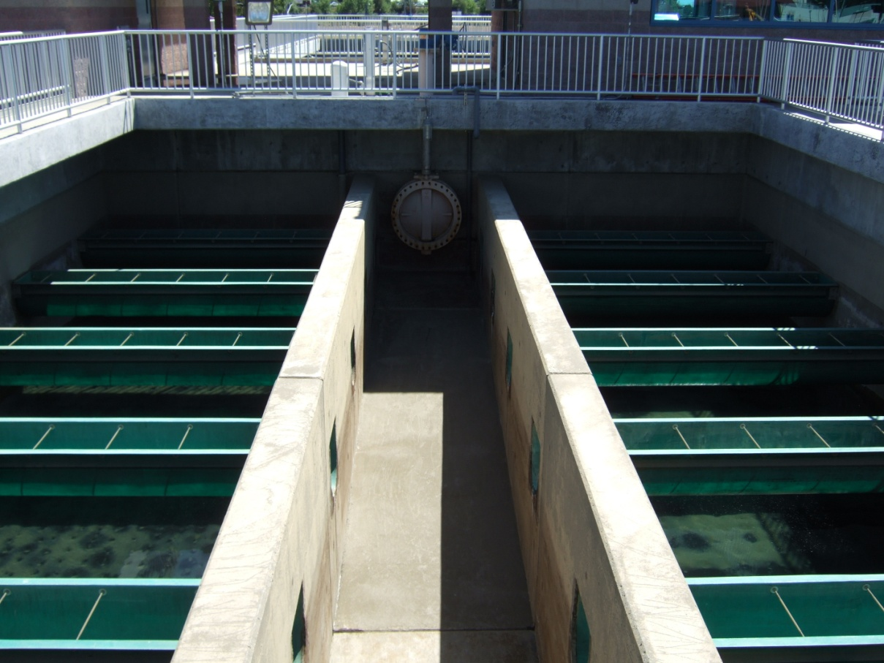
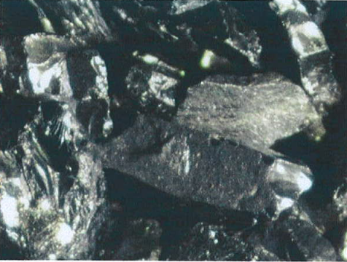
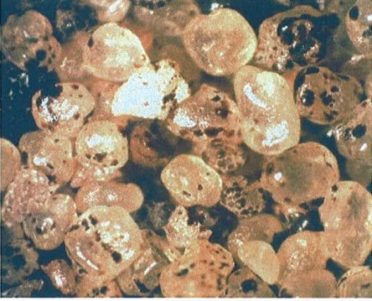
Purpose of the Filter Surveillance Program
Increase Filter efficiency
Improve Filter Performance
Notes:
Fig 10

Slide 3
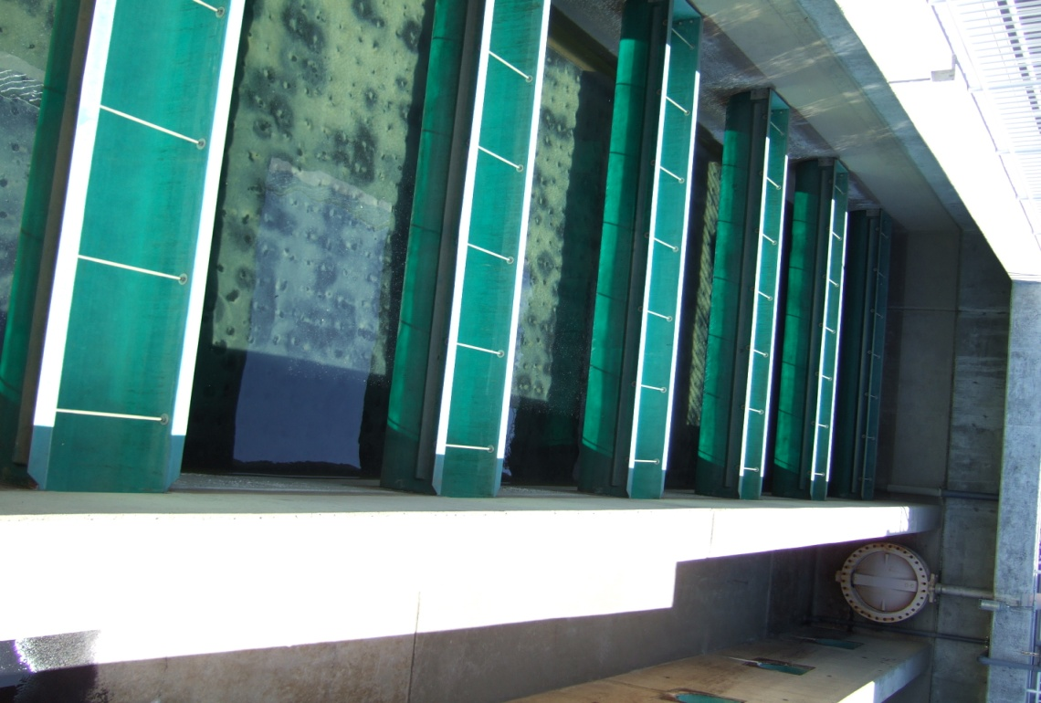
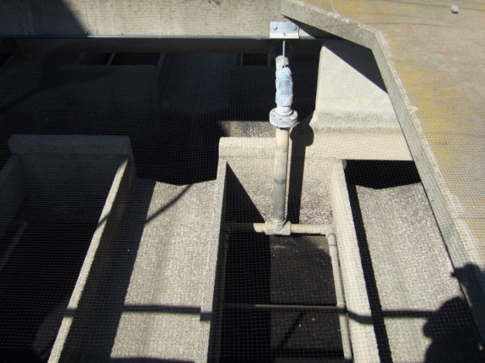
How Do We Increase Filter Efficiency and Improve Filter Performance?
Determine the condition of the filter
Evaluate the need for rehabilitation or change in operations
Notes:
Fig 10

Slide 4
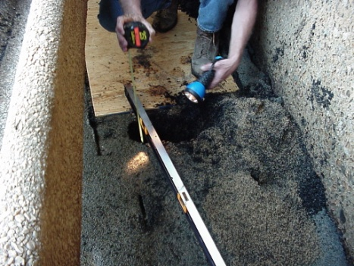
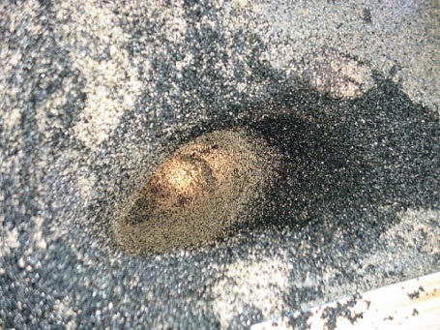
Starting a Filter Surveillance Program
Identify filter surveillance teams
Minimum of two people
Review historical records
Design drawings, operating reports, SOPs, filter media specifications
Inspections will require
between 8-16 man-hours
and 1.5-2 times the normal amount of backwash water
Notes:
Fig 10

Slide 5
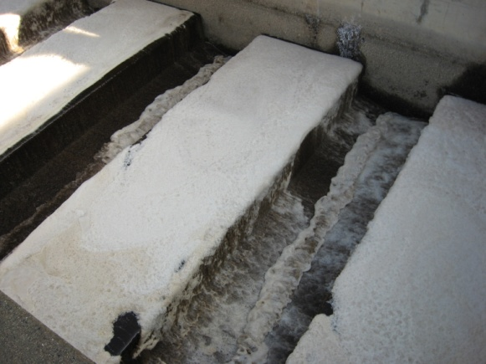
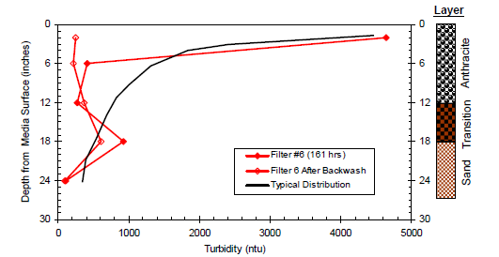
Filter Surveillance Program Components
Backwash Evaluation Tests
Filter Bed/Media Tests
Filter Performance Tests
Notes:
Fig 10

Slide 6
Backwash Evaluation Tests
Backwash Rise Rate
Filter Media Bed Expansion Test
Filter Backwash Turbidity Profile
Observation of the Surface Wash
Filter Boil Check
Notes:
Fig 10

Slide 7
Backwash Rise Rate Test Example
Purpose: To confirm the accuracy of backwash flow meters
Measurable
Zone
Media
Media
Filter area
18 x 14 = 252 ft²
Notes:
Fig 10

Slide 8
Backwash Rise Rate Test Example
Measure the time it takes for the water level to reach the following levels
t₀
t₆
t₁₂
t₁₈
t₂₄
12 in
18 in
24 in
6 in
Media
Media
Media
Media
Media
Also measure the metered backwash flow = 3,630 gpm
Notes:
Fig 10

Slide 9
Backwash Rise Calculation
Distance | Time, Seconds | Velocity, ft/min | Average Velocity, ft/min | Backwash rate, gpm/ft²
0-6 in. | 15 | 2.00 | 1.94 | 14.51
6-12 in. | 16 | 1.88
12- 18 in. | 15 | 2.00
18-24 in. | 16 | 1.88
Velocity = 0.5 ft / 0.25 min = 2.00 ft/min
Backwash rate = 1.94 ft/min x 7.48 gal/ft³ = 14.51 gpm/ft²
Backwash Flow = Backwash rate X Filter Area
Backwash Flow = 14.51 gpm/ft² x 252 ft² = 3656 gpm
metered backwash flow = 3,630 gpm
Notes:
Fig 10

Slide 10
Filter Media Expansion Test
Purpose: To check how much the filter bed is expanding during a backwash
Importance: The bed expansion is a direct indication of backwash efficiency
Expanded Media
Notes:
Fig 10

Slide 11
Measure Media Depth Before Backwash
Rope/pole
Length =
68 inches
Secchi disk
Media
Depth = 30 inches
Media
Notes:
Fig 10

Slide 12
Measure Media Depth During the Backwash
Rope/pole
Length = 60 inches
Backwash water
Expanded Media
Notes:
Fig 10

Slide 13
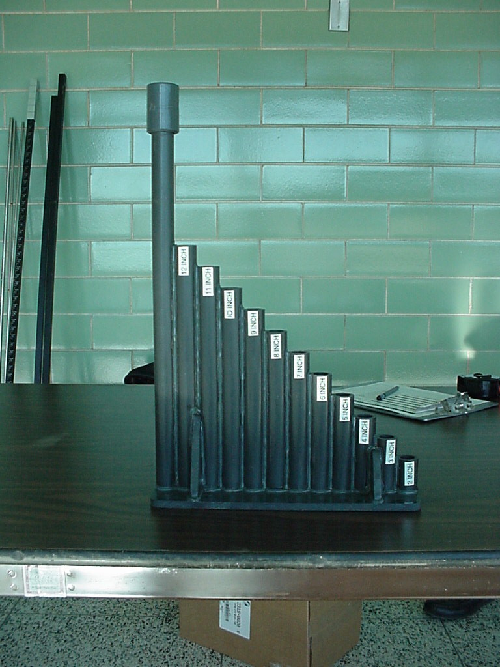
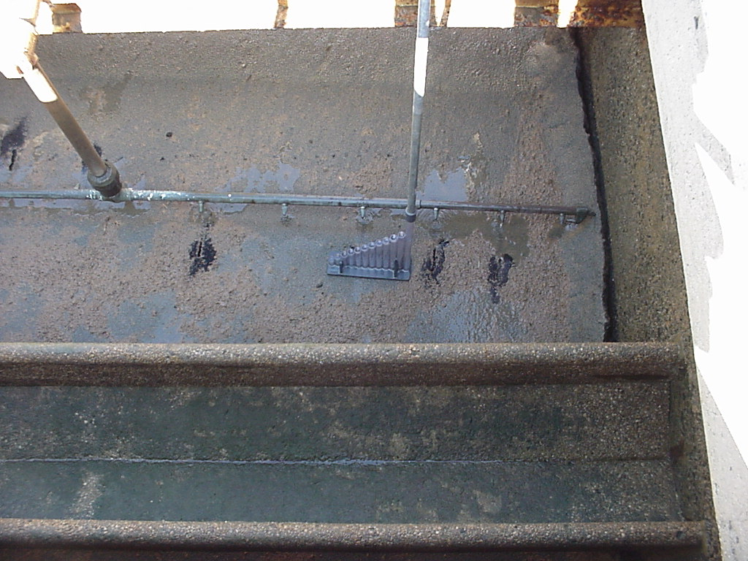
Alternative Method of Measuring Media Expansion
Notes:
Fig 10

Slide 14
Alternative Method of Measuring Media Expansion
Backwash water
Expanded Media
Notes:
Fig 10

Slide 15
Calculate Media Expansion
Initial Depth = 68 inches
Expanded Depth = 60 inches
Bed Expansion = 8 inches
Bed Expansion Percent = 8 in./30 in. =27%
Typical Bed Expansion is 20-30%
Therefore o.k.

Slide 16
Filter Backwash Turbidity Profile
Purpose: To determine optimal backwashing duration
Importance: Over backwashing can
cause all of the solids to be washed out of the filter.
result in effluent turbidity spikes during the filter ripening process
cause the wasting of water
Notes:
Fig 10

Slide 17
Filter Backwash Turbidity Profile
A minimum of two plant employees
Stopwatch
Sampling device
Bench-top turbidimeter
30-100 mL sample bottles marked in 1 min intervals

Slide 18
Collect Backwash Samples Every minute

Slide 19
Transfer Samples into Sample Containers

Slide 20
Measure Backwash Water Turbidity

Slide 21
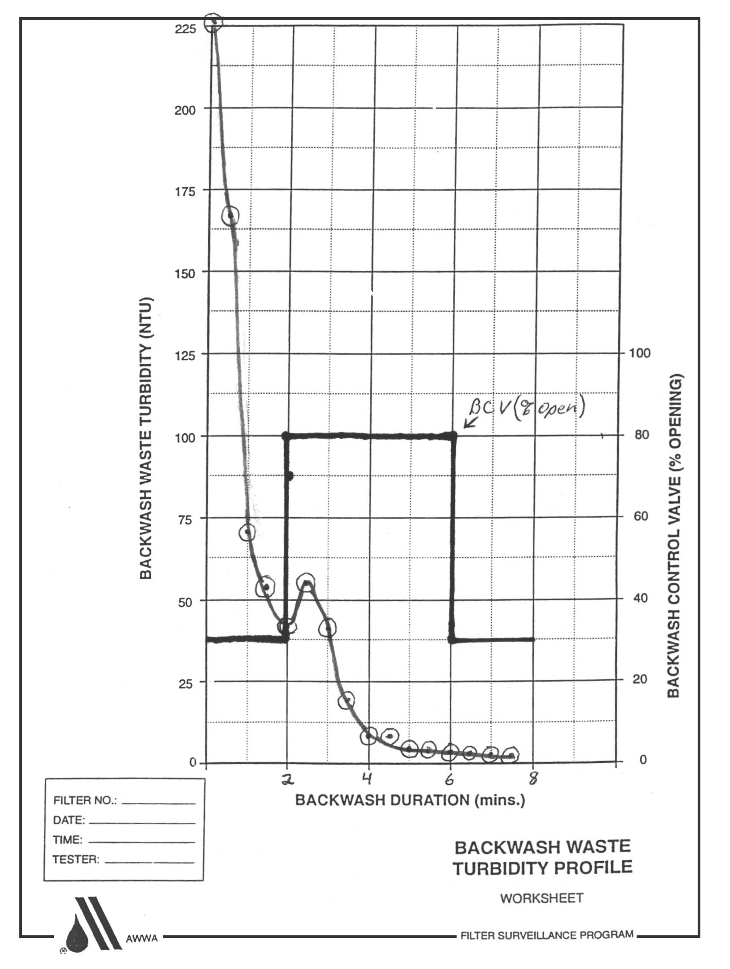
Prepare A Backwash Turbidity Graph
It is recommended that a backwash be ended
when the turbidity reaches the range of 10-15 NTU

Slide 22
Surface Wash Observation
Purpose: To determine the effectiveness of the surface wash
Importance: The surface wash improves backwashing effectiveness by adding energy and abrasion during the backwash and higher hydraulic shear forces in the bed

Slide 23
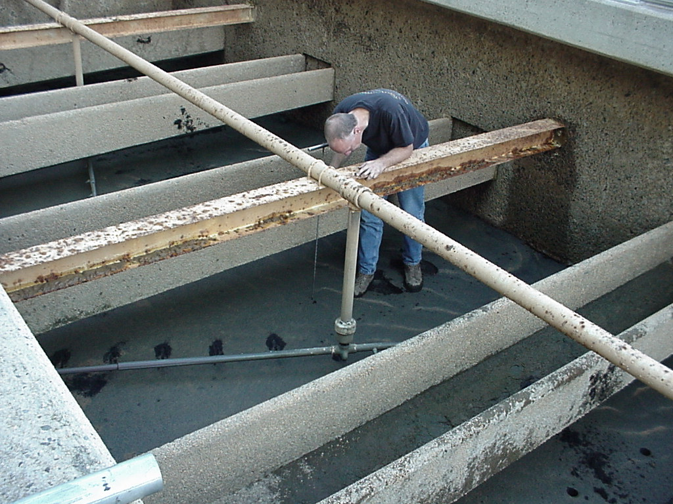
Types of Surface Wash Systems
Notes:
Fig 10

Slide 24
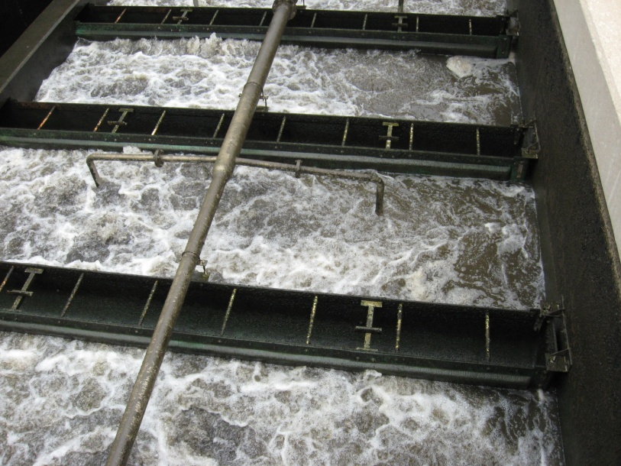
Air Scour Surface Wash

Slide 25
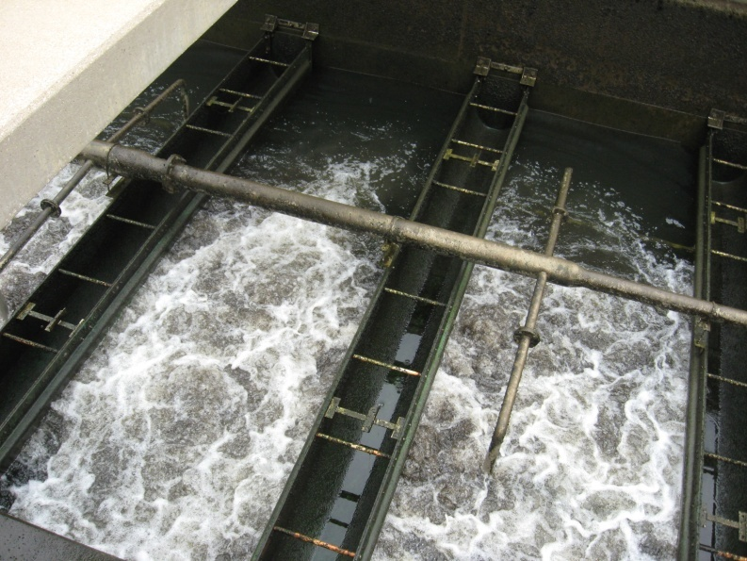
Surface Wash Or Air Scour System Check
Operate the arms without backwash water
Do the arms rotate?
Are all the nozzles spraying water
During the Surface wash any surface wash deficiencies should be noted.
Notes:
Fig 10

Slide 26
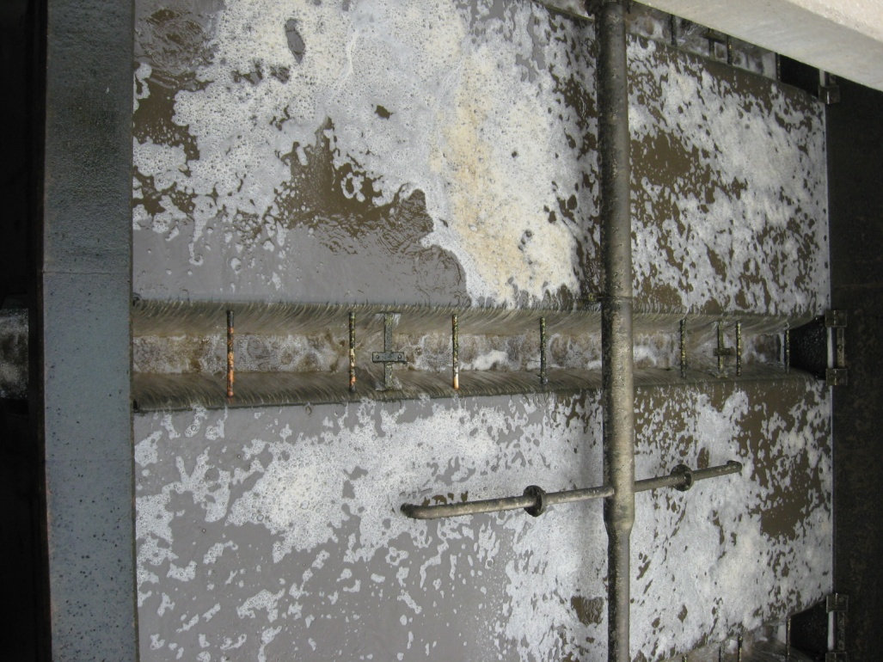
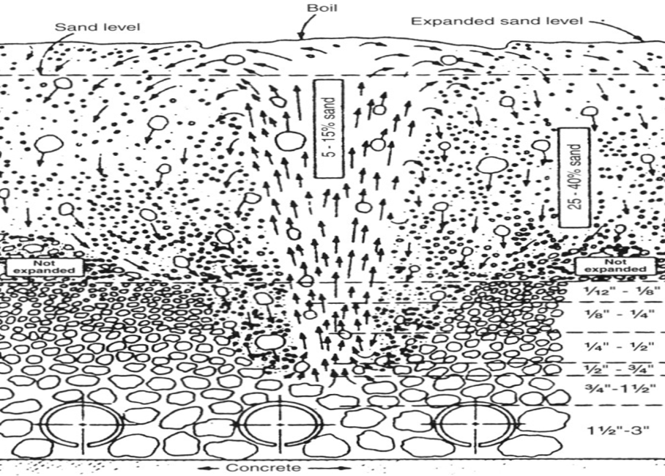
Other Issues To Check for During The Backwash
Media boiling
Uneven distribution of backwash water
Media Carryover
Notes:
Fig 10

Slide 27
Questions?

