Slide 1
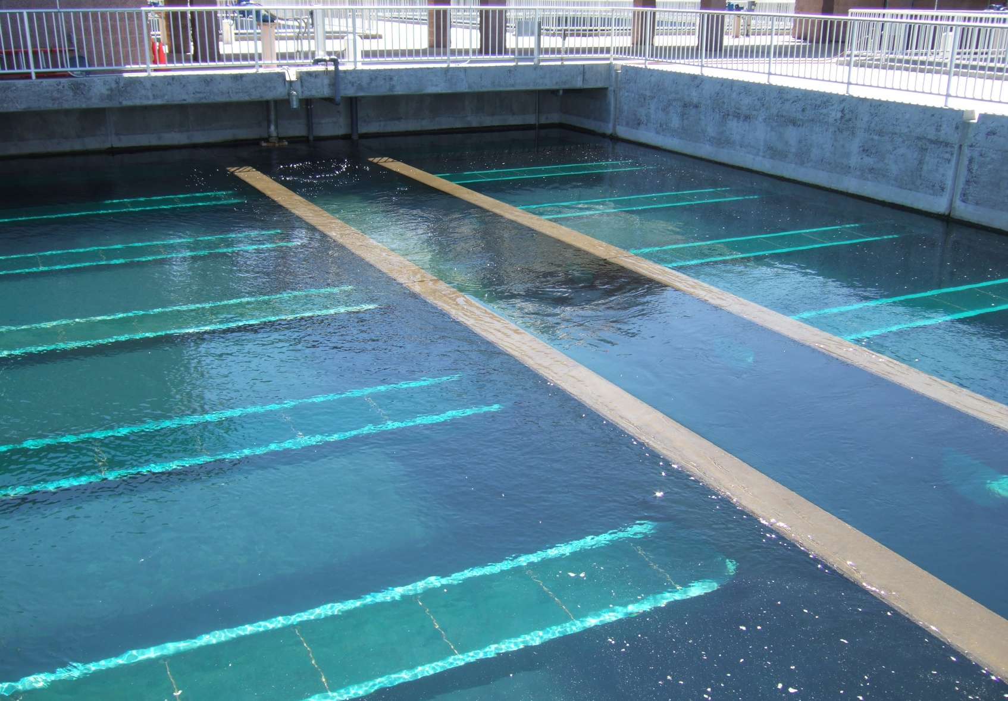
Development of a Filter Surveillance Program Part 3
Brandt Cashion
S4 Water Sales and Service, LLC

Slide 2
Filter Excavations
Purpose: To investigate trouble spots and to inspect the filter underdrain
Importance: Allows you to inspect a portion of the underdrain without removing all of the media
Notes:
Fig 10

Slide 3
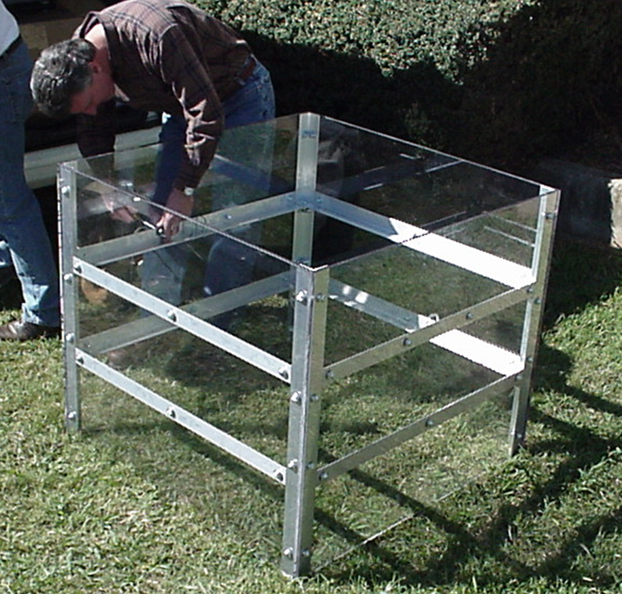
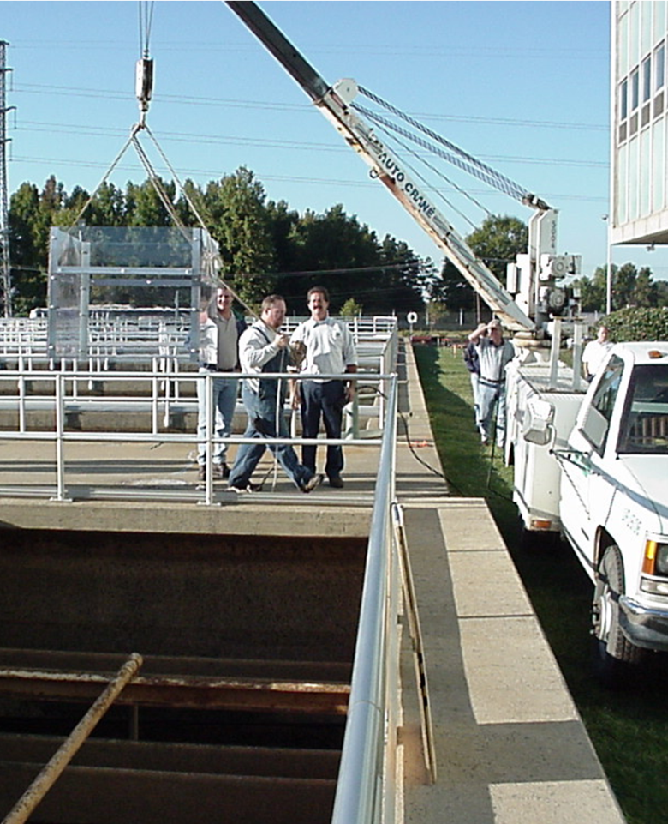
Filter Excavations
Get an excavation box
Place it in the filter

Slide 4
Filter Excavations
Place it on the media
surface
Fluidize the bed &
gently press down
Excavation box
Excavation box

Slide 5
Filter Excavations
Allow the box to
rest on the underdrain
Begin removing the
media
Excavation box
Excavation box

Slide 6
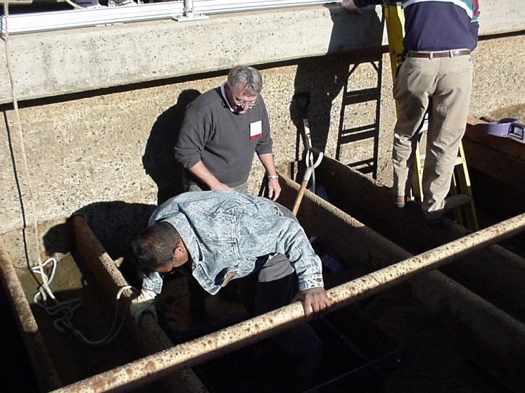
Filter Excavations
Remove the
bottom layer of media
Excavation box

Slide 7
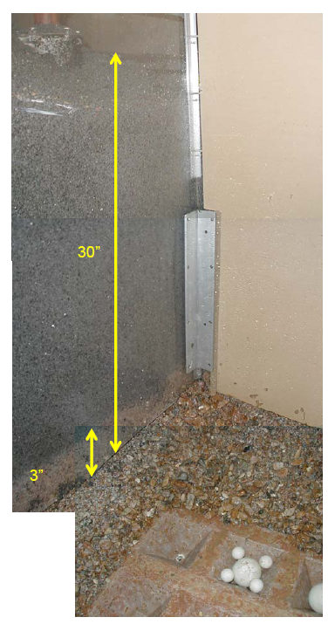
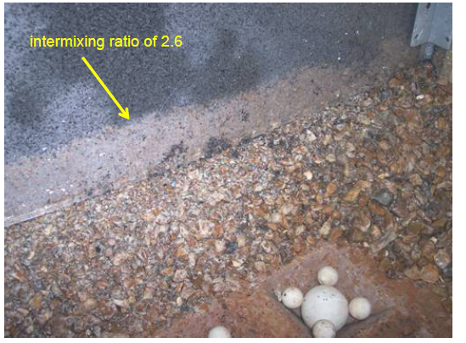
Filter Excavations
Begin the inspection

Slide 8
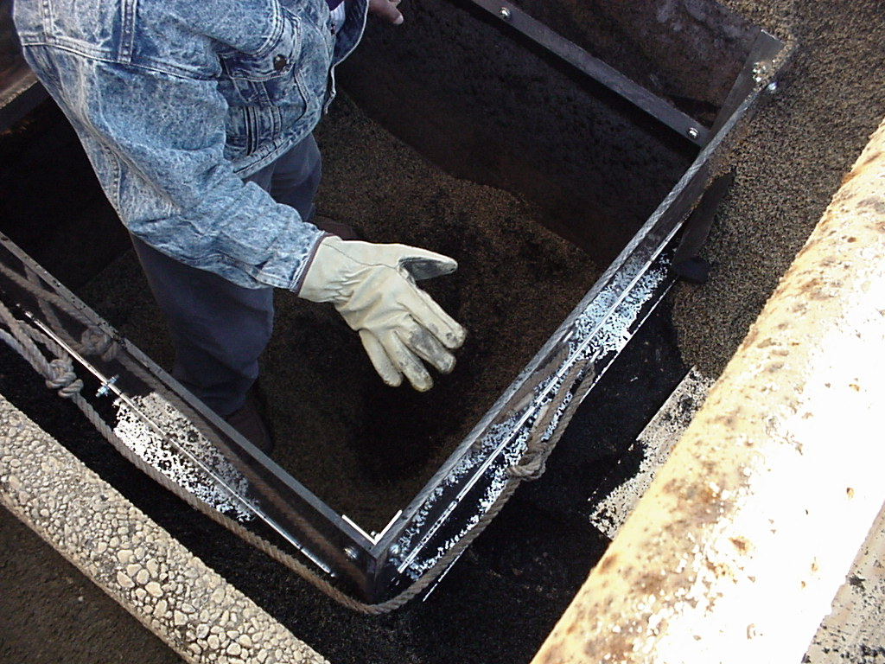
Filter Excavations
Replace the media in the correct order
Excavation box
Excavation box

Slide 9
Filter Excavations
Refluidize the bed and remove the excavation box
Excavation box
Excavation box

Slide 10
Questions?

