Slide 1



“Survival Skills for Communications from the Trench to the Board Room”
Bob Cashion, CWT
Daren Thompson, MBA, MPM

Slide 2
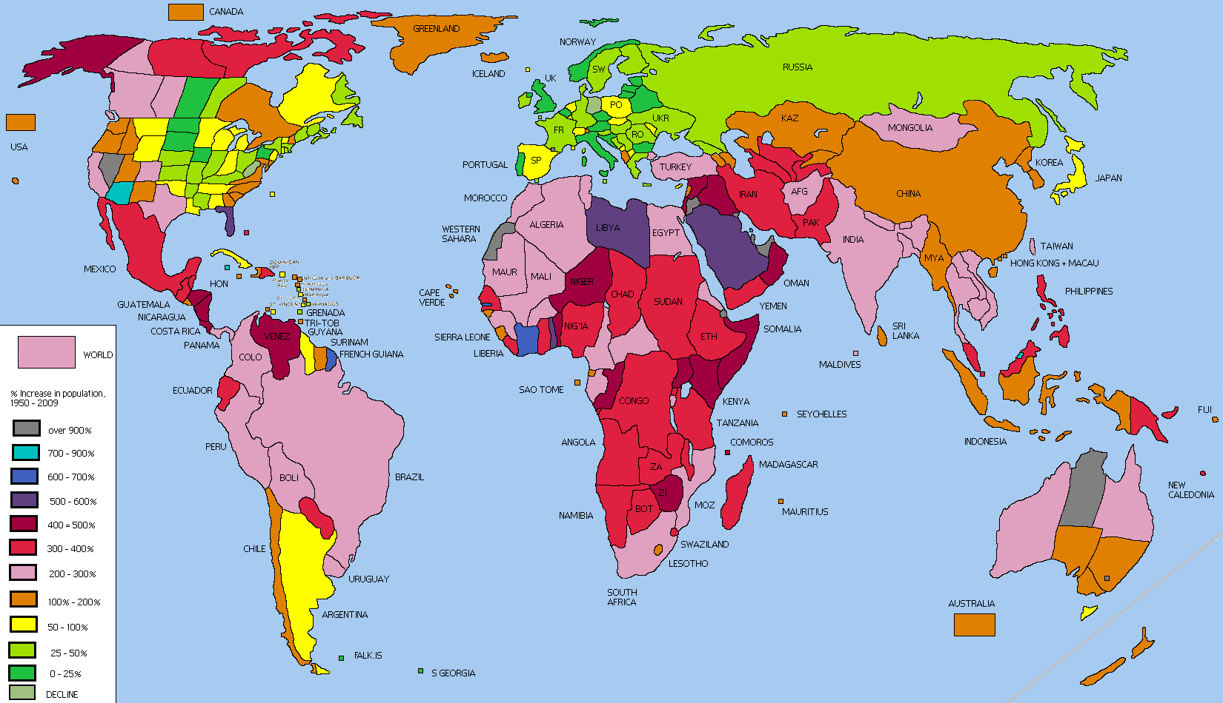
Matter a Fact
Did You Know That There are More People Alive in the World at the Present Time Than Have Ever Died………???

Slide 3
FACTS

Slide 4
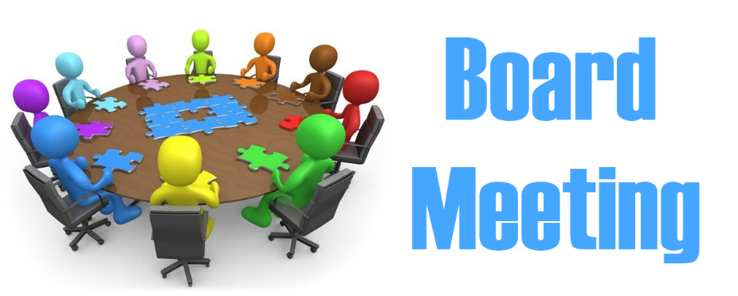
Take Home Message
Survival Skills for Communications
Effective Communications Factors
Responsibility of Sender & Receiver
Getting Receivers to Buy In and Become Senders
Using Data to Prove Your Point
Tell Them What Your Going to Tell Them, Tell Them & Tell Them What You Told Them
What are the consequences if you don’t listen, react or comply?
Do You Have Sufficient Data or Verification to make an intelligent Decision?
Using Various forms of mediums to get your attention.

Slide 5
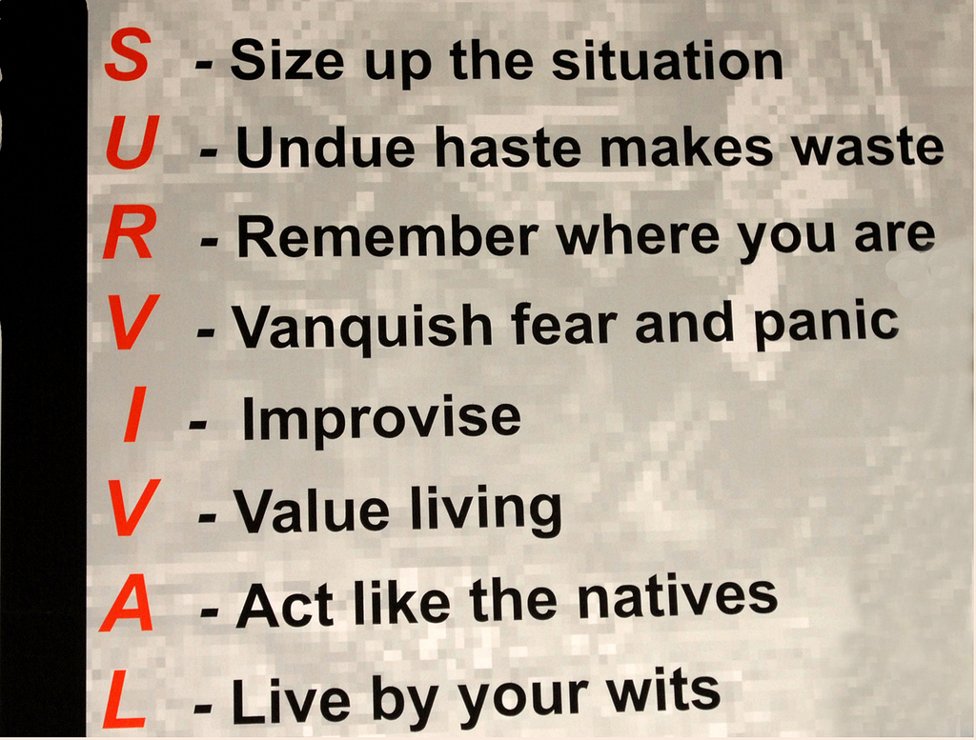
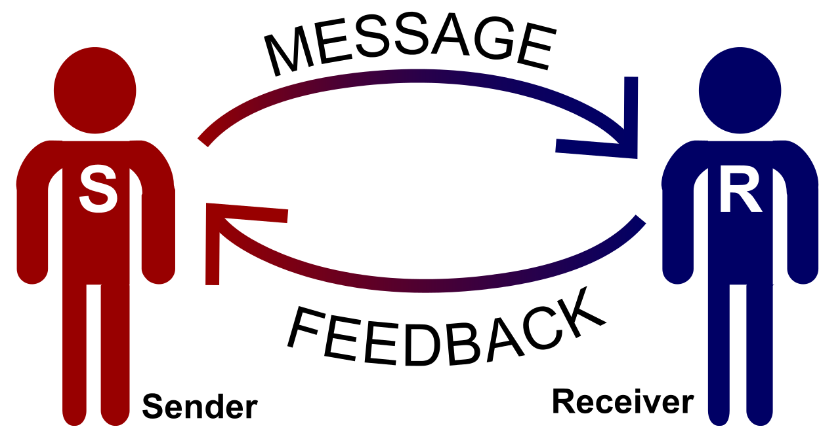

Survival Skills

Slide 6
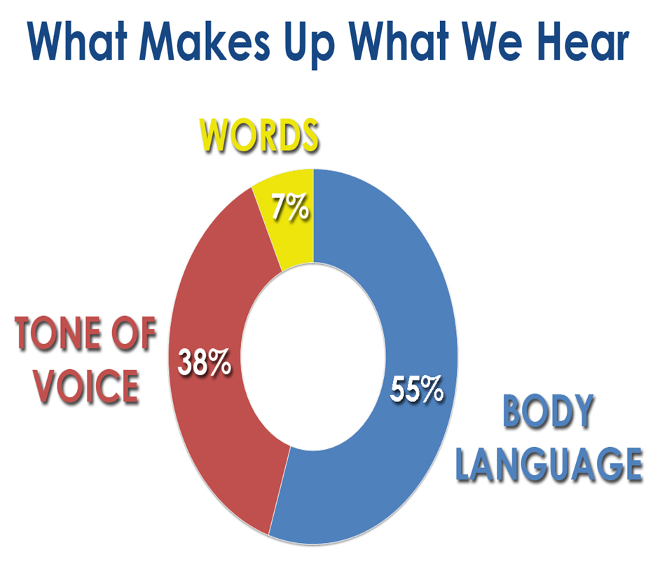
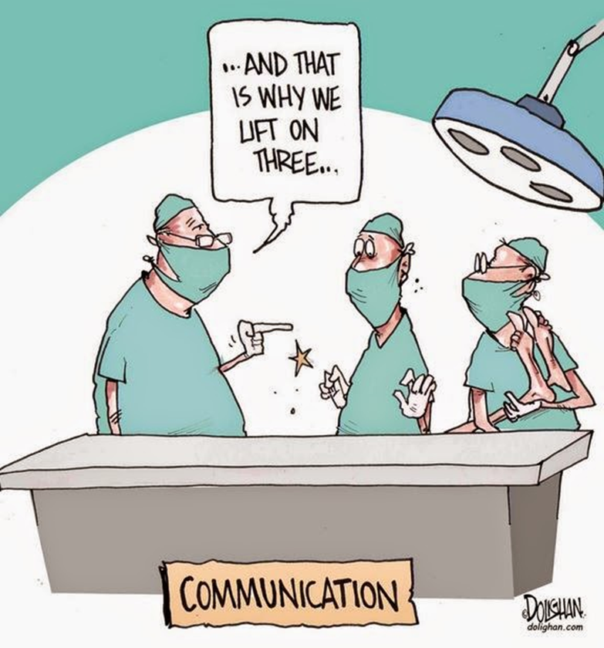
“ Effective Communications ”

Slide 7

Being A Sender
Transmit-Getting the Point Across
Encode Information-Make it “Crystal Clear”
Reliability- Viable Information

Slide 8
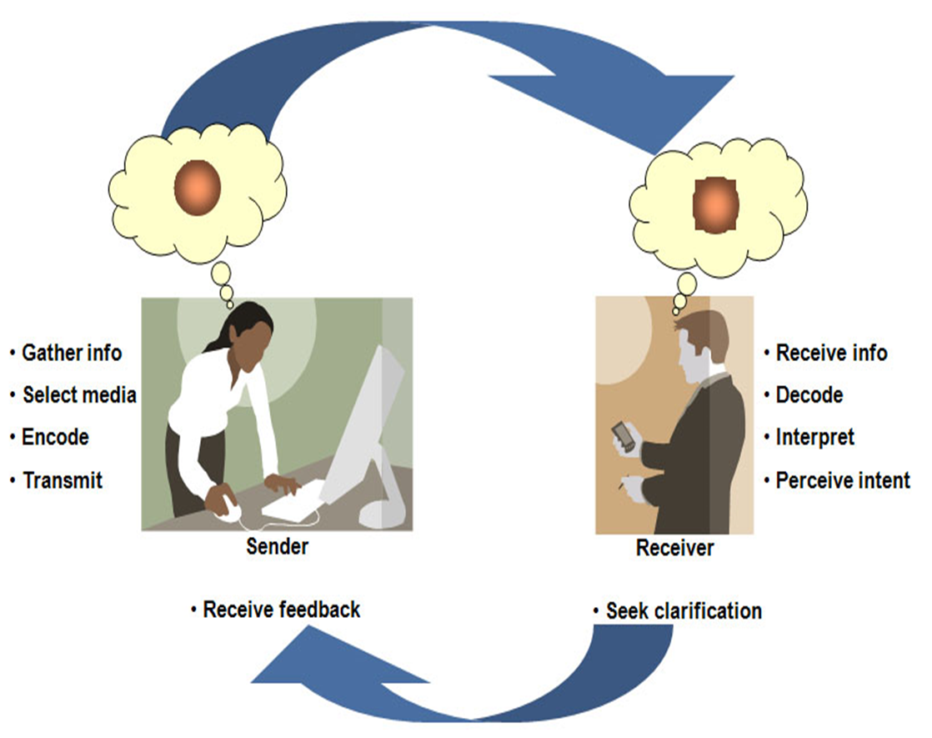
Being A Sender
Receive Info-Listening with Intent
Interpret - Is it “Crystal Clear”
Perceive Intent
Seek Clarification
Give Feedback

Slide 9
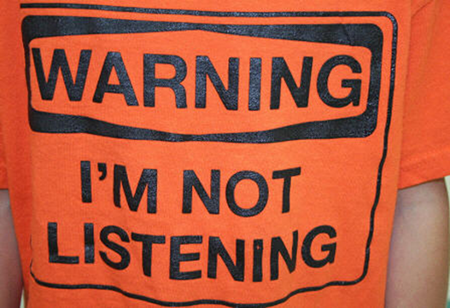
Three Rules of Communications
Tell Them What Your Going to Tell Them
Tell Them What You Are Telling Them
Tell Them What You Told Them
They are Most Likely to Remember What You Tell Them Last

Slide 10

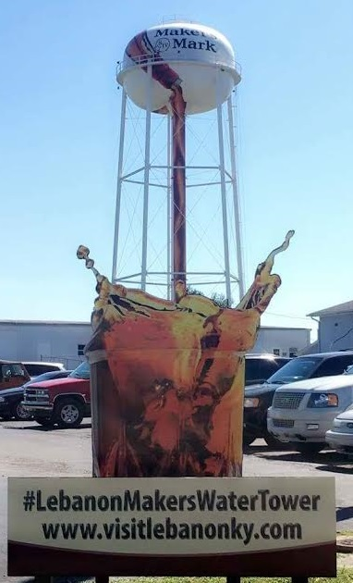
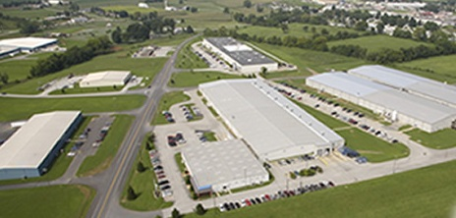

Lebanon & Marion County

Slide 11
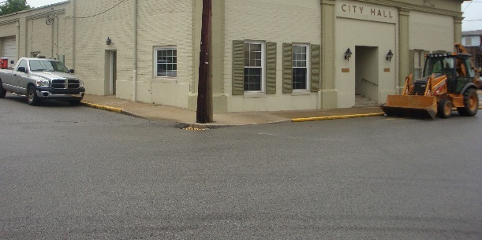
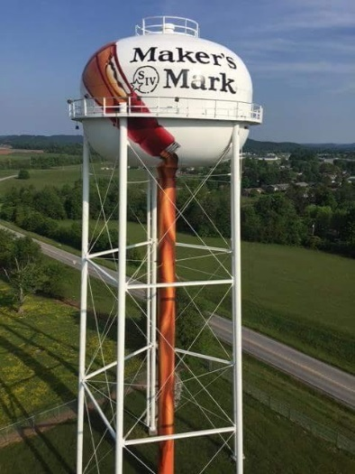
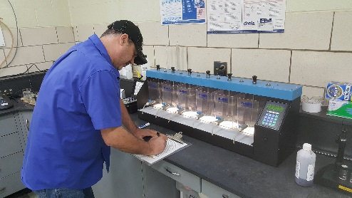
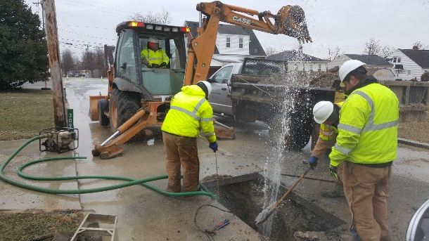

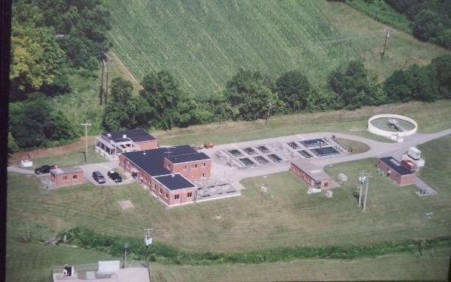
Overview of Lebanon Water Works System
1 Surface Water Plant (5.2 MGD)
Average Daily Flow 2.5 MGD
3 Storage Tanks ( 1 elevated 250,000 Gallon Tank and 2 ground storage tanks (940,000 gallons each)
Over 500,000 lf of Distribution Pipeline & over 300,000 lf is old cast iron
Serves Approx. 2,600 Customers including the Marion County Water District
Notes:
Constructor and Regulator
US Army Corps of Engineers
Completed in two sections: City Levee
1957 & Southwest Extension 1988
Owner
Louisville Metro Government
Local Sponsor and Maintainer
Louisville MSD since 1987

Slide 12
Managing Challenges – Build a strong team
6 Board
Members
11 Operations
Staff - Treatment & Distribution
14 Employee Total Staff

Slide 13
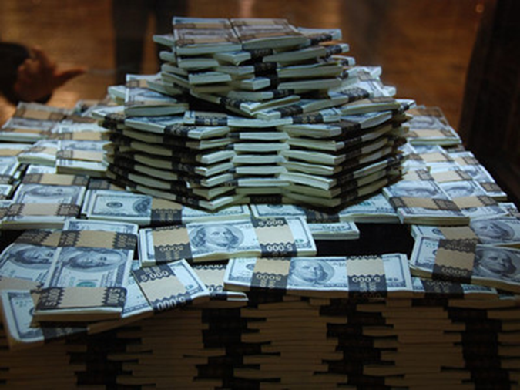
Value of Communication
Price is what you pay. Value is what you get.
-Warren Buffett

Slide 14

Board Communication - Identify the Key Ingredients
Integrity
Transparency
Training
Open Mind & Continuous Evaluation

Slide 15
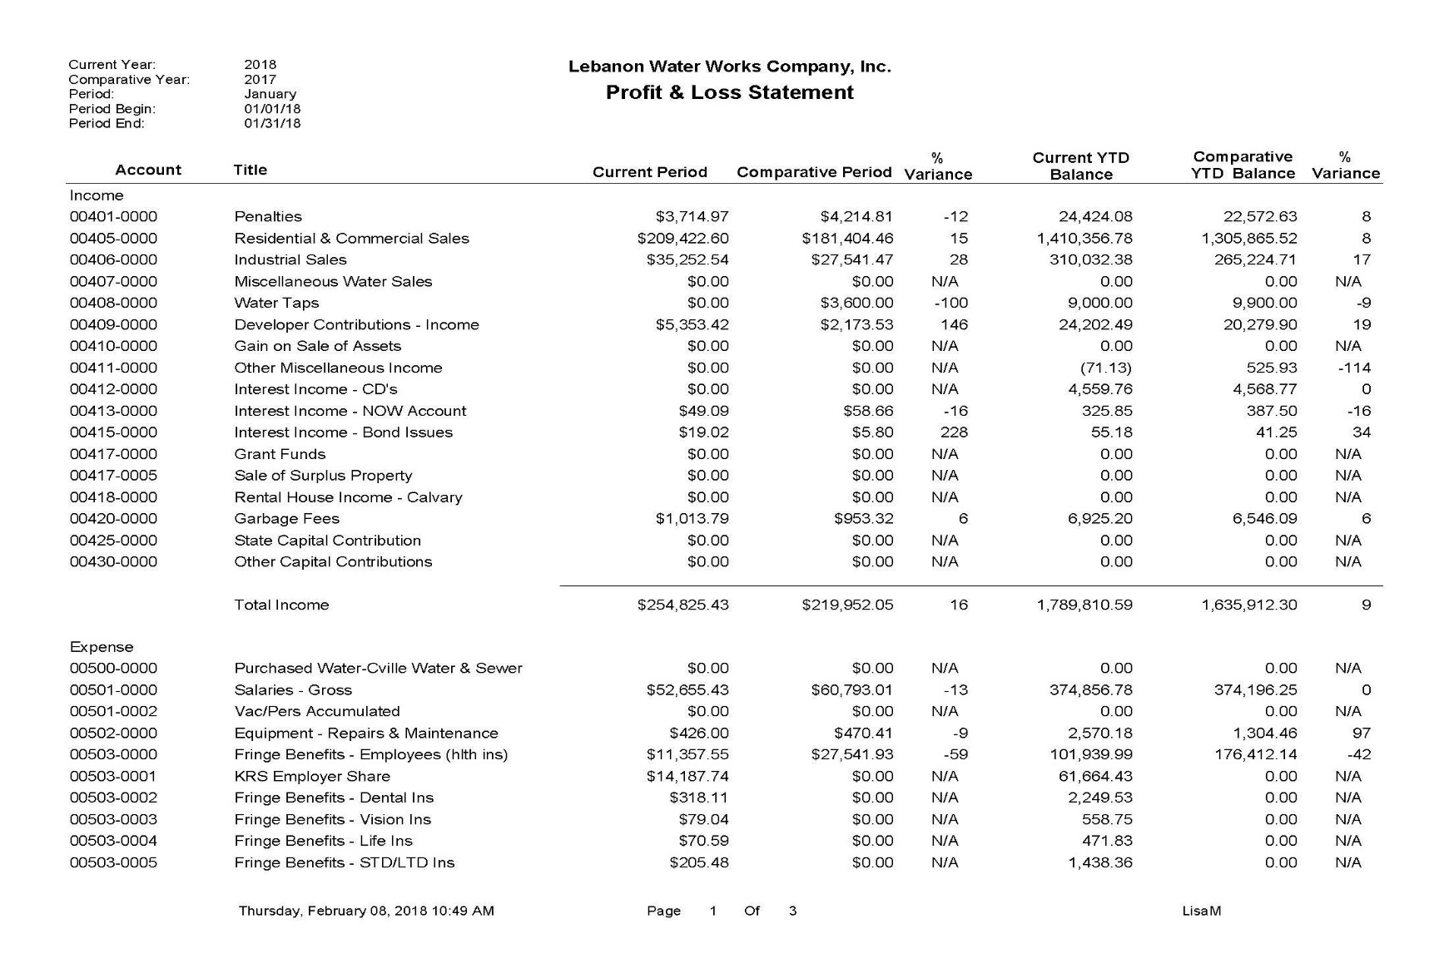
What are we discussing in board meetings

Slide 16

Weighing the Options
Needs
Cost
Budget/Rate increase
Regulatory Compliance/Water Quality
Certified Operators
Capital Improvement Plan

Slide 17


Strategic Plan with SMART Goals

Slide 18
Corporate Goals
Safety
# of OSHA Recordable Injuries
# of Lost Days Due to Injury
Regulatory
# of Non Reporting related NOV’s
# of Reporting Related NOV’s
Financial
% of FY 18 Cumulative Expenses to Cumulative Revenue
% of Backwash Water Savings at the Plant Compared to FY17
# of Preventable Vehicular Accidents
# of Samples out of Compliance
# of Free Chlorine Reading below 0.20
# of DBP Samples out of Compliance for the Marion County Water District
% of Chemical Savings at the Plant Compared to FY17

Slide 19

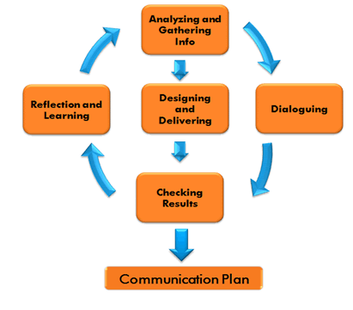
Communicating the Plan
What is the message- Plan for Success!!!

Slide 20
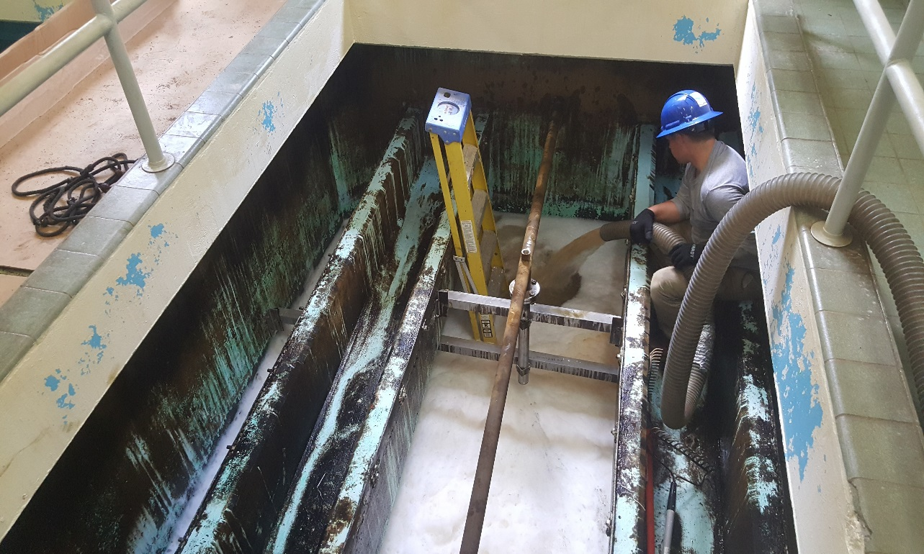
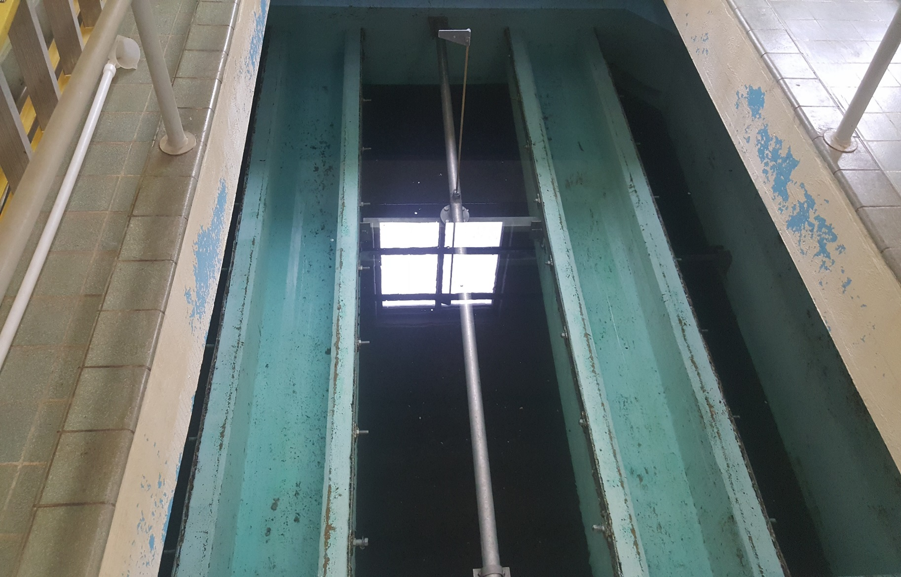
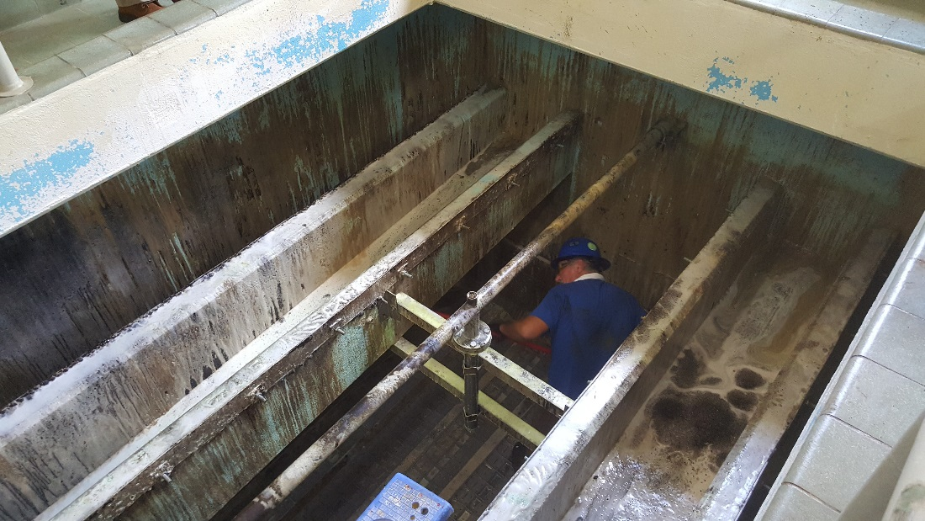
Filter Media

Slide 21
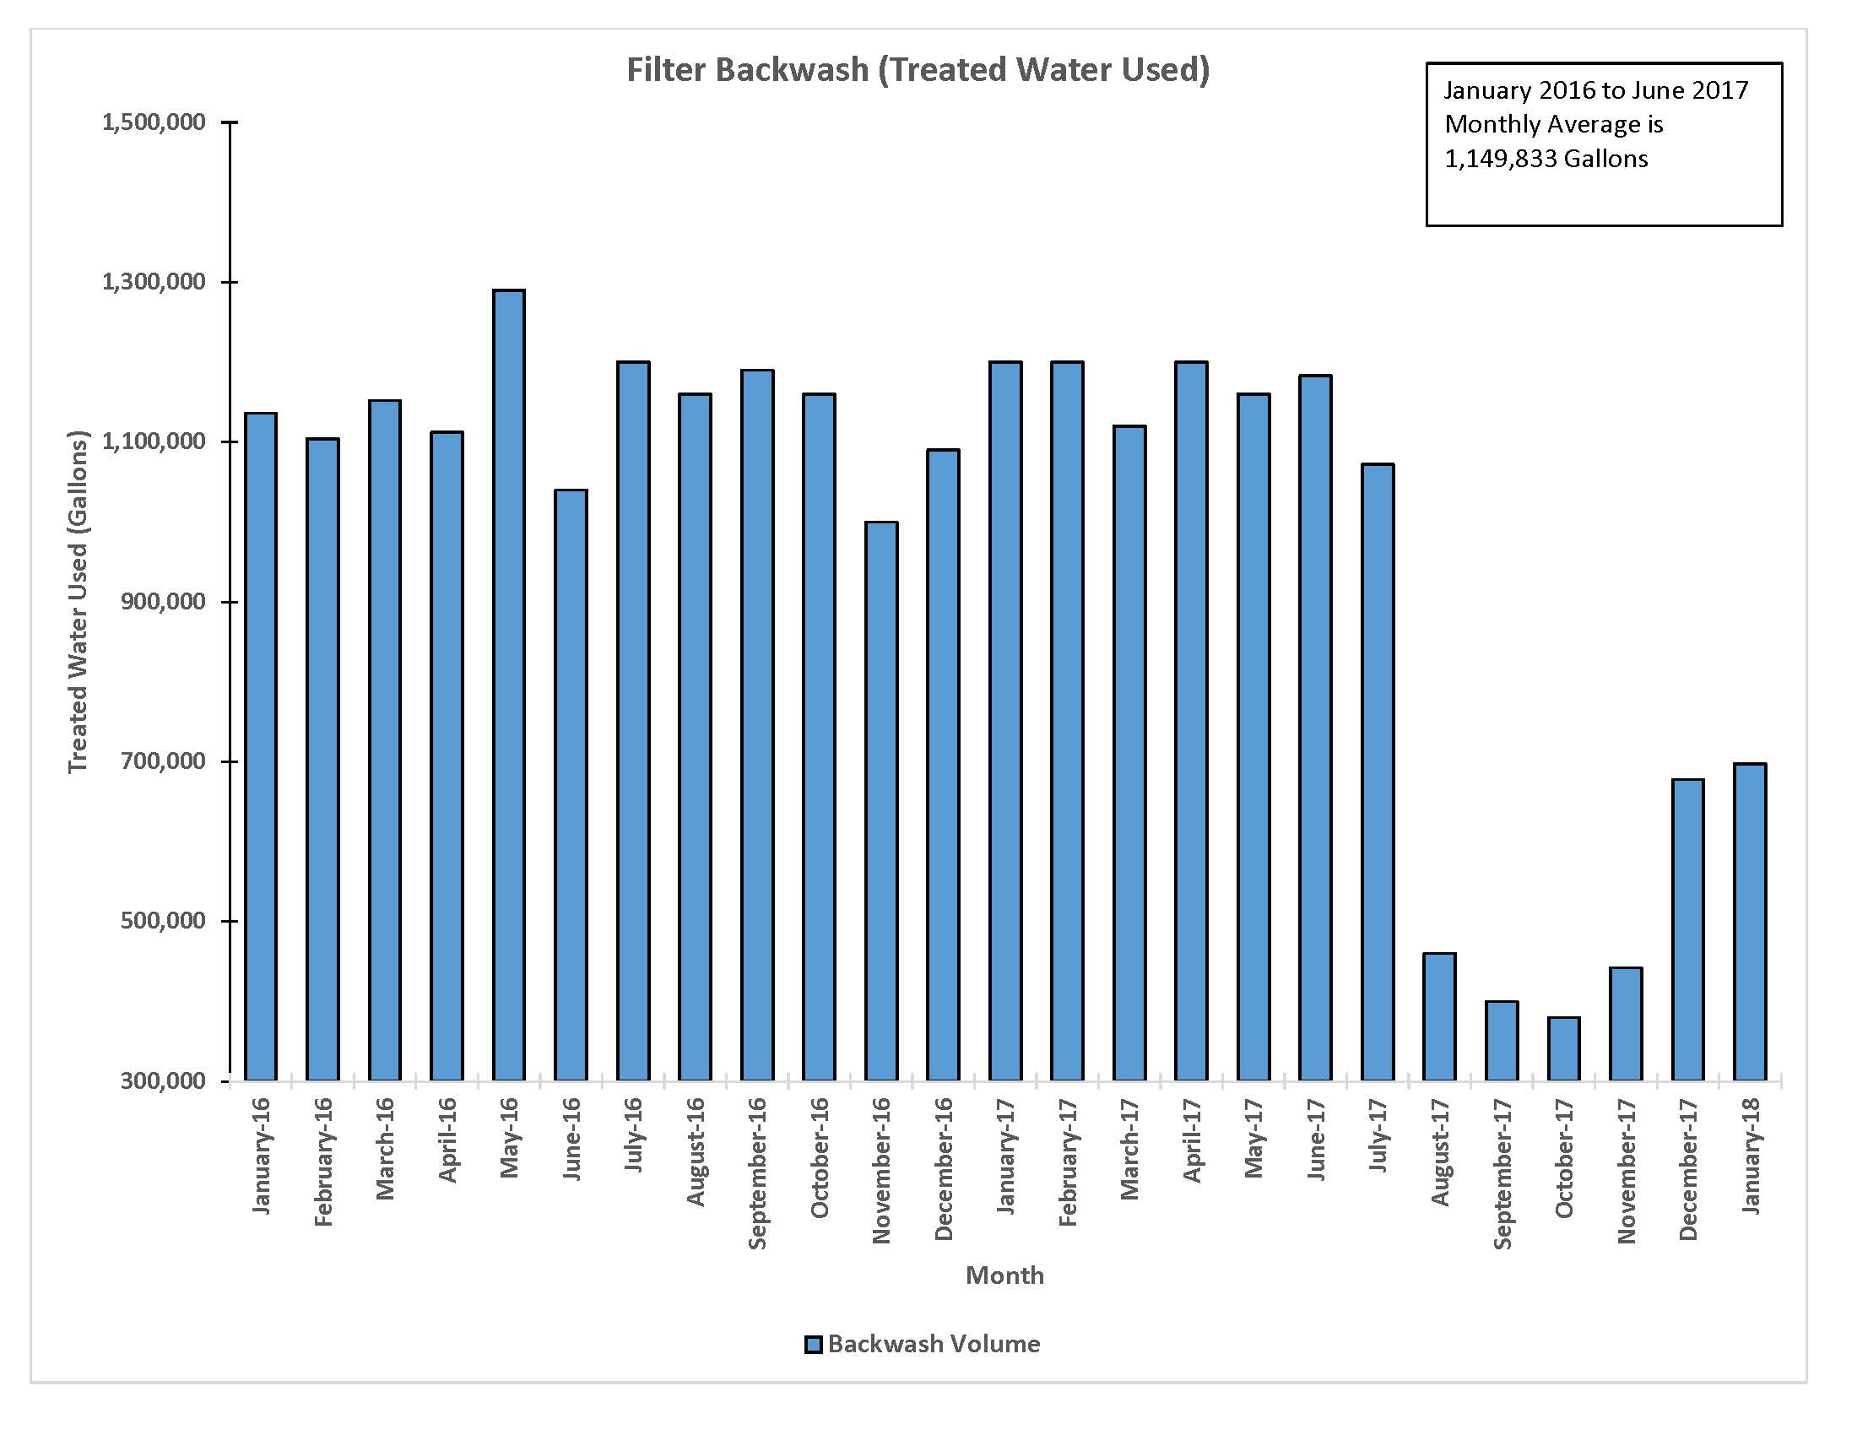
Filter Backwash Initiative- Financial Goal

Slide 22
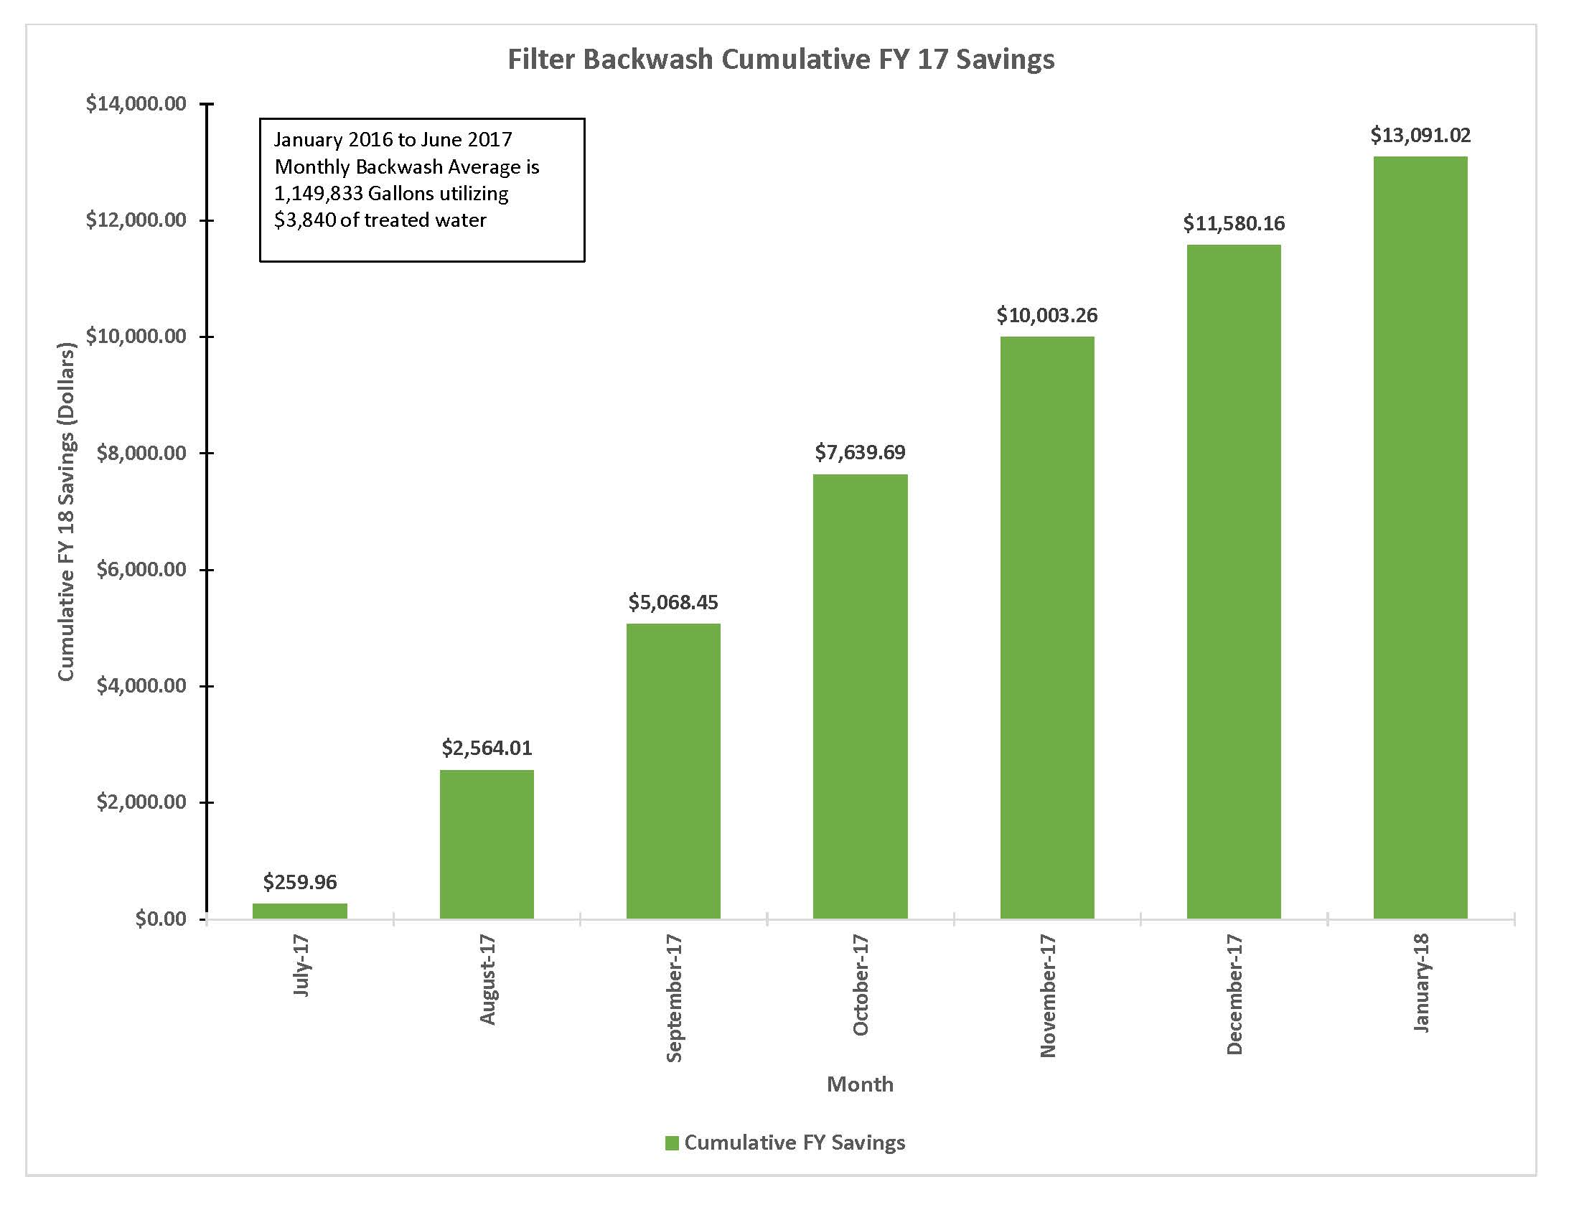
Filter Backwash Initiative- Financial Goal

Slide 23
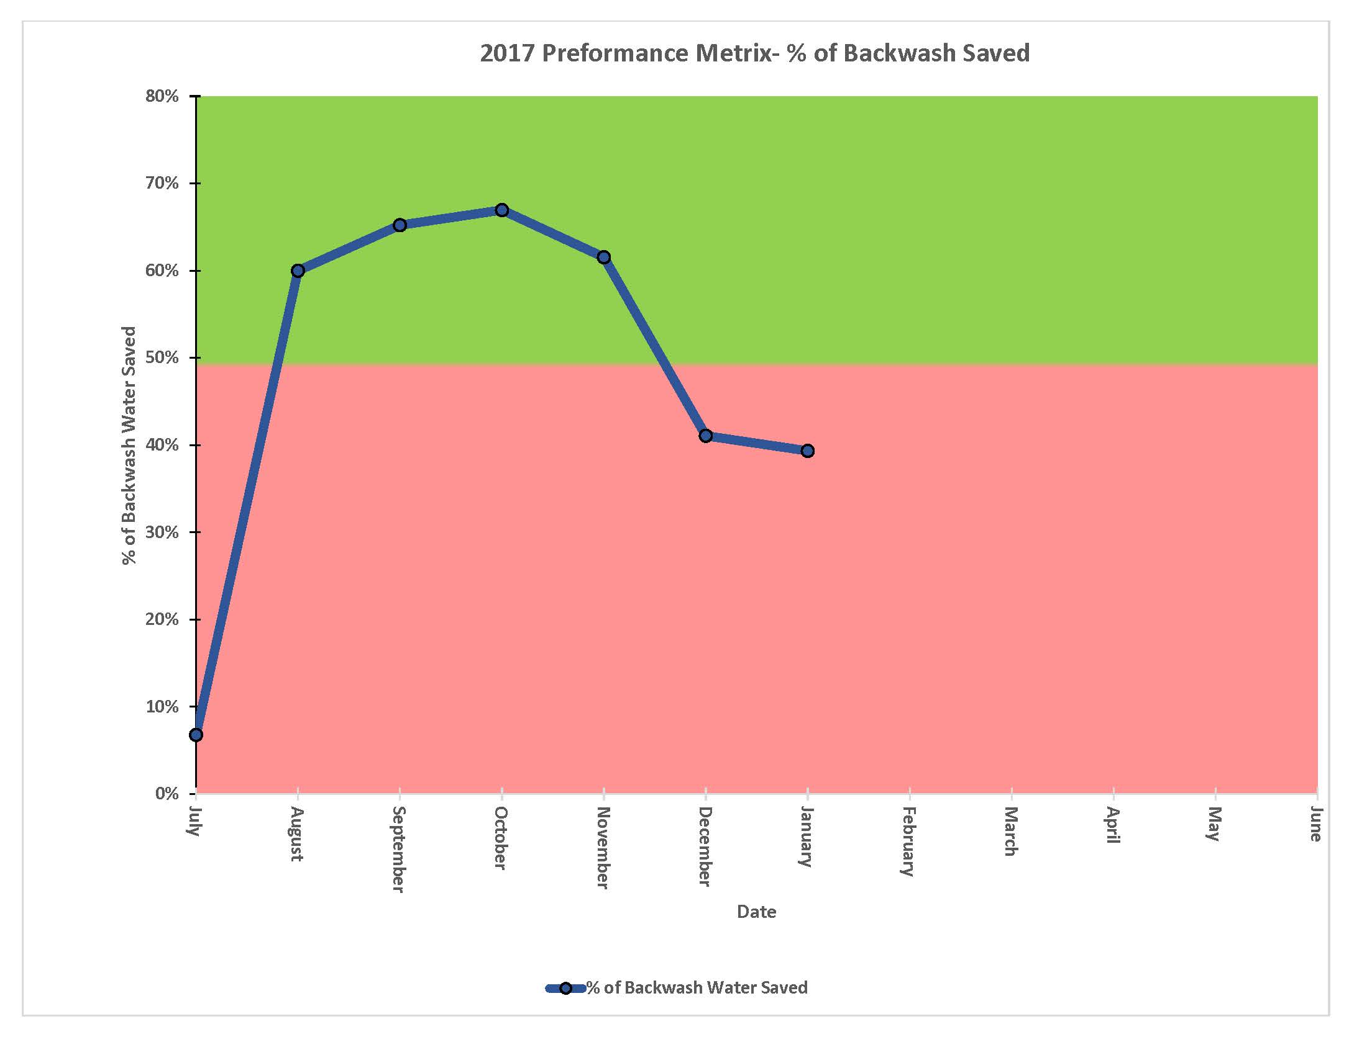
Filter Backwash Initiative- Financial Goal

Slide 24
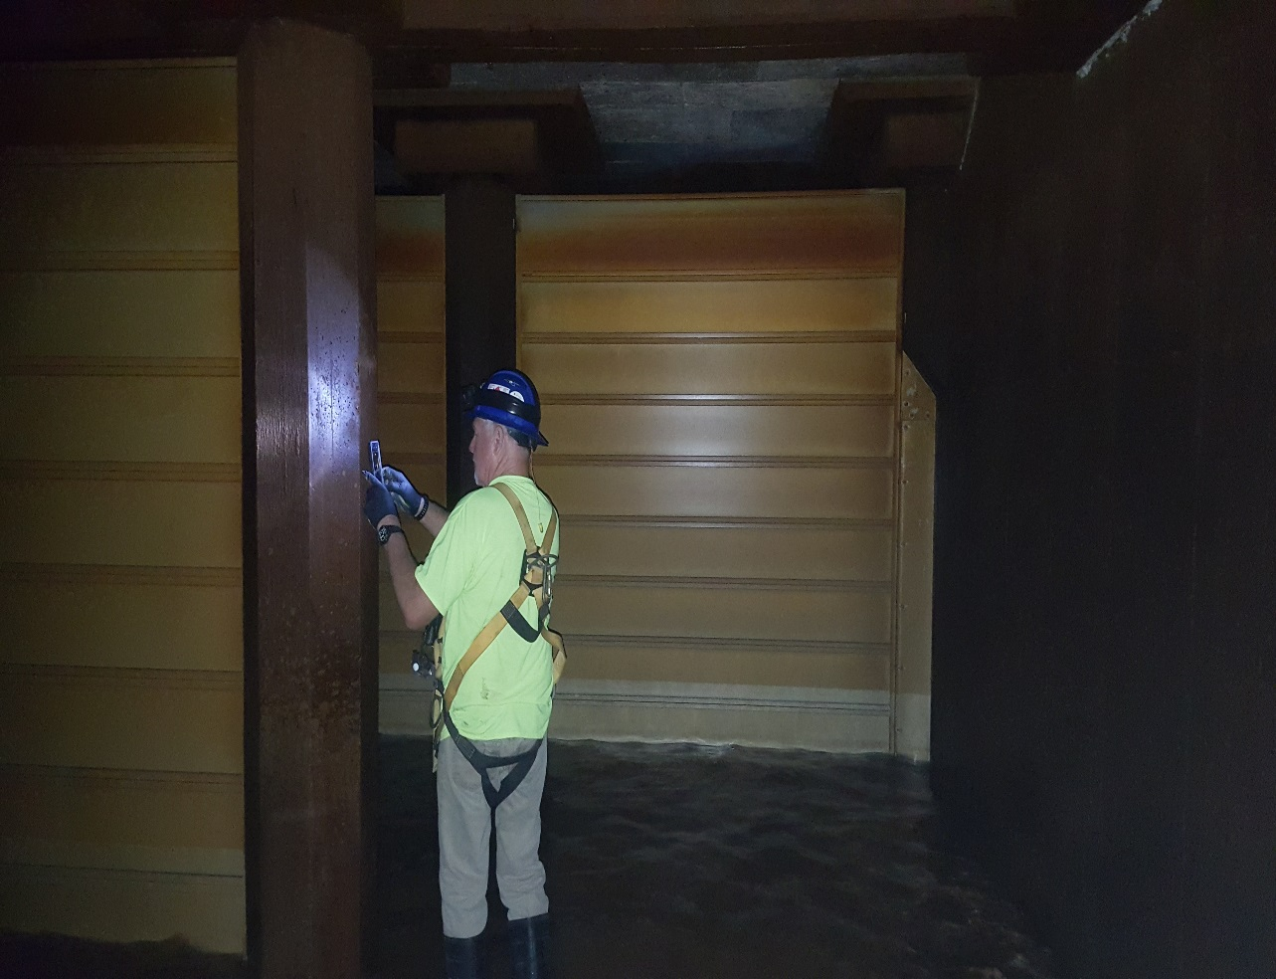
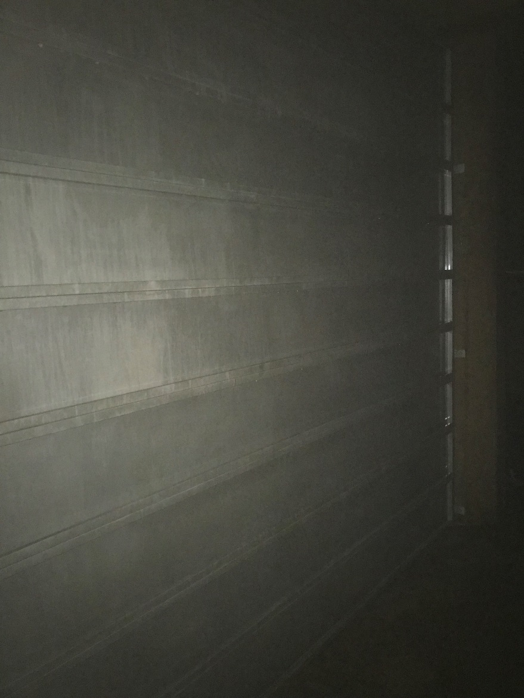
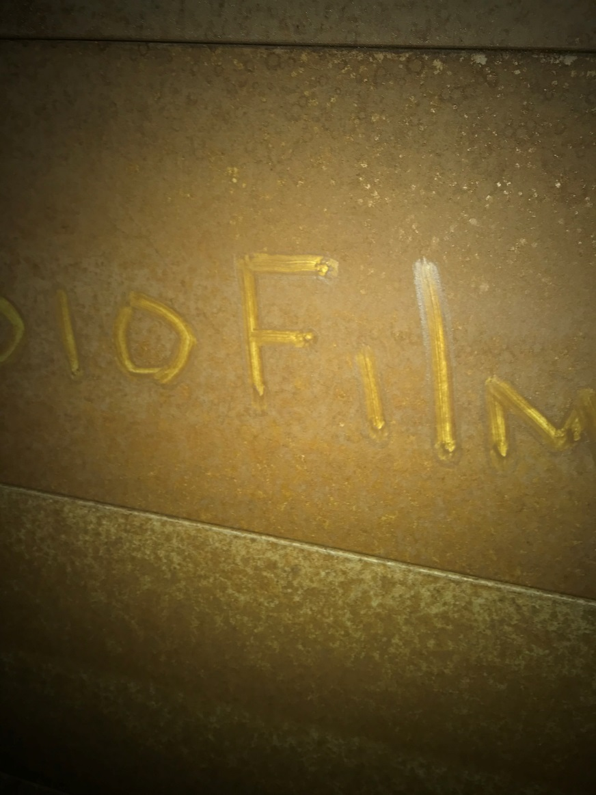
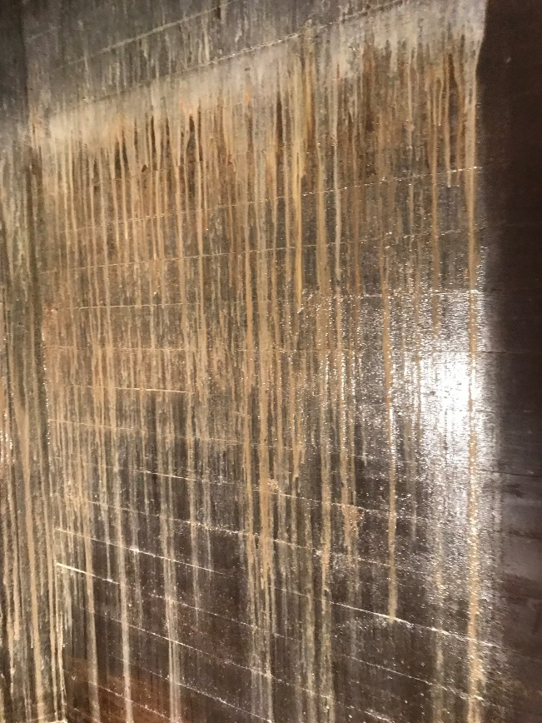
Chlorine Demand / DBP Monitoring / Clearwell Cleaning

Slide 25
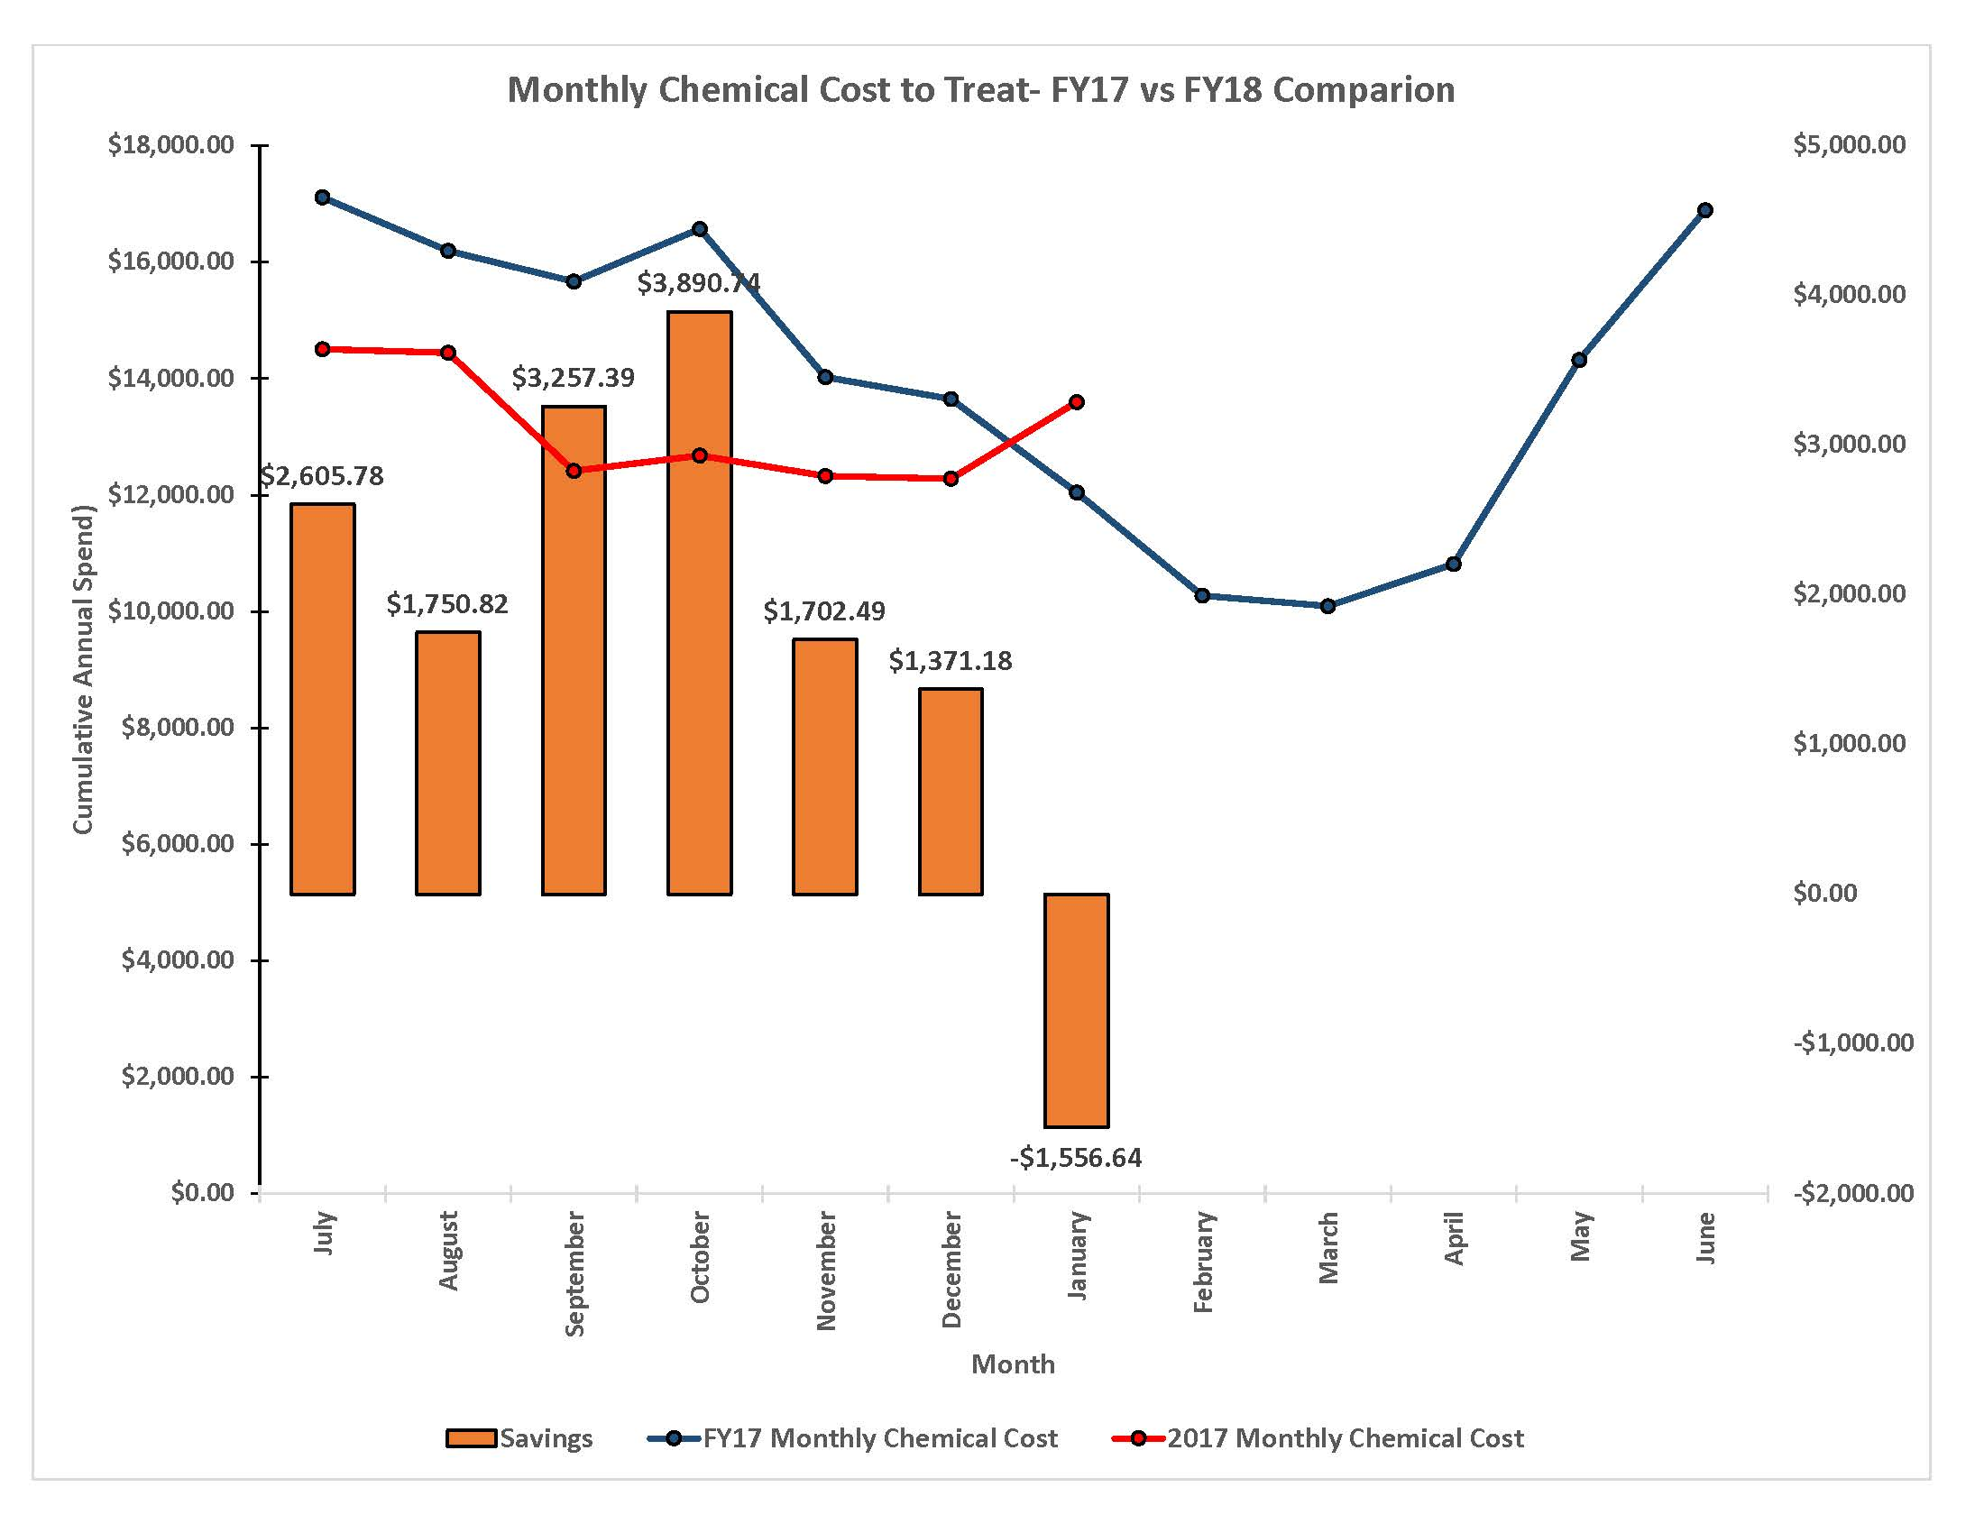
Chemical Savings Initiative- Financial Goal

Slide 26
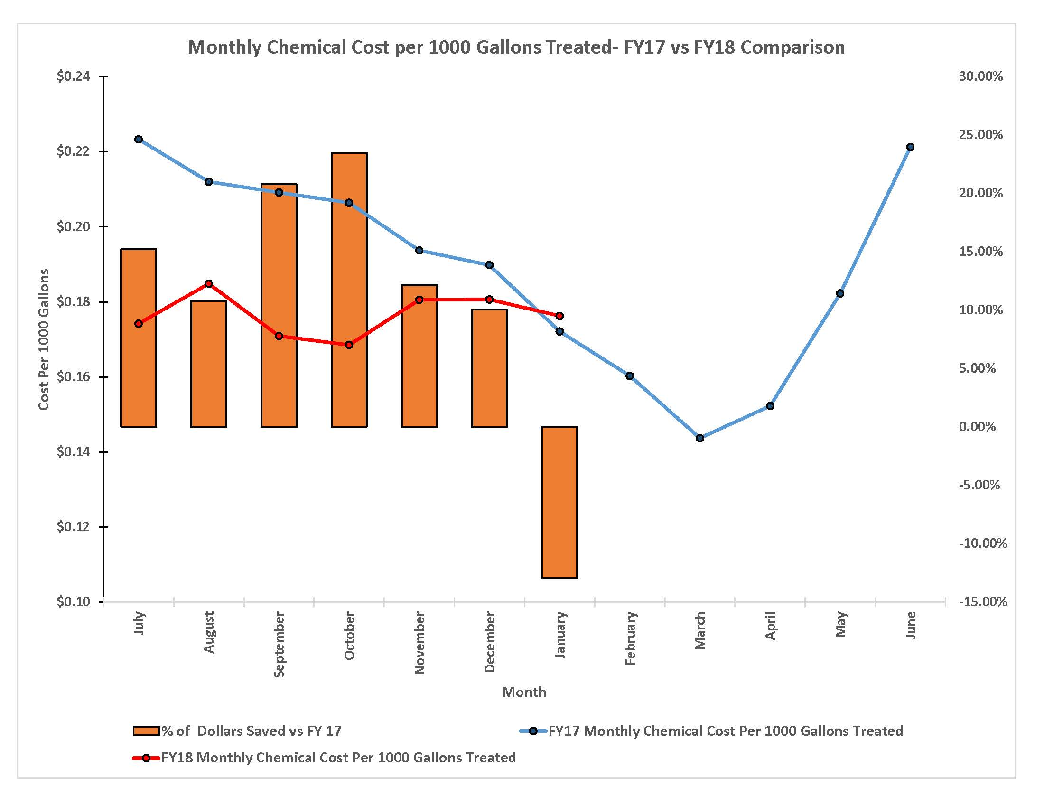
Chemical Savings Initiative- Financial Goal

Slide 27
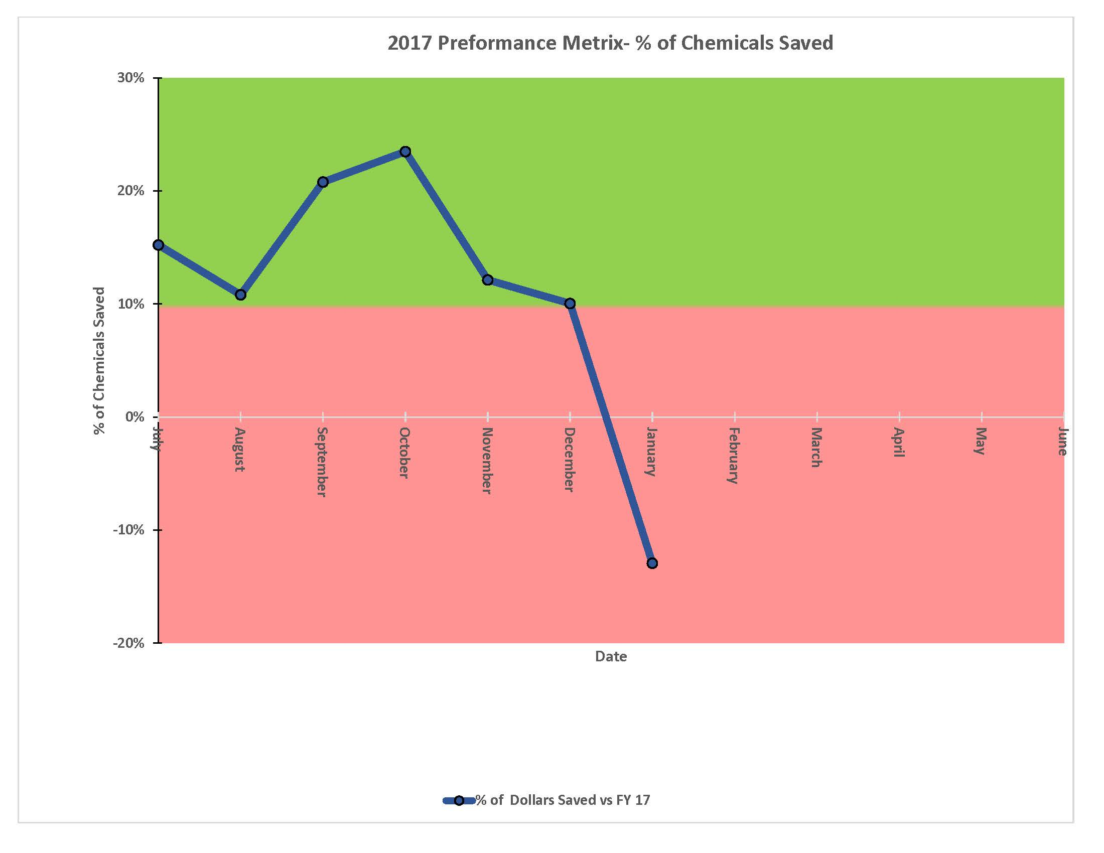
Chemical Savings Initiative- Financial Goal

Slide 28
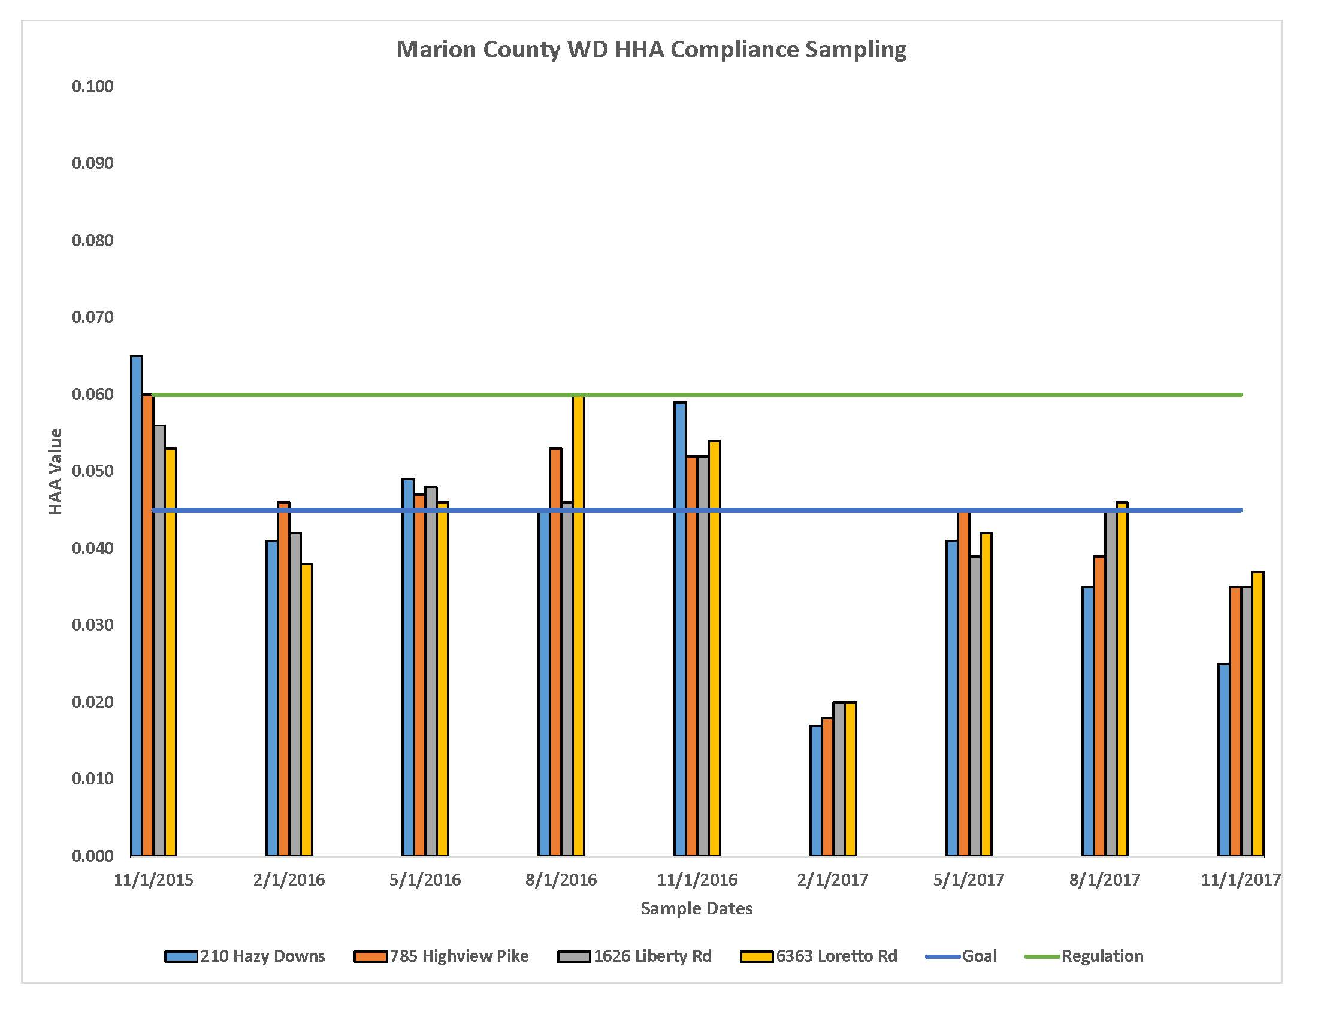
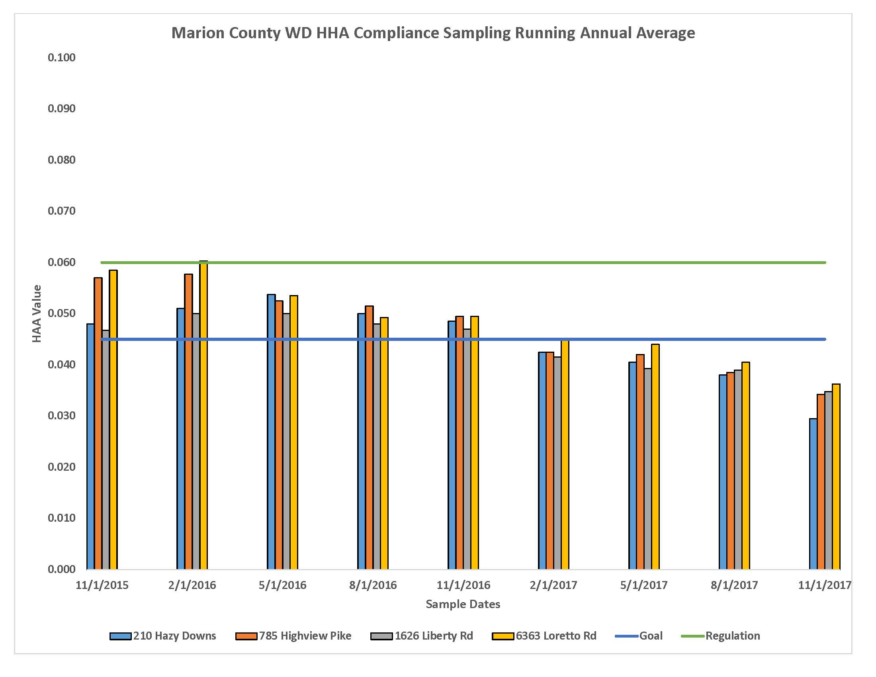
# of DBP Samples out of Compliance for the Marion County Water District- Regulatory Goal

Slide 29
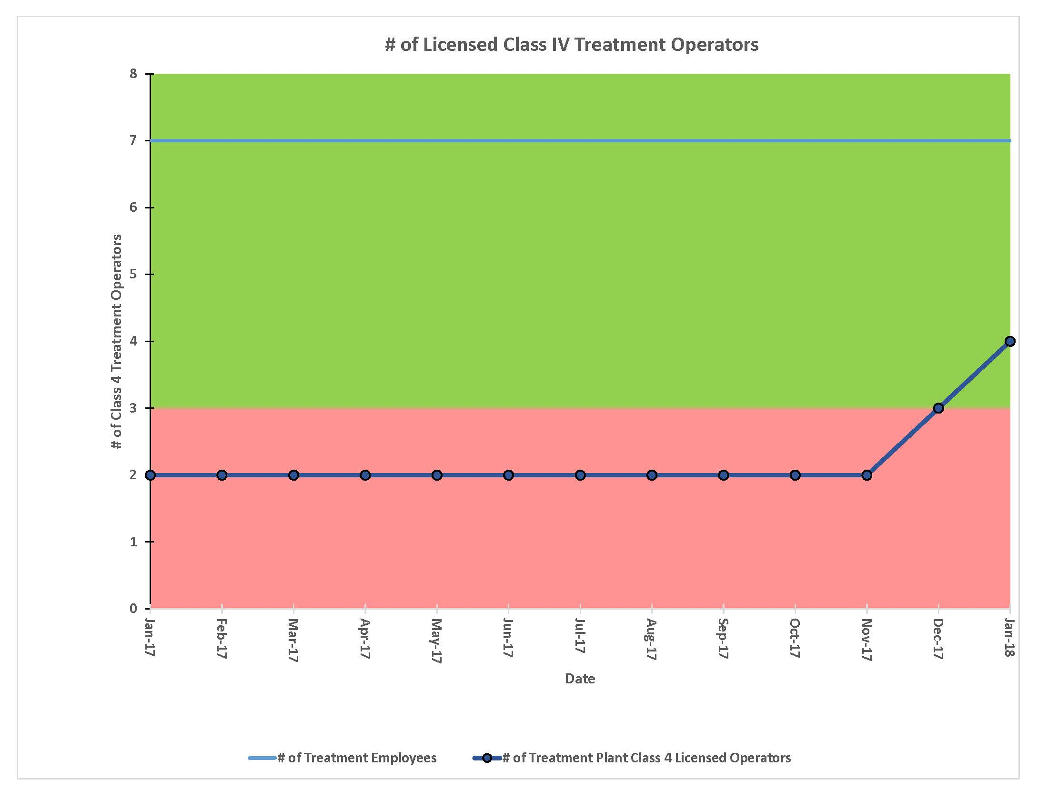
Licensed Operators

Slide 30
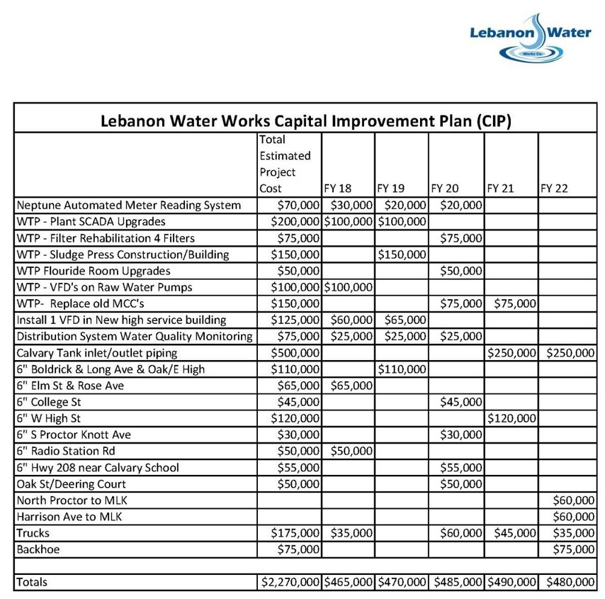
5 Year Capital Improvement Plan

Slide 31


Delivery & Evaluation
The Message Should be Communicated Clearly-
Do your Staff & Board
Understand the “Health” of the Utility?
Evaluating the Goals &
Continuous Training

Slide 32

In Review- Tell Them What You Told Them
Effective Communication is the Key to Team Success
Getting Receivers to Buy In and Become Senders
Using Data to Prove Your Point
What are the consequences if you don’t listen, react or comply?
Do You Have Sufficient Data or Verification to make an intelligent Decision?
Using Various forms of mediums to get your attention.

Slide 33
QUESTIONS or Comments?
Lebanon Water Works Co.
270-692-2491
Daren Thompson 502-648-0927
Daren.Thompson@lebanonwaterworks.com
www.lebanonwaterworks.com
S4 Water Sales & Service
270-781-0617
Bob Cashion 270-790-2726
RKCashion@S4Water.net
www.s4water.net
The information included in this presentation is proprietary and/or confidential, and protected from disclosure. Do not disseminate, distribute or copy this presentation without the express consent of S4 Water Sales & Service ,LLC or Lebanon Water Works Co. Company
" It's not what you know, it's knowing where to find what you need. "

