Slide 1
Peracetic Acid (PAA)
Kentucky Division of Water
Annual Training Meeting
October 20,2016

Slide 2
Background Information
Acetic Acid + Hydrogen Peroxide=PAA
Registered by EPA in 1985
Kills microorganisms by oxidation and disruption of cell membranes
Used as disinfectants in meat, poultry, canning, hospitals, pulp & paper, cooling towers for Legionella control
Odor: Strong like vinegar, Appearance: Clear, Weight: 9.7lbs/gal
Available in 15%-30% strength
Neutralized with water

Slide 3
Benefits of PAA vs. Chlorine Gas
No Emergency Management Plan Needed
No Dechlorinating chemistry required
Minimum 7 minute contact time
Advanced Oxidation occurs with UV, reducing amount of PAA
Keeps basins, UV bulbs clean

Slide 4
Pilot Testing Requirements
Systems at that are intent upon switching to PAA must submit to the cabinet:
1. Written notice of the intent to begin pilot testing that shall not exceed one (1) year. Permanent feed is notification to do so.
2. A detailed plan showing:
a. The treatment train that shall include peracetic acid;
b. The basin that will serve as a chamber for feeding peracetic acid; and
c. Secondary containment of peracetic acid storage;
3. The type of pump used to deliver the peracetic acid.
4. The type of material used in the feed line.
5. The contact time calculations
Per Greg Goode, PE, Water Infrastructure Branch, June 22, 2016

Slide 5
What Plant Size Benefits
All size systems, large and small
Small systems benefit the most, especially with short detention time
Only needs 7 min for disinfection
Small plants cannot afford expensive engineering for one pump and one chemistry

Slide 6
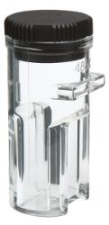
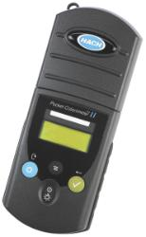
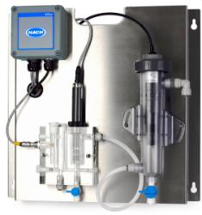
Figuring PAA Residual
Same instrumentation and reagents used for chlorine
Must use Total Chlorine reagent in High Range Vial
Result (mg/l) X 1.07 (PAA Factor)=PAA Residual
Process probes have been used, but need cleaning frequently

Slide 7
Dosing Rates in Effluent
Without UV Disinfection-1.5 mg/l to 3.0 mg/l
With UV Disinfection-0.5 mg/l to 1.5 mg/l
Can be used to reduce Filamentous Bacteria in Aeration basin through RAS (PAA is non-discriminatory)

Slide 8
Pump and Tubing
Best Pump: Peristaltic
Moderate Pump: Diaphragm Pump, with degassing head
Best Tubing: Stainless steel piping or black UV resistant poly with conduit sleeve
Moderate Tubing: UV resistant poly
Best Peristaltic Tubing: Santoprene

Slide 9
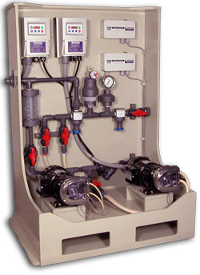
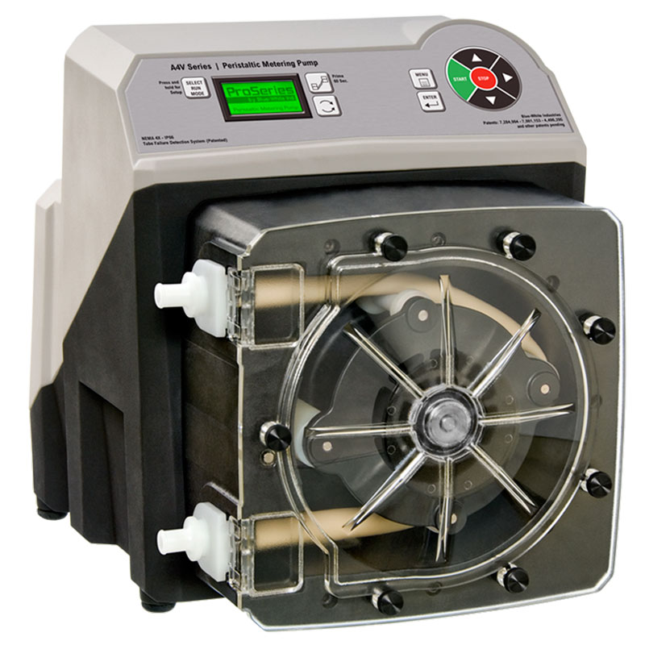
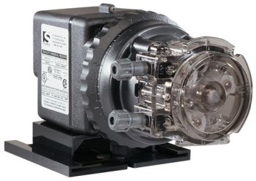
Pumps

Slide 10
Compatibility Chart
PTFE-Polytetrafluoroethylene
PVDF-Polyvinylidene fluoride
PFA-PERFLUOROALKOXY

Slide 11
Feed Location
Just under water surface
Adequate mixing
Before UV disinfection (if present)

Slide 12
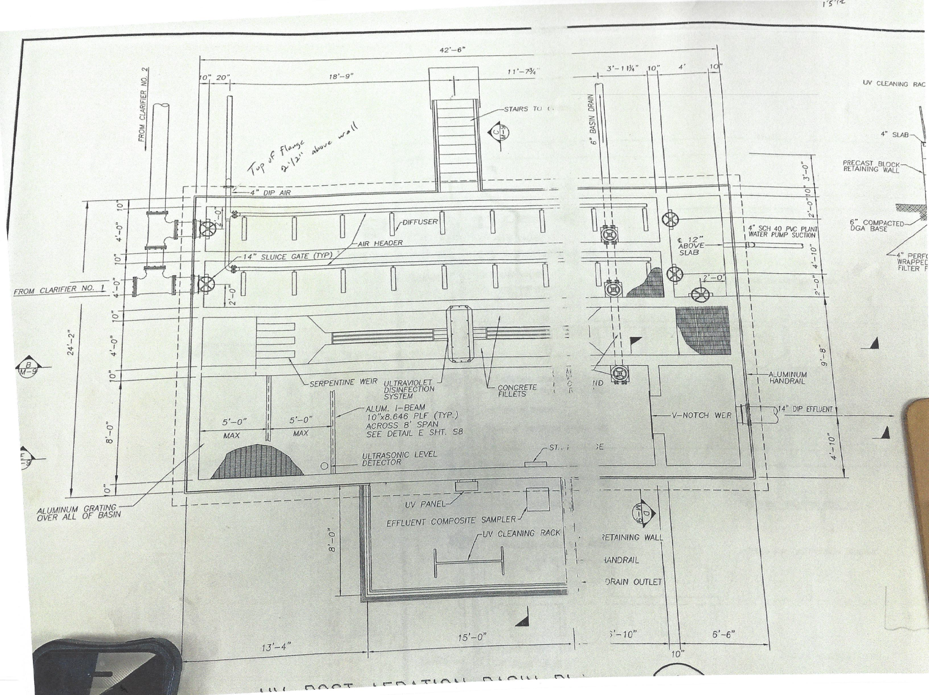
Injection Site
200gpm flow
V Notch Basin=353.33cuft x 7.48=2,643 gal
2,643 gal / 200 gpm=13 min
UV Basin=1440cuft x 7.48=10,771 gal
10,771 gal / 200 gpm=53 min

Slide 13
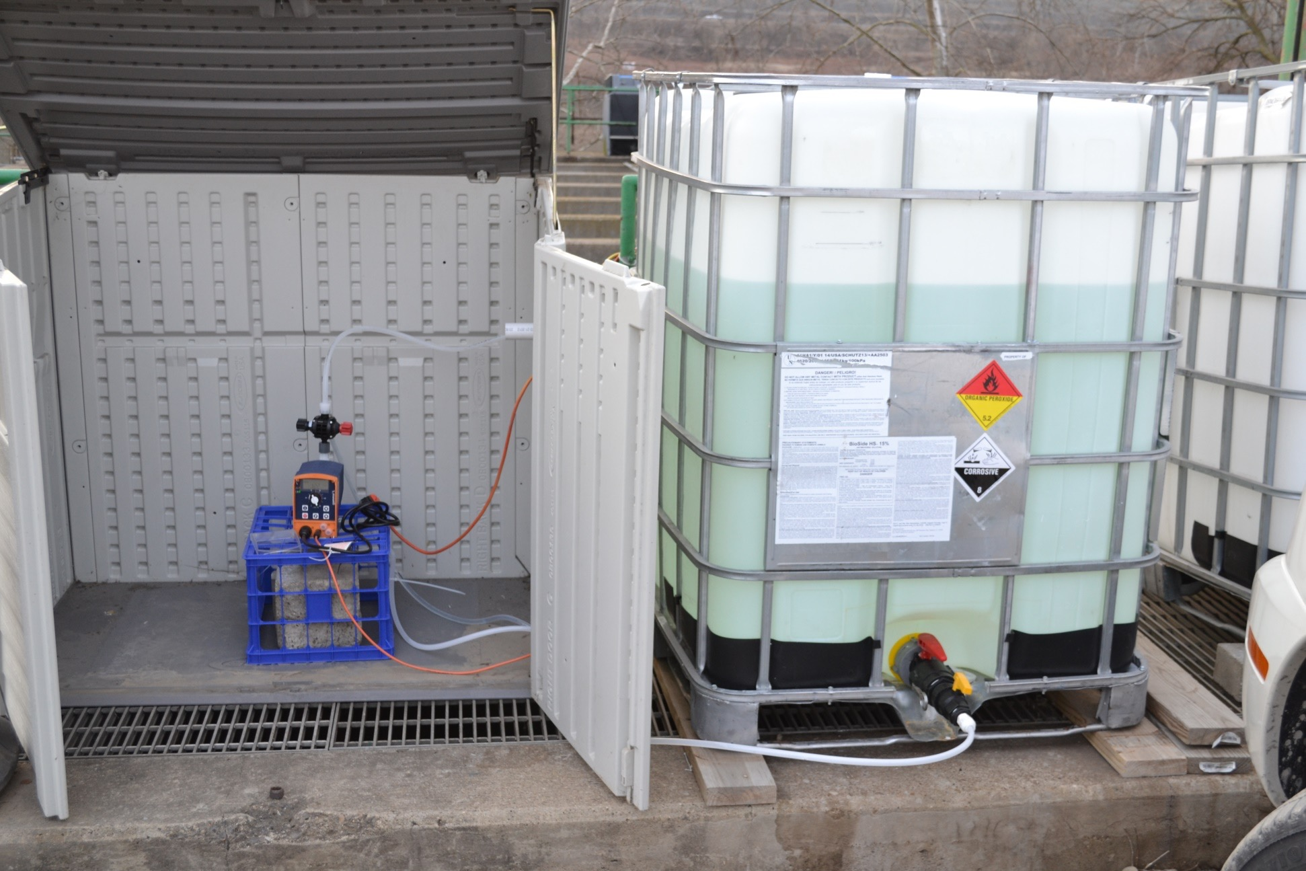

Slide 14
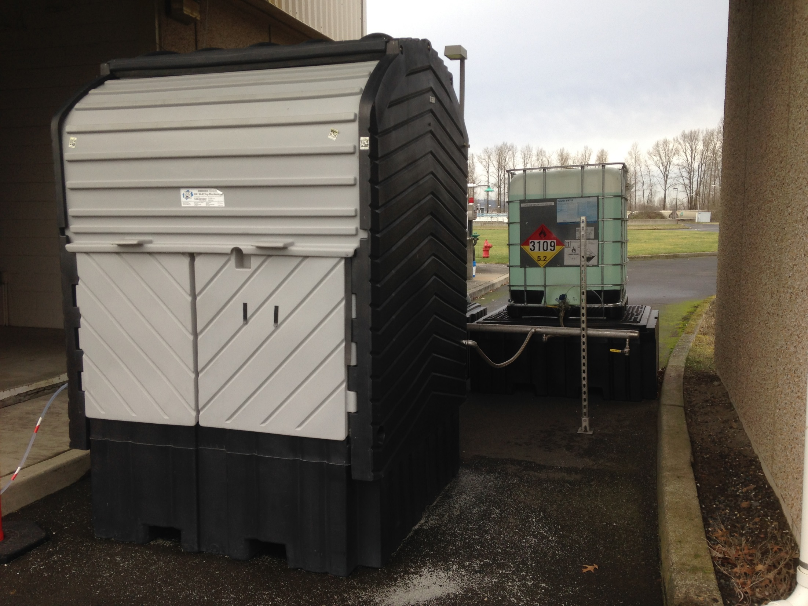

Slide 15
Cost vs. Chlorine
Chlorine
PAA
2x gas chlorinators (Chlorine and Sulfur Dioxide)
2x pumps (Bleach and Bisulfite)
Emergency Management Plan
SCBA equipment and certifications
Alarms, detectors and equipment maintenance
1x pump
Eye Wash Capabilities

Slide 16
Cost vs. Chlorine
Cost of 150lb Chlorine Cylinder=$121.50
Cost of 150lbs of PAA=$157.50
Based on a 1MGD Plant
8.34 X 1MGD X 2 ppm=17 lbs/day
Cl2 gas=$14/day
PAA=$18/day
However, use costs of PAA will be much less than gas, due to EMP, equipment, etc.

Slide 17
What is NOT Recommended
Long Term storage in unapproved containers
Contamination if re-drummed or other containers
Pump with no degassing head

Slide 18
DOW Inspectors “What to look for?”
Pump and tubing selection (Degassing)
Meets minimum contact time
Weather proof pump (Building or rated for outdoor)
Containment where necessary

Slide 19
How many plants are using PAA in Kentucky?
Over 20 Facilities
All large facilities (BGMU, Frankfort, Morganfield)
Looking at smaller facilities currently

Slide 20
PAA Projections
Any and all size systems that use chlorine gas could be possible PAA users, especially smaller systems
Package plants

Slide 21
What limits PAA disinfection?
High TSS, harbors coliforms
Washout conditions, however feed rates can be increased for disinfection

Slide 22
PAA Demonstration

Slide 23
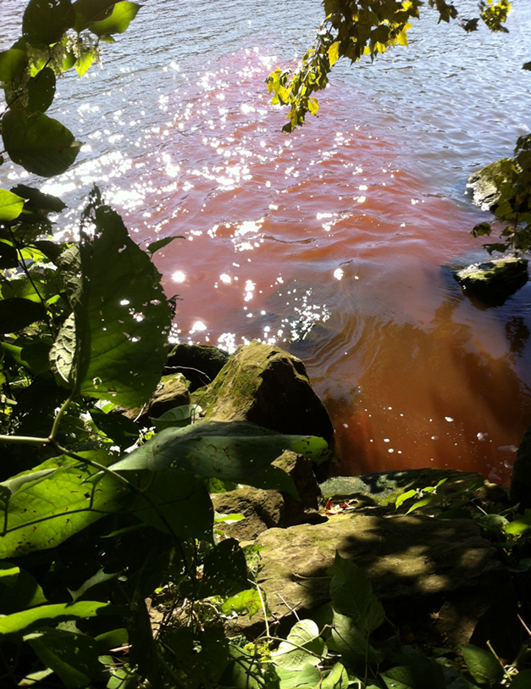
0.02 ppm
8 ‘
0.14 ppm
6 ‘
0.21 ppm
2 ‘
0 ‘
Overflow: 0.41 ppm

Slide 24
