Slide 1
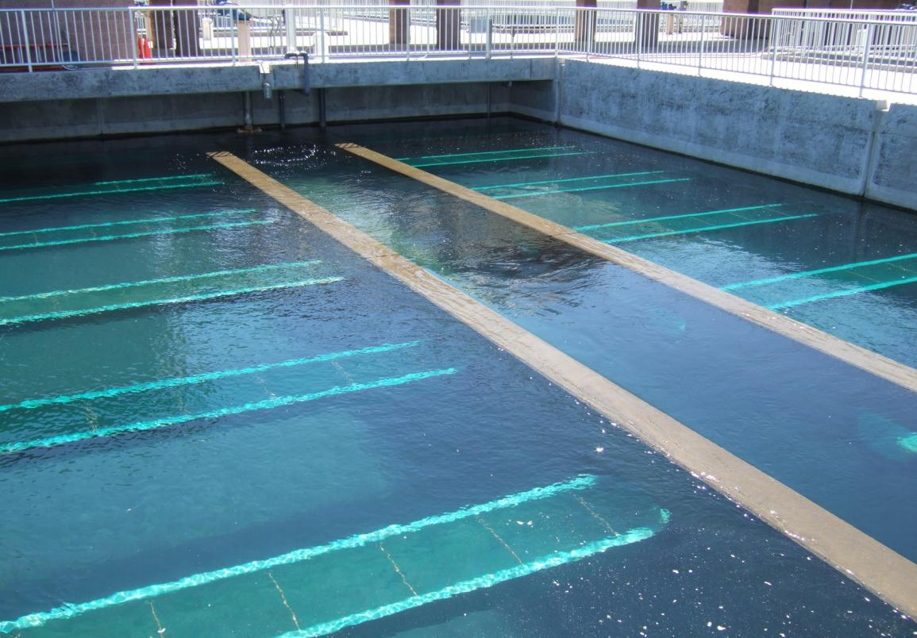
Development of a Filter Surveillance Program
Part 2
Brandt Cashion
S4 Water Sales and Service, LLC

Slide 2
Filter Bed/Media Tests
Top of Gravel Footprint
Filter Coring/Sampling
Media Inspections
Filter Excavations
Notes:
Fig 10

Slide 3
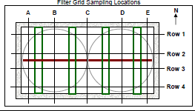
Top of Gravel Footprint Testing
Gravel helps
Evenly distribute backwash water
Gives support to finer media
Purpose: To ascertain the levelness of the gravel layer
Importance: Can result in uneven backwash water distribution, poor media statification

Slide 5
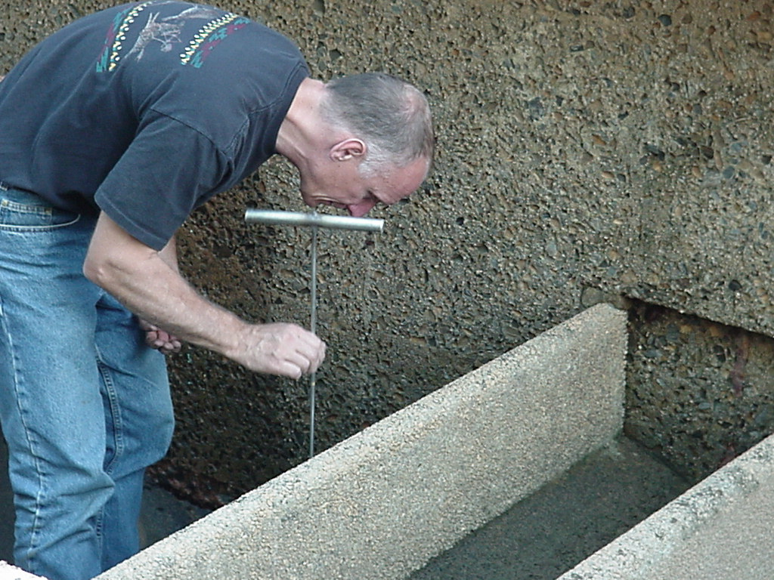
Top of Gravel Footprint Testing

Slide 6
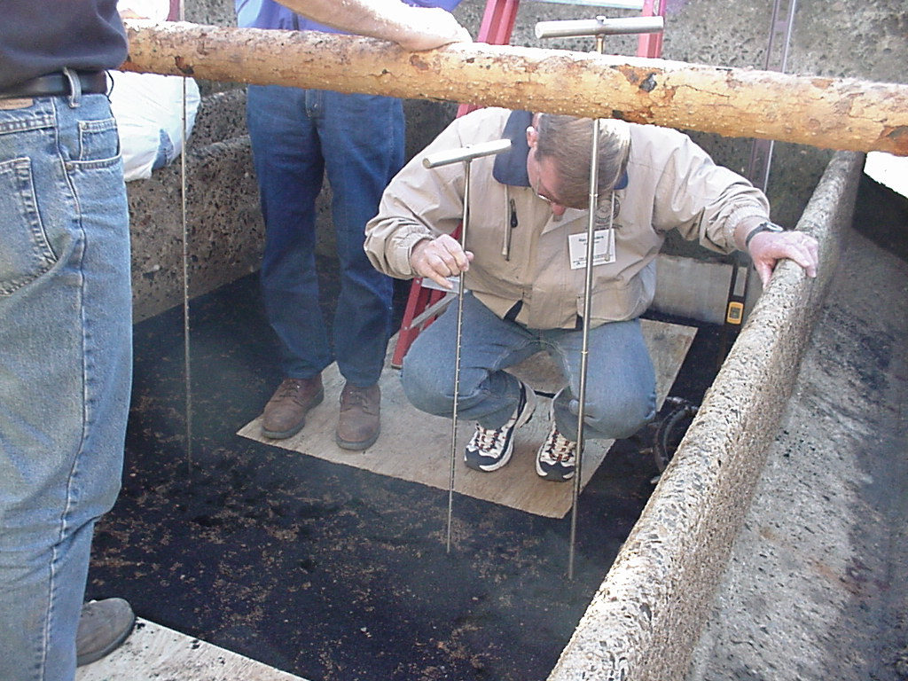
Top of Gravel Footprint Testing

Slide 7
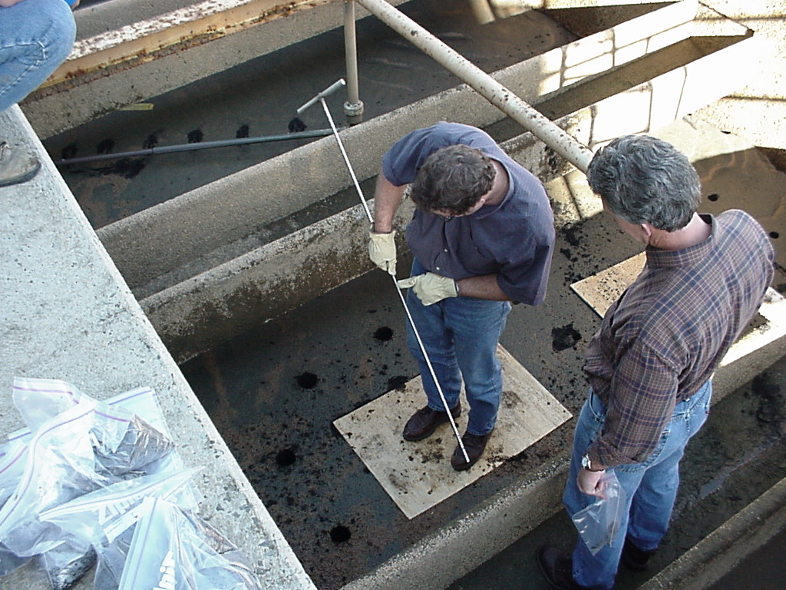
Top of Gravel Footprint Testing

Slide 8
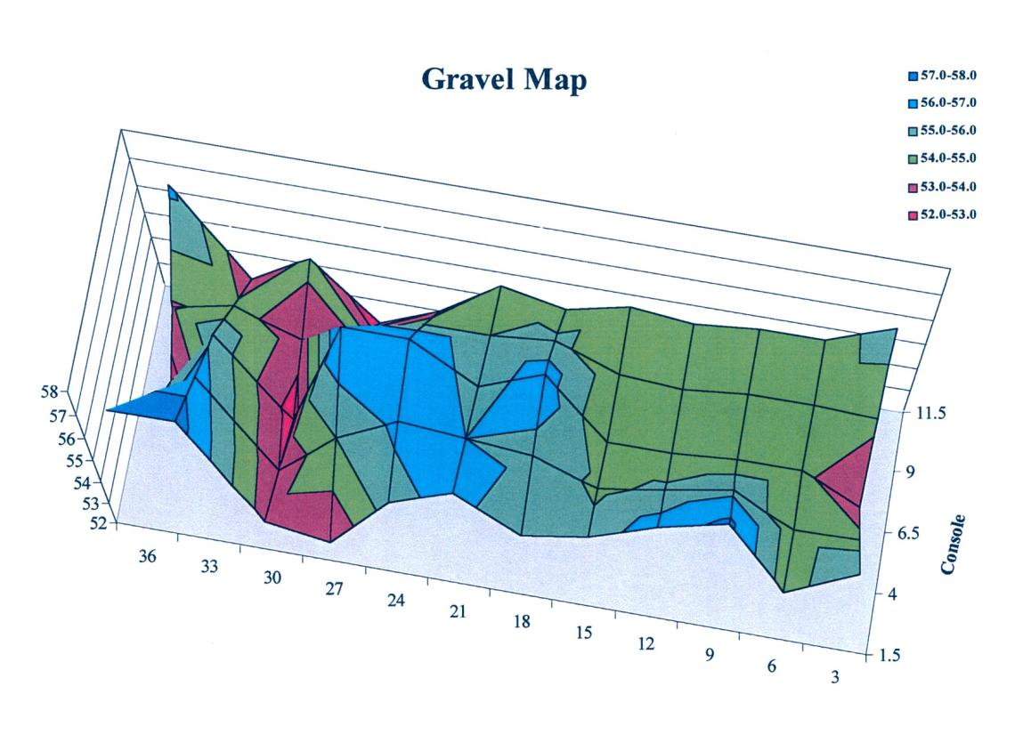
Top of Gravel Footprint Testing

Slide 9
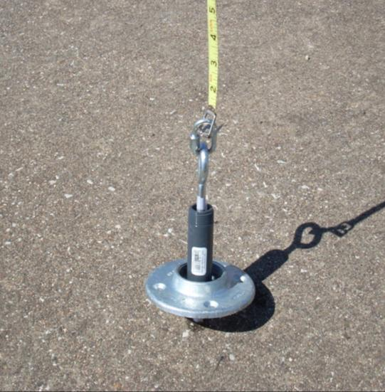
Media – Surface Profiles
Measured down from trough to media
Use a 5’ level to check the media surface

Slide 10
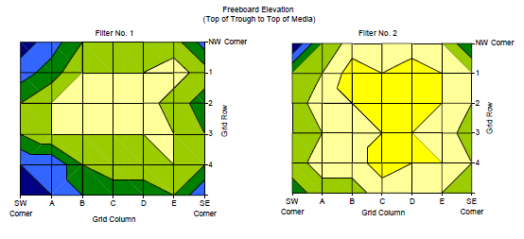
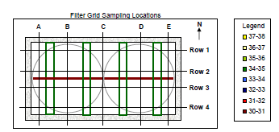
Freeboard Elevation Footprint Testing

Slide 11
Top of Gravel
Depth of Media Testing
32 in. | 30 in. | 29 in. | 28 in. | 27 in. | 26 in.
29 in. | 29 in. | 29 in. | 27 in. | 27 in. | 26 in.
29 in. | 28 in. | 26 in. | 27 in. | 27 in. | 27 in.
29 in. | 29 in. | 26 in. | 26 in. | 27 in. | 27 in.
29 in. | 29 in. | 29 in. | 28 in. | 27 in. | 27 in.
28 in.
27 in.
28 in.
28 in
28 in
29 in
29in. 29 in. 29 in. 29 in. 27 in. 28 in

Slide 12
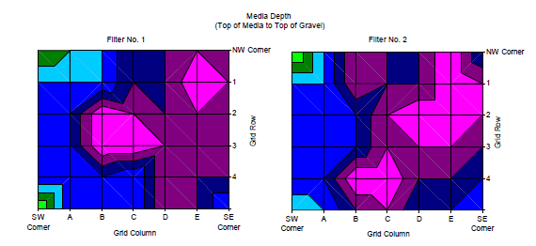
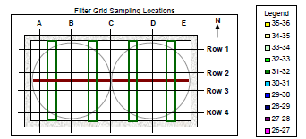
Media Depth

Slide 13
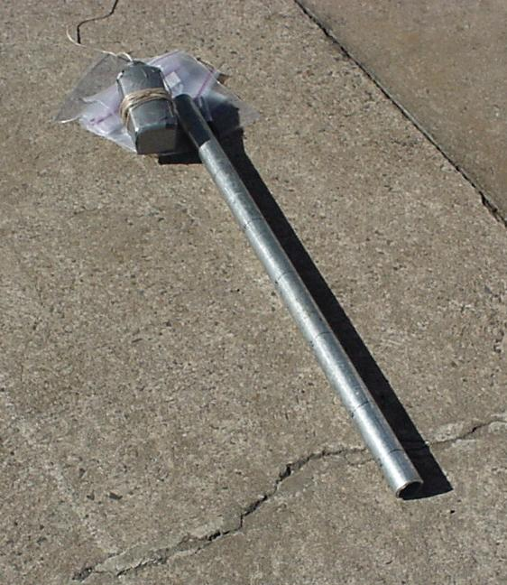
Filter Coring
Purpose:
To sample media throughout the depth of the bed
Importance:
Allows you to obtain samples that can be used in sieve analysis and floc retention profile testing

Slide 14

Filter Coring Steps

Slide 15
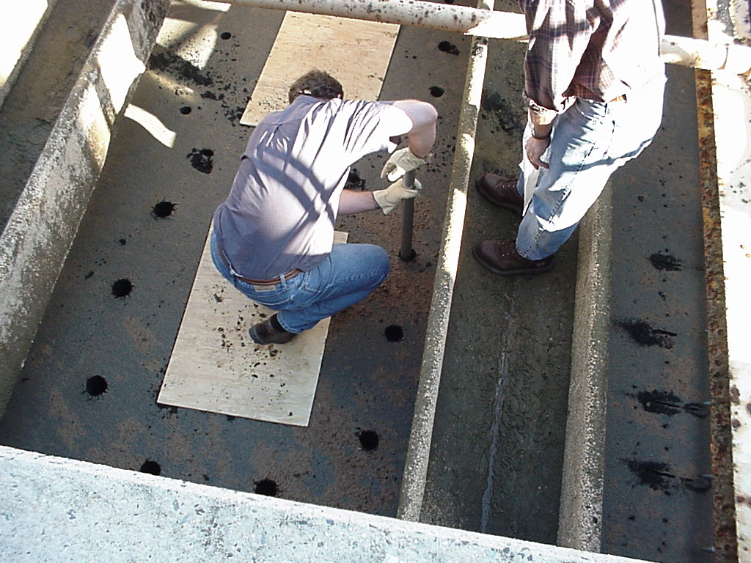
Filter Coring

Slide 16
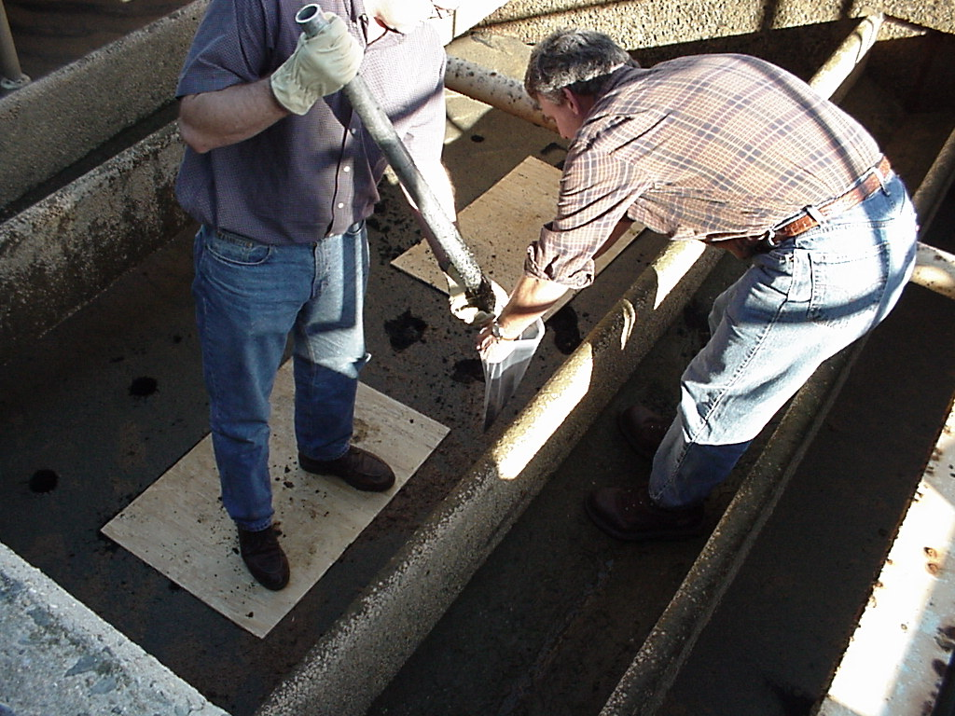
Filter Coring

Slide 17
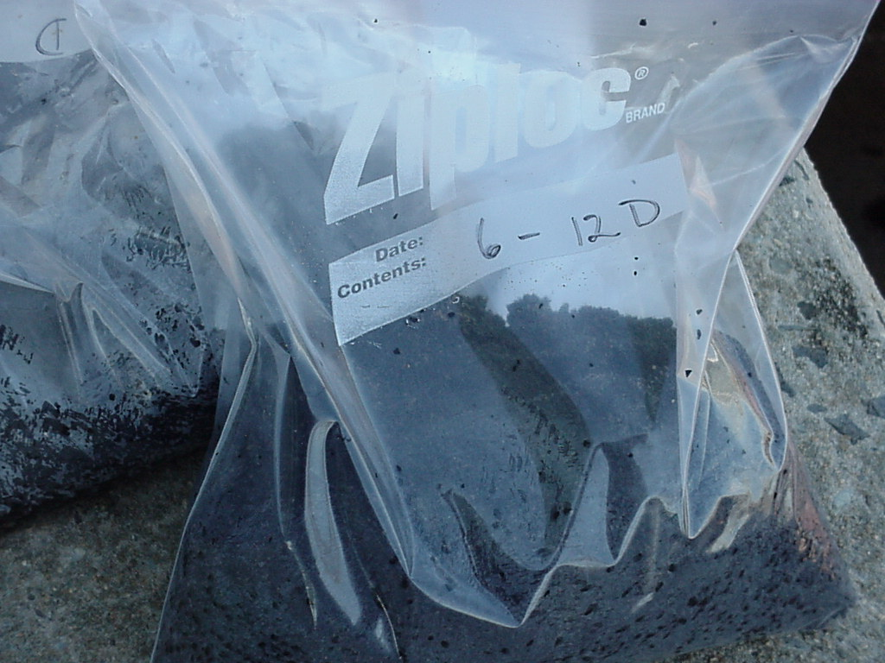
Filter Coring

Slide 18
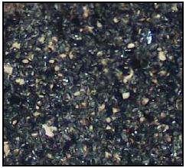
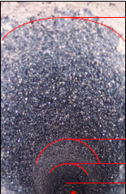
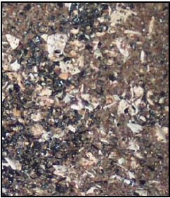
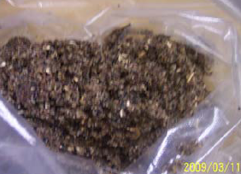
Filter Coring
Anthracite
0-12”
Transition 12”-18”
Sand Layer 18”-24”

Slide 19
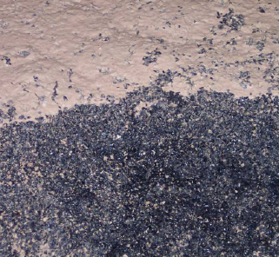
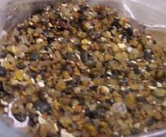
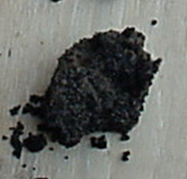
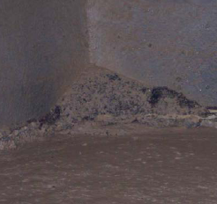
Media Inspections
Purpose: To determine the state and condition of the media
Importance: Media state and condition affects filter performance
Notes:
Fig 10

Slide 20
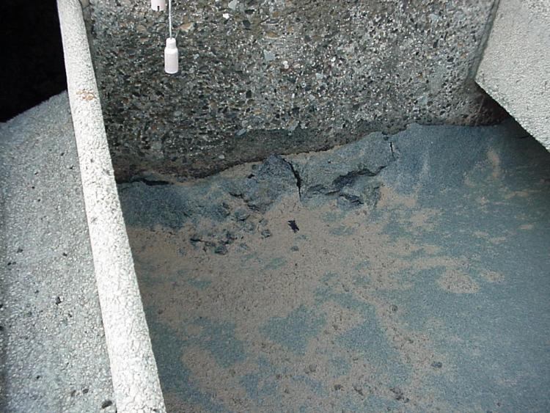
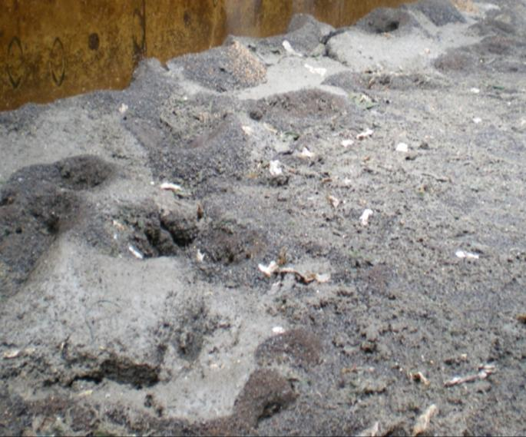
Media Inspections-Filter Mounding
Mounding may be caused by the gravel layer being disturbed allowing more backwash through at that point.
Notes:
Fig 10

Slide 21
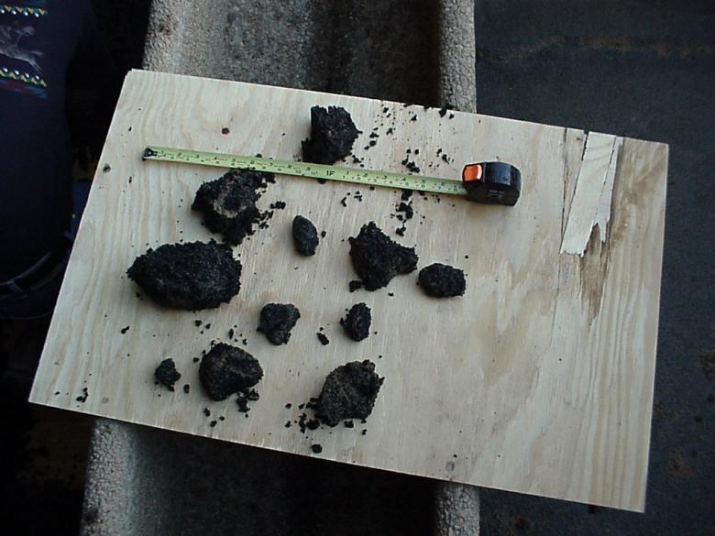
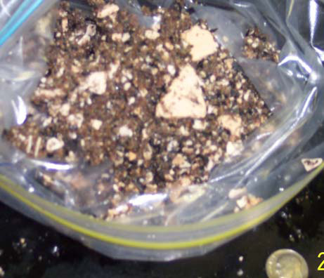
Media Inspections-Mudball Formation
Mudballs can form over time because of improper or inefficient backwashing
Notes:
Fig 10

Slide 22
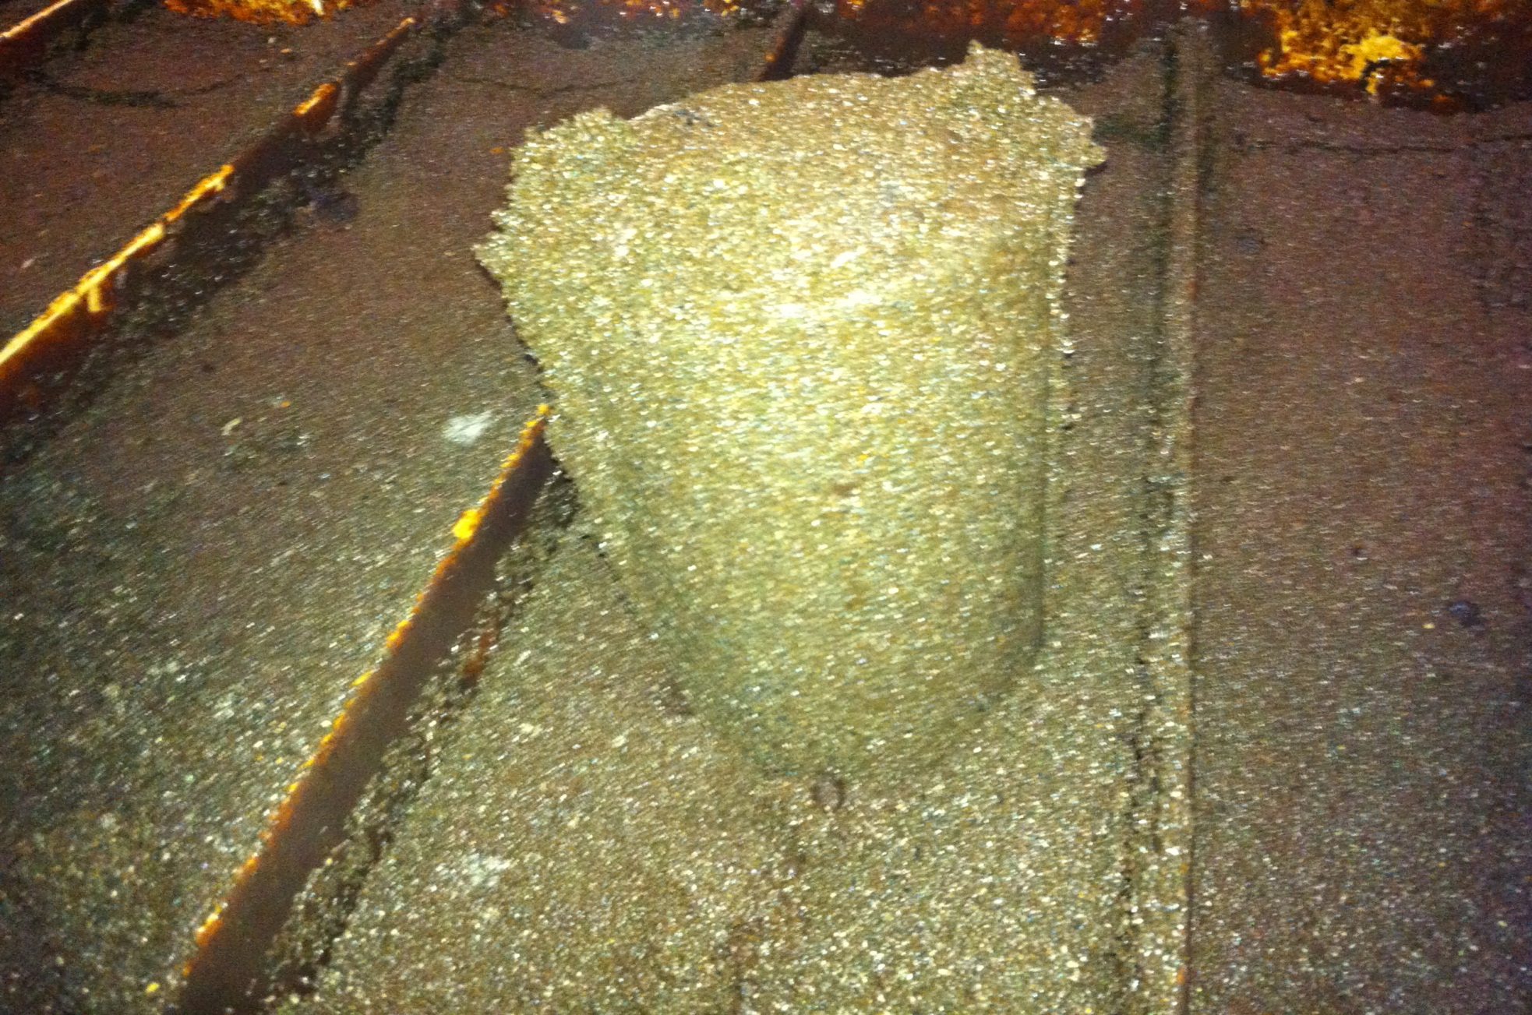
Mud Balls

Slide 23
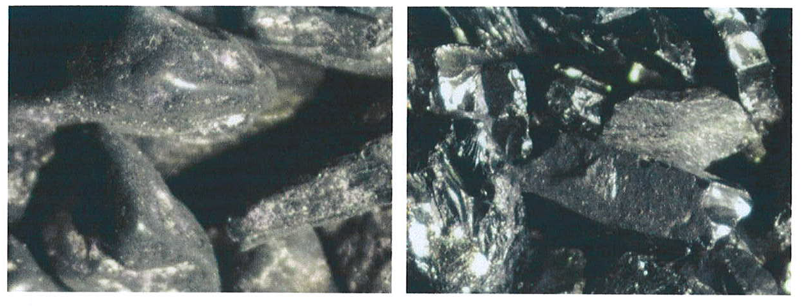
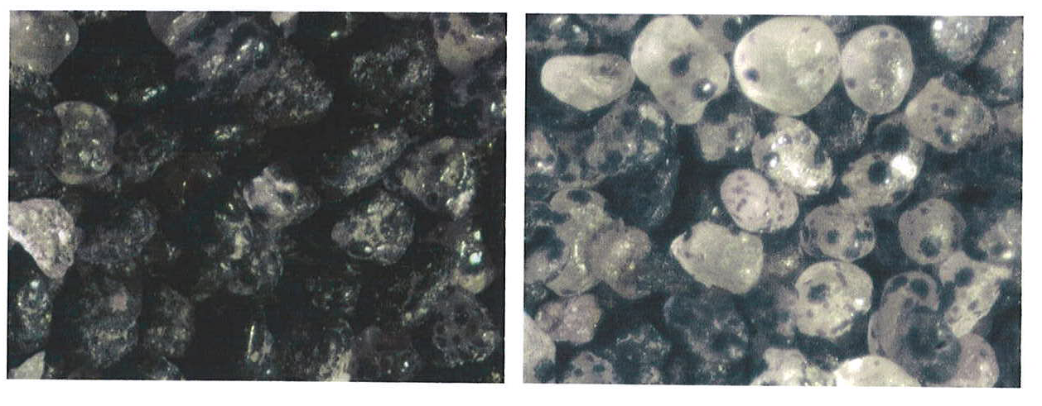
Microscopic Media Evaluations
Anthracite
Untreated
Treated
Sand

Slide 24
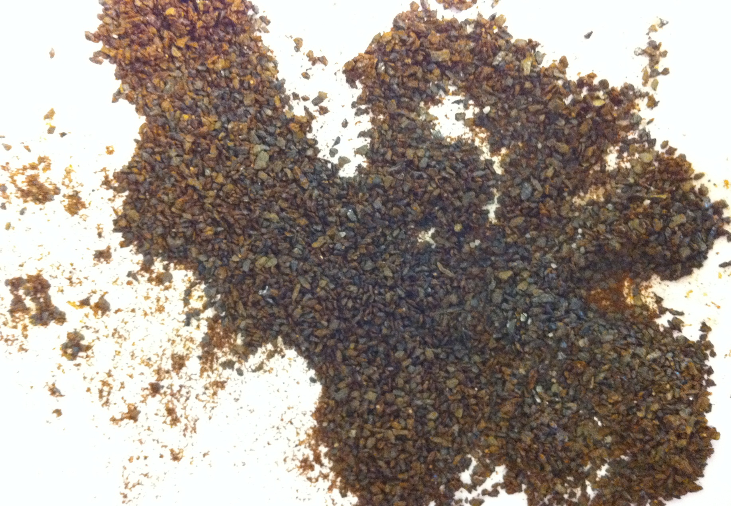
Media Analysis

Slide 25
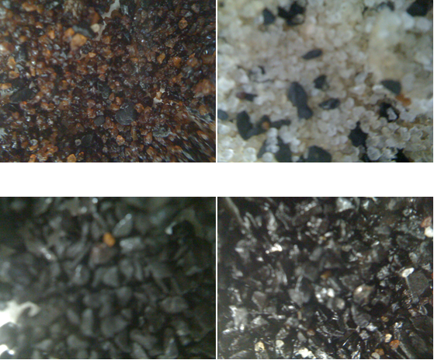
Media Analysis

Slide 26
Questions?

