Slide 1


Sampling, Analysis and Data Interpretation
Notes:
This presentation takes the place of the original Five Steps of Analysis.
The presentation still covers the Five Steps of Analysis. It has just expanded in order to answer more questions involved with water analysis. In this presentation we will investigate the “5 Ws” (who, what, when, where, why) of water testing.
Why a road? Since HTTC is in the process of expanding offsite training programs, with an ambitious schedule of visiting 23 cities in 2002, a road seems somewhat fitting.

Slide 2
S⁴ Water Sales and Service, LLC

Slide 3
Contact Information
Brandt Cashion
bcashion@s4water.net
270-779-9198

Slide 4
Agenda
Why is sampling important?
Wastewater Perimeters: BOD, COD, TSS, Fecal Coliform, NH3, O&G, Chloride, TP, DO, pH, TKN, NO3, NO2, TN
Grab vs Composite Sampling

Slide 5
Why is sampling important?
Need to comply with regulations or permits
Ensure water safety
Solve a problem/troubleshooting
Satisfy your customers concerns
Notes:
Why do we test water?
Clifford Hach was probably the only person who tested water for the fun of it.
The rest of us are testing water for some specific purpose. Most of us are testing water for one of three reasons: to comply with regulations (EPA) or permits (NPDES) (although note that internationally, this is not always as significant of a factor as it is in the United States), for process control and optimization, or for troubleshooting purposes.
All three of these reasons can be summarized by the same phrase – We are testing water because we are asking a question, and we require an answer in order to keep things running smoothly.

Slide 6
Why is sampling important?
Provide adequate data for proper interpretation
Reduce erroneous, invalid data
Increase ability to verify accuracy and representativeness of data
Provide a true basis for answering the original question or concern

Slide 7
When to sample and test?
To answer the question “Am I in compliance?”
  Sample and test at least as often as regulations require
Notes:
To answer the question of “Am I in compliance?” one needs to test as least as often as the regulations require. It is acceptable to test more frequently than what is specified by the regulations, but it is typically not acceptable to test less frequently. For example, if the EPA requires that a turbidity data point be collected every 15 minutes, data could be collected every 5 minutes, but it is not acceptable to collect a turbidity data point once per hour.
Compliance issues may not be of the same importance internationally as they are in the United States.

Slide 8
When to sample and test?
For process control (preventative maintenance) and troubleshooting
  Test frequently enough that there is sufficient information to determine
    When there is a problem
    When the problem has been corrected
Notes:
For process control and troubleshooting, one needs to test frequently enough so that there is sufficient information to determine when there is a problem and when the problem has been corrected. This is the basis behind water security monitoring. In order to determine if water security has been breached, we need to be able to recognize normal values and variation for a parameter. How can we do this? See the next slide.

Slide 9
When to Test?
Look for trends
Measurement
Time
Notes:
We are able to determine when problems arise and are alleviated by looking for trends in sample measurements. In order to determine a trend, we need to collect enough data points to determine a typical baseline value for a parameter, as well as normal expected variation.
At this point, ask the class what kind of interpretation they can draw from the data displayed on the graph? Which point is high? Which point is low? Are both normal? The point is, that we cannot draw any conclusions from this data, because we do not have enough information.

Slide 10
When to Test?
Look for trends
Problem
Problem Solved
Measurement
Time
Notes:
With enough data, differentiating the problem point (and when the problem is solved) gets a lot easier.
Process analyzers make it easy to collect data at regular intervals.

Slide 11
Who Tests Water?
In any application, the person performing the test is called the analyst.
The analyst (hopefully):
  Knows why test is performed
  Is able to run test correctly (including sample collection)
  Can be relied upon for accurate results
    Has verified performance of analytical system
    Has done accuracy checks on results
Notes:
In any application, the person performing the test is called the analyst. Whether they are usually a chemist, operator, or something else, when they are performing the test they are the analyst.
This slide helps to define the role of analyst. Note that the analyst may not always know why the test is performed, be able to run the test correctly, and be relied upon for accurate results. However, if the analyst meets these criteria, they are more likely to produce quality results.

Slide 12
Who Tests Water?
Someone that has a knowledge of how to do it!
  Instrument or apparatus
  Reagents
  Procedure
Notes:
One of the founding principles of Hach Company is that Hach methods for analysis simplify complex procedures so that anyone who could read could be an analyst and run the test correctly.
An example of this is Hach’s very first test kit. The first test kit that Clifford Hach created was for water hardness. Previous to the creation of this kit, the hardness titration was quite difficult. Reagents had to be synthesized by chemists and the titration performed using a buret. The hardness test kit used prepackaged, premeasured reagents – meaning that one did not have to be a trained chemist to run the titration. Literally, anyone who was able to read the instructions could now test their water for hardness.

Slide 13
Why is water tested?
Important decisions are often based on test results
  it is crucial that the answer is appropriate!
The analyst must follow the right steps to be sure that the analytical system is used correctly.
Notes:
Because important process and treatment decisions are based on test results, it is important that analytical results are as accurate at possible. In order to do this, analysts must follow the right steps to be sure that the analytical system is being used correctly.
What are the steps one must follow? See the next slide.

Slide 14
How is Water Tested?
Steps of Analysis
  Sample Collection
  Sample Preparation
  Use of Standards
  Procedure
  Interpretation
Notes:
The Five Steps of Analysis
This slide lists the Five Steps of Analysis. It is not necessary to go into too much detail at this point, since we will cover each of the steps in detail, in the following slides.

Slide 15
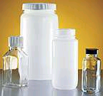
Sampling and Sample Preservation
The sample must be representative of the investigation site.
Notes:
The sample is the greatest potential source of error in a chemical analysis. When collecting a sample, one must be sure that it is representative of the investigation site. This will mean different things in different applications.
For example, when collecting a soil sample from a large site, it may be necessary to collect a composite sample from multiple locations throughout the site. When sampling for chlorine, it is important to let the water run before collecting the sample. When collecting a bacteria sample from a tap, it is necessary to sterilize and remove the aerator from the spigot before collecting the sample.

Slide 16
Sample Containers
Coke and Gatorade bottles

Slide 17
Sampling and Sample Preservation
The sample is the greatest potential source of error in a chemical analysis.
When collecting a sample, one must be sure that it is representative of the investigation site.
  This will mean different things in different applications.

Slide 18
Sampling and Sample Preservation
There are many documents and mathematical formulas available to determine how many samples are necessary to accurately represent a particular site or situation.

Slide 19
Sampling and Sample Preservation
For example, when collecting a soil sample from a large site, it may be necessary to collect a composite sample from multiple locations throughout the site.
When sampling for chlorine, it is important to let the water run before collecting the sample.
When collecting a bacteria sample from a tap, it is necessary to sterilize the tap and remove the aerator from the spigot before collecting the sample.

Slide 20

Sampling and Sample Preservation
Follow the correct sampling protocol for the test and sample type.
This information is provided in the procedure.
Notes:
Sampling protocol may differ depending on the analysis method and sample type. Most Hach methods have a section titled “Sampling and Storage” that describes proper sampling technique for a specific method and sample type. For example, the Sampling and Storage section of the chlorine procedure describes letting a tap run for 5 minutes prior to collecting a sample.

Slide 21
Sampling and Sample Preservation
Some tests must be performed on-site
  Temperature
  pH
Some tests can wait – if this is the case, the sample may need to be preserved
  pH adjustment
  Proper temperature
  Filtration
Notes:
After sample collection comes sample preservation. Some tests must be run on-site. In this case, samples cannot be preserved. Some tests that must be run on-site include temperature (you just can’t take that temperature sample, store it on ice, and transport it to the lab for measurement) and pH. Some tests do not need to be run on-site. In this case, samples typically need to be preserved in some way for transport and later testing. A few sample preservation techniques include pH adjustment (acidification), temperature adjustment (storage on ice, for example bacteria samples), and filtration.
In either case, the Sampling and Storage section of Hach procedures describes whether or not a sample can be preserved. If a sample can be preserved, it also describes proper sample preservation techniques and maximum holding times. This type of information can also be found in Standard Methods for the Examination of Water and Wastewater.

Slide 22
The Answer (What Now?)
The test was run to ask a question.
Results of the test help answer the question.
Notes:
Remember that the test was run because you were asking a question (Am I in compliance? Is my process under control and optimized? What’s wrong with my system?)
Results of the test help answer the question.
Keep in mind that results may not always be what you expected or what you want to hear. But they must be handled and interpreted.

Slide 23
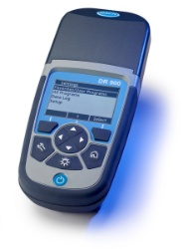
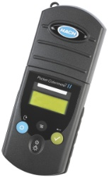
Instrument
Can the instrument do what I want it to?
What is the current condition of the instrument?
  Wavelength accuracy
  Noise
  Stray light
  Absorbance check: tests the lamp, monochromator and photodetector as a system
Notes:
157
Slide 37 -- Instrument -- By basic architecture, we mean what is the instrument designed to do? The resolution of the readings, quality of monochromator, and detection range for each parameter is part of the instrument design. Don’t try and make the equipment do something it wasn’t set up for.

Slide 24
Procedure (Method Performance)
Be sure the procedure is correct for:
  Analyte
  Analysis range
  Precision and sensitivity required

Slide 25
Use of Standards
What is a standard?
  Solution containing a known amount of a specific substance
  Example – 1.00mg/L iron standard
How are standards used?
  Accuracy check
    Confidence that results are correct
    Saves time and money
    Prevent scrap product or excess chemical usage
    Prove performance to inspectors or customers
  Instrument calibrations
Notes:
The use of standards is an essential part of any analysis. Hach procedures typically include an Accuracy Check section. This section describes how to verify the accuracy of a test using standard solutions or standard additions (which are described on the following slides).
Before discussing standards in more detail, it is important that everyone understands the definition of a standard solution. Although the example on this slide refers to a standard for colorimetric analysis, remember that pH buffers and Formazin/StablCal solutions are also standards. Be sure the audience understands that a sample, regardless of how reliable the concentration of a parameter is, does not serve as a standard, because the concentration of a sample is never truly known.

Slide 26
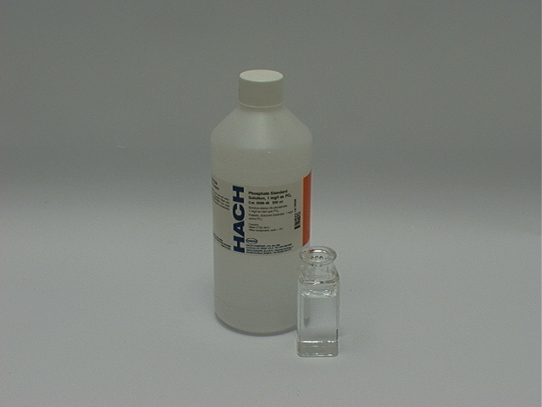
Use of Standards
Standard Solutions
  Verify technique, chemistry, and instrumentation
  Am I running the test correctly?
Notes:
Standard solutions are important because they are used to answer the question of “Am I running the test correctly?” A standard solution is analyzed in the same way as a sample. Used correctly, running a standard solution verifies the analyst’s technique, reagents, and instrumentation.
If running a standard produced correct results, chances are good that the analytical system is working correctly and that sample results will also be accurate. If standard results are not correct, stop and troubleshoot before proceeding. The first step to troubleshooting is to repeat the test.

Slide 27
Sample Collection
What type of sample do you need?
Grab Sample
  One Sample collected at a particular point and time
Composite Sample
  Multiple Samples collected and added together to make one sample
  Time Composite
  Space Composite
  Flow Proportional Composite
Manual vs. Automatic

Slide 28
Grab Samples
One snapshot in a period of time.

Slide 29
Composite Samples
Frequently used to estimate average values over a 24-hr period
Gives information over a longer period of time
Permit samples are often flow proportional composites

Slide 30
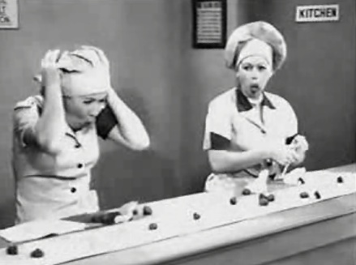
How to Composite
Simple Composite
  Add equal volumes of samples collected from different times or locations.
  Mix thoroughly
Flow Proportional Composite
  Volume of each subsample based on flow
    Estimate total volume of sample required
    Estimate total flow over sampling period
    Calculate sample per flow

Slide 31
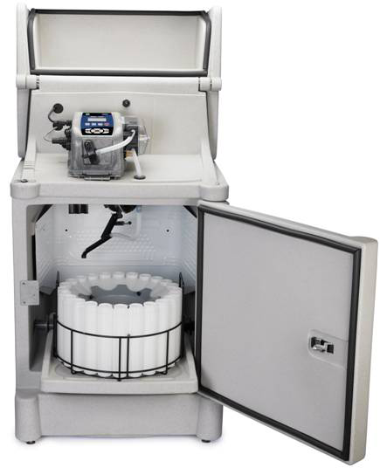
Manual vs. Automatic Sampling
Manual samples are collected by hand
Automatic samples are collected by machine
Cautions for automatic samplers:
  Not necessarily better
  Not accurate when collecting < 20ml
  Clean frequently; watch for clogging
  Variable flows and intake locations
  Do you need EPA compliant sample?
    Must maintain a 2ft/sec transport velocity

Slide 32
Chemical Oxygen Demand (COD)
COD is a hazardous test
Labs now have mercury free testing reagents
Mercury free reagents will not mask interferences from Chloride
Digested sample and uses strong oxidizers of potassium dichromate and sulfuric acid. Takes two hours to do this digestion

Slide 33
Chemical Oxygen Demand (COD)
Collection
Sample in only glass bottles
Plastic is fine, but only if treated for organics

Slide 34
Chemical Oxygen Demand (COD)
Preservation
Use Sulfuric Acid to reach a pH of <2
Refrigerate at 4 deg C
Holding time is 28 days

Slide 35
Chemical Oxygen Demand (COD)
Interferences
Chlorides-If present mercuric acid reagents must be used in the analysis

Slide 36
Ammonia-Nitrogen (NH3-N)
Ammonia compounds combine with chlorine to form monochloramine. Monochloramine reacts with salicylate to form 5-aminosalicylate. The 5-aminosalicylate is oxidized in the presence of a sodium nitroprusside catalyst to form a blue-colored compound.

Slide 37
Ammonia-Nitrogen (NH3-N)
Collection
Collect samples in clean plastic or glass bottles
Best if sample is run immediately

Slide 38
Ammonia-Nitrogen (NH3-N)
Preservation
Add 1 drop sodium thiosulfate if chlorine is present
Adjust pH to <2 with sulfuric acid
Store samples at 4 deg C
Sample is good for 28 days

Slide 39
Ammonia-Nitrogen (NH3-N)
Interferences
Sulfide-Any amount will make color darker
Nitrite->10 mg/l will cause a positive interference
Monochloramines-use dechlor reagent

Slide 40
Oil and Grease (O&G)
Collection
Collect ~1L of sample in a glass bottle

Slide 41
Oil and Grease (O&G)
Preservation
Acidify with 1:1 Hydrochloric Acid to a pH <2
Do not dip probe in sample acidification
Clean pH probe very very well after pH test
Store at 4 deg C
Acidified sample is good for 28 days

Slide 42
Chloride
Silver nitrate is used as the titrant and potassium chromate as the indicator. Silver nitrate first reacts selectively with the chloride in the sample to produce insoluble white silver chloride. After all the chloride has been precipitated, the silver nitrate reacts with the chromate to form an orange or red-brown silver chromate precipitate

Slide 43
Chloride
Collection
Plastic or glass bottles

Slide 44
Chloride
Preservation
No pretreatment needed
Can be stored in sealed container

Slide 45
Chloride
Interference
Orthophosphate-concentrations over 25 mg/L will cause a precipitate to form

Slide 46
pH
What do you think?

Slide 47
Questions?

