Slide 1
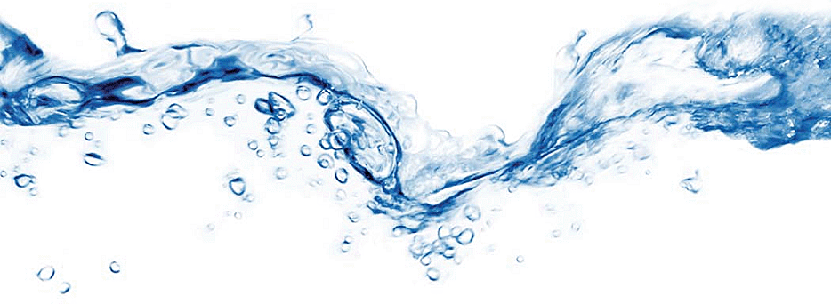
Basic boiler and boiler water training

Slide 2
Objectives of Boiler Water Treatment
Prevent Scale and other Deposits in Pre-Boiler, Boiler and Condensate Systems.
Prevent Corrosion in Pre-Boiler, Boiler, Steam, and Condensate Systems.
Provide Required Steam Purity.

Slide 3
Effects of Poor Boiler Water Treatment
Operational Upsets & Unscheduled Outages.
Reduced Plant Safety & environmental/regulatory Non-compliance
Excessive Costs
Limited Reliability

Slide 4
Basic steam generation cycle
1 Pre-Boiler
4 Condensate
2 Boiler
3 Steam

Slide 5
Boiler sub-systems
Pre-boiler: Feed water piping, Feed water heaters, and deaerator.
Boiler
Steam
Condensate

Slide 6
pretreatment system components
Softeners
Reverse Osmosis Units
Demineralizers
Dealkalizers
Combinations of above

Slide 7
Why do we care about feed water contaminate levels?
Deposition is the primary driver

Slide 8
solubility vs temperature
Ion
Concentration
In Solution
Calcium/
Magnesium
Concentration
In Solution
Regular
Retrograde
Temperature

Slide 9
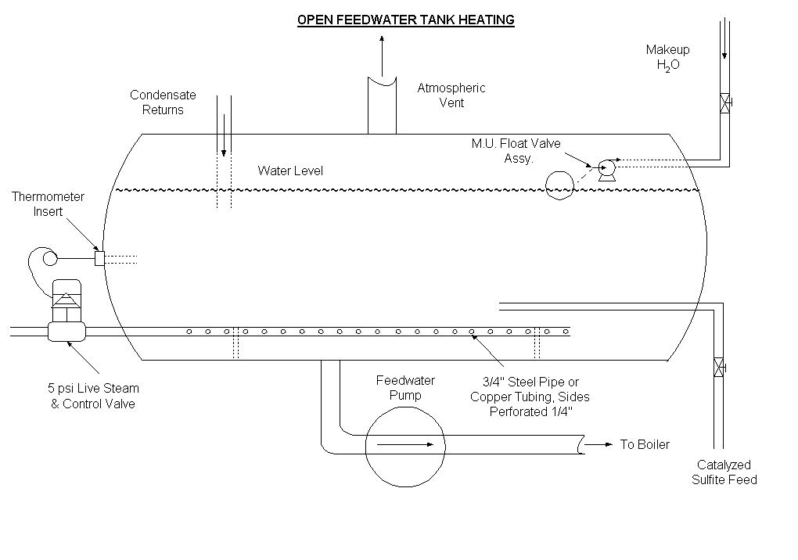
Example of a Feedwater tank
Steam-sparge of feedwater tank

Slide 10
O2 Solubility in water
TEMPERATURE, C
0 10 21 32 43 54 66 77 88 99 110 121
cm³/l 16
22.9 ppm
14
20.0
12
10
DEAERATOR GAUGE PRESSURE POUNDS
17.2
8
14.3
10
6
4
2
VACUUM INCHES
MERCURY
11.4
8
0
4
8.6
Atmospheric
Pressure
(0 psig)
8
6
12
5.7
16
4
20
2.9
24
TEMPERATURE, F
2
28
0.0
0 50 70 90 110 130 150 170 190 210 230 250
CHARLES’ LAW
OXYGEN SOLUBILITY DECREASES WITH INCREASING WATER TEMPERATURE
Notes:
The solubility of oxygen in water is dependent upon the temperature and pressure.
Oxygen content of cold makeup (70 F) will contain 8 to 10 ppm of oxygen.
The incoming stream of water to the Deaerator is sprayed into fine droplets or spilled over trays to maximize the waters steam contact .
2. Fresh steam is added so it can have intimate contact with the water. This heats the water to that of the saturated steam temperature.
3. The heating of the water drives the non-condensable gases (such as oxygen) off into the vapor phase.
4. Venting of these hot gases/steam from the deaerators producers an extremely low O₂ gas environment.
5. This in turn results in oxygen values of less than 7 ppb in feedwater.

Slide 11
Type of deaerator
CONDENSATE
MIXING TEE
MAKEUP
HEATER TANK
VENTS
VALVES, NOZZLES
COLLECTOR
STEAM
BAFFLES
STEAM EQUALIZER
COUNTER-CURRENT
UPWARD FLOW
DOWNCOMER
SCRUBBER SECTION
STORAGE TANK
Spray Type
TO FEEDWATER PUMP
Notes:
Spray Scrubbing Deaerators
Perform best at stable high load conditions.
Perform best when approaching water stream is approximately 50 ⁰ F less than the feedwater temp. (Higher temperatures reduce the amount of steam addition and can lead to increased venting needs).
Rely on excellent spray nozzle operation to break the water up into fine droplets.

Slide 12
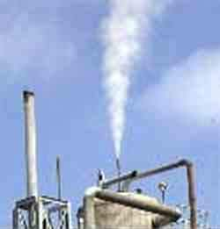
Venting the DA is critical

Slide 13
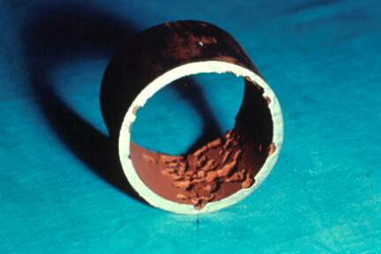
poor mechanical deaeration

Slide 14
dissolved oxygen
Mechanically removed in deaerator to < 7 ppb guarantee. Typical performance 20-50 ppb.
Chemically lowered to <10 ppb.
Dissolved oxygen causes corrosion in Preboiler, Boiler, Steam, and Condensate Systems.
#1 cause of failure in low-pressure boilers.

Slide 15
chemical scavenging
Sulfites/bi-Sulfites are utilized to reduce the remaining oxygen in the feedwater.
Direct reaction with sulfite generates sulfate.
Operators measure residual sulfite.
Good scavenger performance depends upon
Time, temp, pH, and catalyst level

Slide 16
sodium bisulfite
Best conditions for maximum performance.
pH > 8.5
Time > 10 minutes
Temperature > 230 F
Catalyst present

Slide 17
types of Boiler systems
Firetube ~
Watertube ~
Waste heat ~ waste heat is used to make steam
HRSG ~ Heat Recovery steam generator

Slide 18
ASME (American Society of Mechanical engineers) Guidelines
Based upon what has worked industrially for years in standard boilers which are:
Industrial water tube with or without superheaters and turbine drives
Industrial firetube boilers
Coil boilers
Marine boilers
Electrode boilers

Slide 19
ASME water parameters to monitor
Dissolved Oxygen
Iron, Copper, Hardness, and Suspended Solids
pH
Organic Matter
Silica
Alkalinity
Conductivity

Slide 20
asme water chemistry guidelines

Slide 21
Energy loss vs scale thickness
8
7
6
5
4
Energy Loss (%)
3
2
1
0
1/64
1/32
3/64
1/16
Scale Thickness (Inches)
Iron & Silica
High Iron Content
"Normal" Scale

Slide 22
boiler tube heat transfer
Fireside
Waterside
Fireside
Waterside
o
800 F
Scale
Metal
Wall
Tube
o
600 F
Metal
Wall
o
o
500 F
Tube
500 F
Without Scale
With Scale

Slide 23
pH
pH between 8.3 - 10.5 for Feed water will minimize corrosion.
pH between 9.5 - 12.5 in Boiler will minimize corrosion.
Low pH in Condensate system caused by carbonic acid - Carbon Dioxide in condensate system.

Slide 24
pH
M or Total Alkalinity = pH is 4.3 and above
P alkalinity = pH of 8.2 and above
OH alkalinity = ph of 10.2 and above
Acidic
Basic
Hydrogen Ions Increase
1
2
3
4
5
6
7
8
9
10
11
12
13
14
pH

Slide 25
objectives of internal treatment
Minimize deposition
Minimize corrosion
Minimize carryover
By meeting these goals we maximize your equipment reliability and minimize your cost of operation.
Your pretreatment equipment is the front line of defense.

Slide 26
maximizing efficiency
How?
By maximizing condensate return
Return on effort
High energy value
Good quality water
Lowers overall water costs
Lowers chemical treatment cost
It’s not free

Slide 27
Condensate corrosion
Carbon Dioxide occurs in the atmosphere and can leak into the steam system.
Carbonate and Bicarbonate Alkalinity break down under thermal conditions and produce Carbon Dioxide.
Carbon Dioxide forms Carbonic Acid, a weak acid, and lowers the pH of the condensate system.

Slide 28
Carbonic acid formation
H₂CO₃
CO2
H₂O
+
Carbon
Dioxide
Water
Carbonic Acid
Steam Phase
Condensate Phase

Slide 29
How to protect the condensate system
Pretreatment approaches
RO
Softener
Demin
Chemical treatment approaches
Condensate polishing

Slide 30
Chemical approach
Neutralizing amines
filming amines

Slide 31
Chemical approach
Work on the basis of a weak organic base neutralizing the carbonic acid.
Are highly effective and easy to feed and control
Provide no protection against oxygen
FDA approved products available
Can improve oxygen scavenger performance
Higher alkaline waters require more product.

Slide 32
3 common amines
DR vs. Pressure
AMINE 0 PSIG 200 PSIG 1000 PSIG
CYCLOHEXYLAMINE 4.0 16.0 9.3
DEAE 1.7 4.5 3.4
MORPHOLINE 0.4 1.6 1.0
Notes:
DEAE – Diethylethanolamine
MOPA – Methoxypropylamine
MEA – Monoethanolamine

Slide 33
Filming amines
Hydrophobic Barrier Film
METAL SURFACE
HYDROPHILIC
ANCHOR
Notes:
Review Of Filmer Technology
The picture effectively illustrates how a filmer functions to protect the metal surface. The film does not impede heat transfer; in fact, it may enhance it by promoting drop wise condensation (vs. film condensation).
The integrity and stability of the mono-molecular film is key to performance.

Slide 34
How it protects
H₂CO₃
O₂
Hydrophobic Barrier Film
METAL SURFACE
Notes:
Review Of Filmer Technology
A properly applied filmer program will protect metal surfaces from corrosion. This concept is similar to what you do when you apply wax to the metal surface of your car - protecting the surface from the weather.
It can be noted that the film protection is not perfect, e.g. the filming process is dynamic with film continuously being stripped away and again replenished. As a result, the metal will be exposed somewhat to the corrosive environment.
Note, the filmer itself does nothing to change or modify the corrosive liquid.

Slide 35
Carryover
Common concerns & terms
Refers to any contamination that leaves the boiler with the steam.
The most common carryover is entrained boiler water droplets which contain dissolved and suspended solids.
Carryover may be either mechanical or chemical.
Types of carryover include spray carryover, priming, and foaming.

Slide 36
Organic Matter
Common concerns & terms
Consists of Oily Matter & Non-volatile Total Organic Carbon.
Organic contamination can cause internal deposition and/or boiler carryover.
Oily Matter includes hydrocarbons, vegetable oils, animal fats, waxes, soaps, and greases. Limit < 1 ppm in Feedwater.
TOC < 1 ppm in Feedwater.

Slide 37
Silica
Common concerns & terms
Responsible for internal deposition of complex silicates.
Silica scale more retardant to heat transfer.
Limit < 150 ppm in Boiler Water.
Silica in higher pressure systems is volatile and can affect downstream equipment via deposition.

Slide 38
Alkalinity
Common concerns & terms
P Alkalinity = 1/2 carbonates and all hydroxides.
M Alkalinity = Total Alkalinity = All bicarbonates, carbonates, and hydroxides.
O Alkalinity = All hydroxides.
Alkalinity affects pH, deposition, sludge conditioning, and steam purity.

Slide 39
Conductivity
Common concerns & terms
Corresponds to the level of Total Dissolved Solids in the Boiler.
Used for blowdown control to limit cycles of concentration.
Exceeding conductivity guidelines can result in carryover.

Slide 40
Any Questions?
?

