Slide 1
Lessons Learned: Fighting DBP Formations for improved water quality
KRWA 39th Annual Conference & Exhibition
Louisville, Kentucky
August 27- 28, 2018

Slide 2
Take Home Message
History can be beneficial- Peer Review/ State of Commonwealth
Never Before Have there been so many options to remove organics
Implementation of Solutions in a systematic approach Improves Success of Problem Solving.
you can Never can have to much data
water Systems are Dynamic
Options do not stop at the Treatment Plant
Optimization and Management of Source water ,treatment & Distribution system improves water quality

Slide 3
The State of the Commonwealth
Current Regulations & Compliance in Kentucky
Stage 1 & 2 (11 DPB’s) Since 2015
Total Water Systems- 435 Public Water Systems
Non Compliant Systems-44
Consecutive Systems- 29
Trending Down

Slide 4
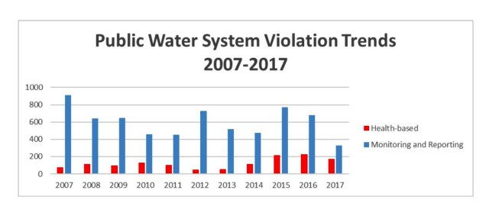
Violation Trends

Slide 5
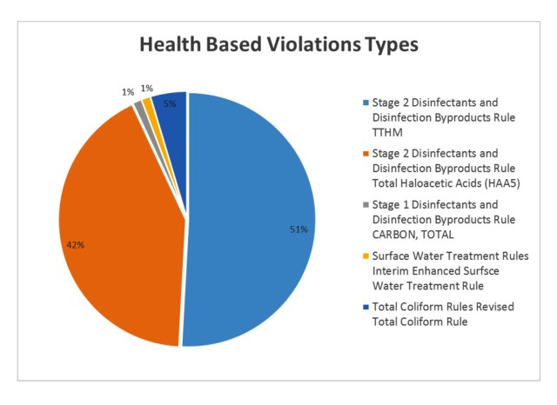

Slide 6
Violations

Slide 7
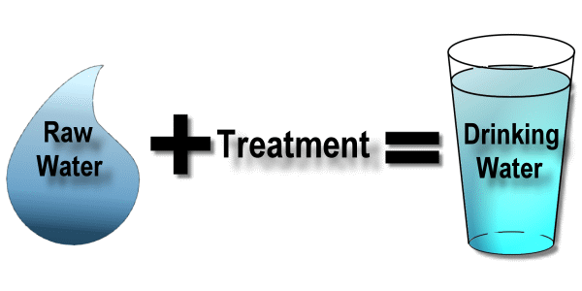
Stage 2
Disinfectant And Disinfection Byproduct Rule (DBPR USEPA 2015)
4- THMs
5-HAAs
Chlorites
Bromates
Precursor Removal

Slide 8
Control Strategies
Three Primary Categories:
Removal of DBP Precursors (TOCs)
Modification and optimization of treatment and disinfection practices to minimize DBP formation
Removal of dbp’s after formation

Slide 9
Treatment Applications
Pre-Oxidation
Oxidation & Aeration
Feed Points
Adsorption with Pac
Enhanced Coagulation
Alternate disinfection methods
Filtration with Gac

Slide 10
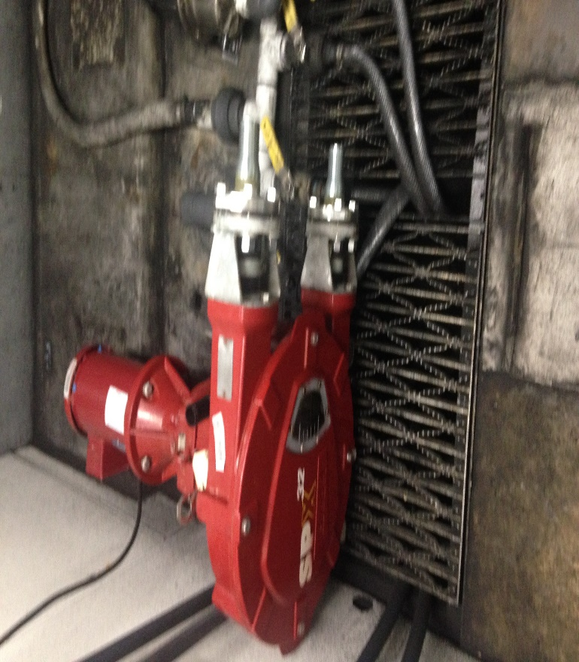
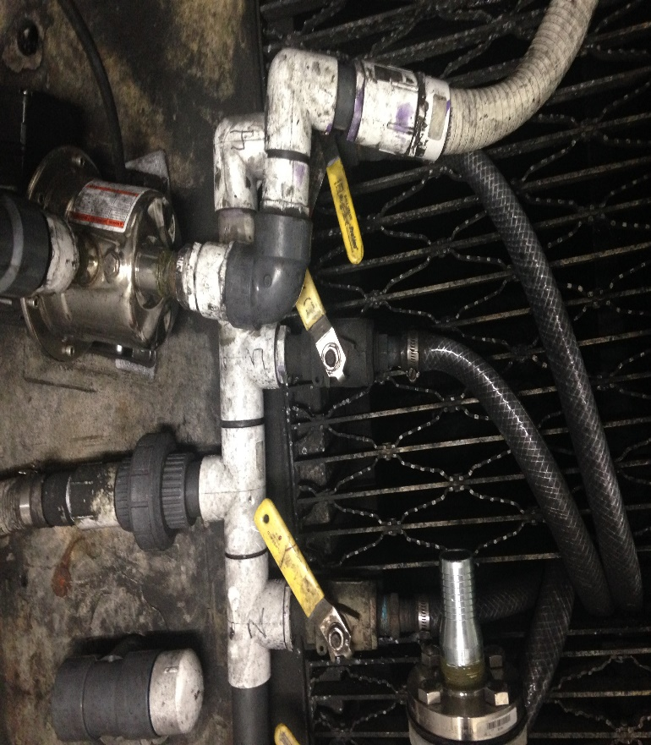
TTHMs & HAAs
After Reaction Formation- Best Methodology
All Carbon is Not the Same
Formed by reaction with NOM and chemical disinfectant
Reducing NOM- Watershed Management
Removing Pre-Chlorination
Enhanced Coagulation
GAC
Ultra or Nano Filtration
Biological Filtration

Slide 11
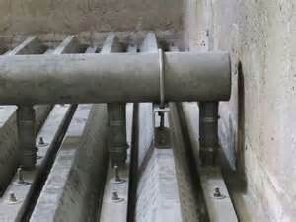
“As Built GAC Cap” Filter # 4
Filter Media Depths
Wall Elev. 483.75
AWI Underdrain
Weir Elev. 476.25
33.125” Free-board at Rest
50% Expansion
Elev. 474.75
476.25
GAC Elev. 472.33
4.833’ of Total Media
48” GAC
Sand Elev. 468.33
AWI Elev. 467.50
10” Sand
AWI Underdrain
Bardstown WTP GAC Project
PWSID # KY0900017
Filters # 4 “ As Built GAC Cap”
Bob Cashion, CWT 7-22-16
Bottom Elev. 464.50
Plenum
6800 gpm BW rate gave 7” Rise Rate @ 12%

Slide 12
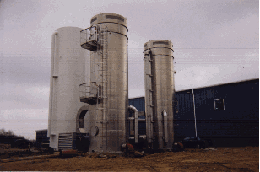
Some Typical Stripping Towers

Slide 13
35 Acre City
Reservoir
WTP Schematic
500K
300 K
1
KMNO4
Actiflo
Actiflo
Post Actiflo CL2
2
3
Activated Carbon
Filter units
HFS
TOF CL2
HS Pumps
7
6
4
Treatment Plant Schematic
Bob Cashion, CWT 4-17
PO4
Post Filter CL2

Slide 14
Alternative Feed Points
Critical for Success
What Mechanism ?
Feed Rate
Demand
Residual
Monitoring Points
Water Quality Changes

Slide 15
Filtration Works
pH depression to break DOC Bond
or
Enhanced Softening
Enhanced Coagulation

Slide 16
Multiple Barrier Concept for Microbial Contaminant Protection
Turbidity
Goal
<1.0 NTU
Coagulant
Addition
Achieve
Inactivation
Goal
Turbidity
Goal
<.10 NTU
Disinfection
Addition
Variable
Quality
Source
Water
Flocculation/Sedimentation
Barrier
Filtration
Barrier
Disinfection
Barrier
Finished
Water
Bio Filtration or GAC Contact Time

Slide 17
Filtration Has Two Mechanisms
Mechanical
Adsorption
Large particles become lodged and cannot continue downward through media
Particles stick to the media and cannot continue downward through media

Slide 18
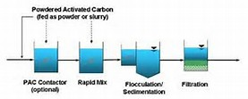
Contact Time = Removal Results

Slide 19
Benefits of Activated Carbon
Taste & Odor MIB/ Geosmin
Cyano Toxins
TOC
DPB’s and Precursors
Endocrine Disruptors
Pharmaceuticals

Slide 20
Causes of DBP Accumulation
2. Inadequate water treatment/
filter media fouling
1. Poor source water quality
3. Contamination and long residence time in the storage and distribution system
Purchasing Systems/ Consecutive Systems

Slide 21
Objectives Chart
TOC Reduction Fight Low Chlorine Residual
DEMAND
Training
SOLUTIONS
Chemical Feed
Flushing
Residence Time
Tank Turn Over

Slide 22
Remediation Critical Control Points
Filtration Media cleaning
Aeration
Wetted Surface cleaning
Storage Tank
cleaning
Pre Oxidants
24-96 Hrs. +
4-6 Hrs.
Water Contact Time
Source Water Protection, Raw Water Line & Storage cleaning
Reduction of chlorine feed, Distribution Line cleaning
Wetted Surfaces
Notes:
Blue Earth Labs’ Cleaning Mechanisms- Source to Tap. NSF approved Off line & On Line Cleaning chemistries and products for each portion of the infrastructure.

Slide 23
Distribution Applications
Main Flushing
Storage Management
Water mixing
Main Cleaning
Biofilm Removal & Prevention
Elimination of Dead Ends
Satellite Feed Systems
Filtration

Slide 24
What Contributes to Water Age?
Long Residence time in storage tanks
Fire Flow requirements in new construction Area
Low flow & Lack of Water usage in large diameter piping
Dead end lines with low usage
High Chlorine Demand (Organic & Inorganics)

Slide 25
“Issues with Water Age”
Chemical Biological Physical
*DBP Formation *Biodegradation Temp Increase
Disinfection Decay *Nitrification Sediment
*Corrosion Control *Microbial Regrowth Color
Taste & Odor Taste & Odor Smell
*Potential Health Impacts associated with chemical and biological issues

Slide 26
Technical Briefing
Water Age – Increases formation of contaminates in tanks, pipes, pipe walls & bulk water that can lead to adverse health effects.
Distribution System is a Reactor That
Affects Water Quality
Water Quality Problems: Dbp’s,
Nitrification, Microbial Survival & Growth and Corrosion
Residence Time, System Turnover

Slide 27
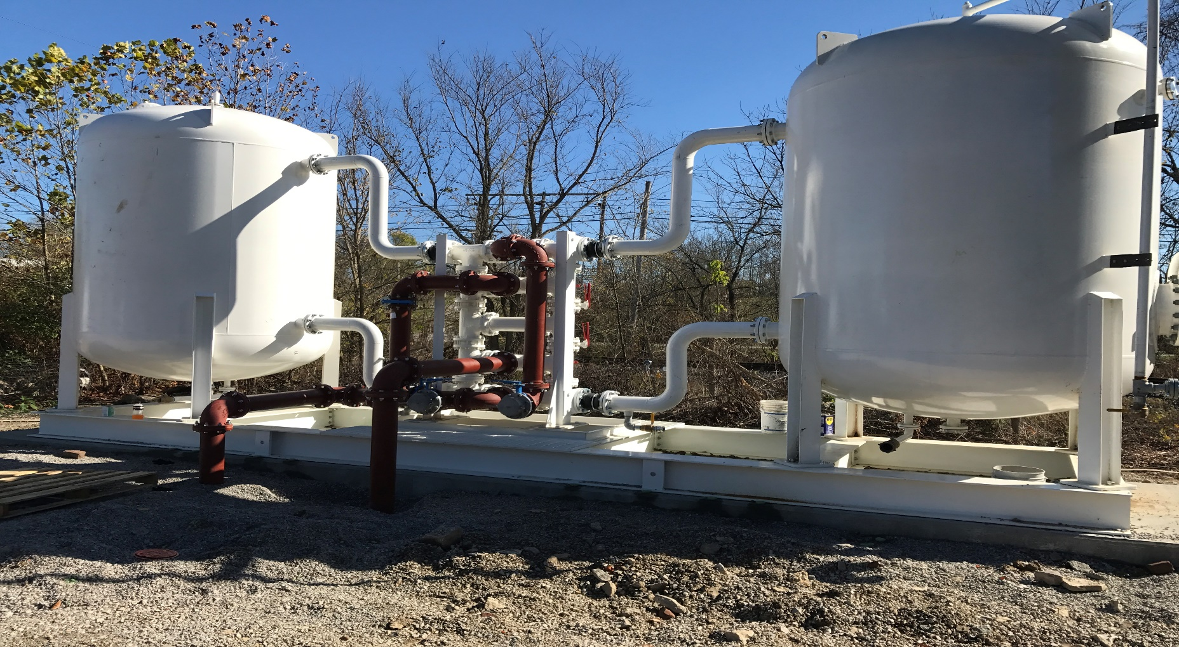
Distribution System Treatment
GAC Filter Prior to Re-chloramination

Slide 28
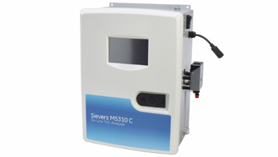
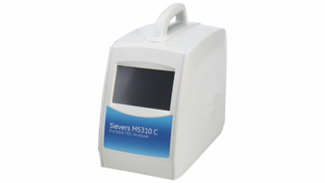
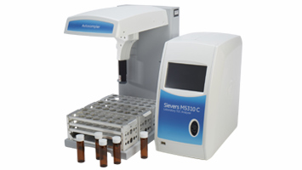
Sampling & Laboratory Management
Represenative Water Samples
Preliminary & Surrogate Testing
Split Samples Verification
Check Lab Results, Temperature, Holding Times

Slide 29
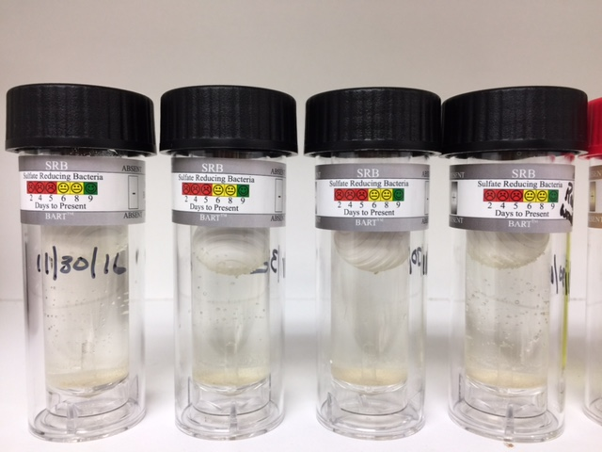
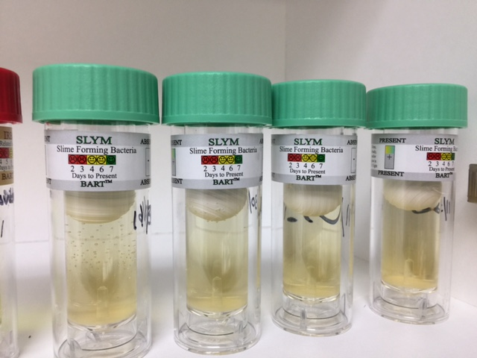
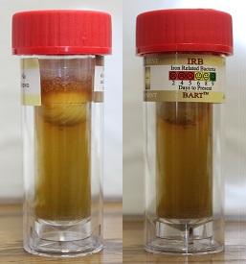
System Wide Bacteria Testing
BART’s Test Utilized to provide bacteria colony counts leaving the WTP and through out the distribution System. Slime, Iron & Sulfur Reducing Bacteria
Slime and Iron Bacteria Positive

Slide 30
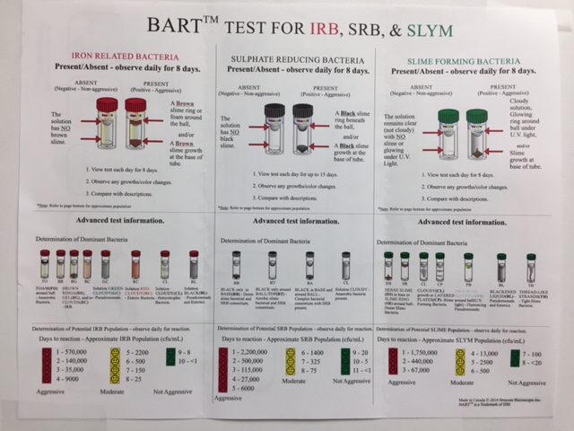

Slide 31
Organics + Chlorine= DBP’s
DBPs
Chlorine Residual

Slide 32
Water Storage

Slide 33
Distribution Monitoring
Loss of Disinfectant Residual
Increase in water temperature
Decrease in pH(Lower alkalinity affects buffering capability)
Decrease in Alkalinity(Significant amount of Bicarbonate consumed during nitrification)
Decrease in dissolved oxygen
Increase HPC (Heterotrophic Plate Count)
Bacterial re-growth

Slide 34
What’s next
Bacteriological sampling/bio penetrant feed
Pressure zone specific fluoride tracer study
Implement changes to valving (open/close) to prevent sloshing
Work with purchasers (wD) to continue water age study in their systems
Once changes are implemented, dbp testing, bacteriological sampling

Slide 35
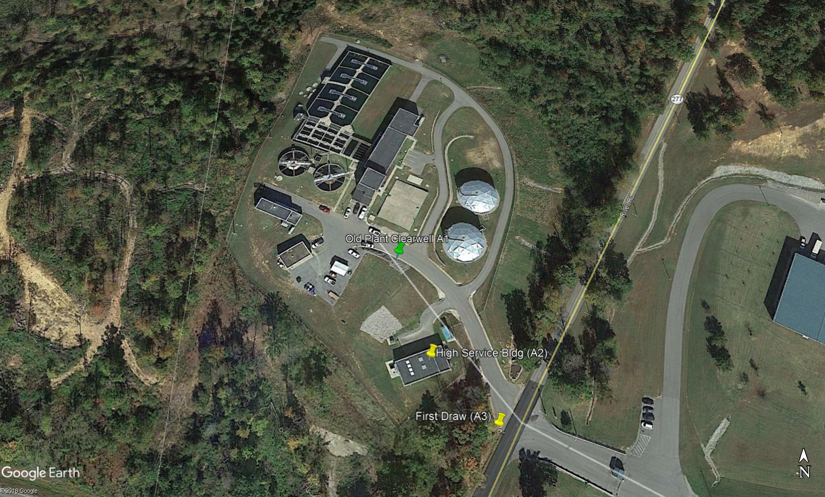
Case Study Central City WTP
PAC Study-Highest Iodine number
Tracer Study-
Bacteria Study-
Phosphate Study
Main Flushing-
Tank Management-

Slide 36
Case Study Bardstown WTP
Lowest 3rd Quarter (Aug-16) numbers in History of the facility
WTPHaa5- 0.024 ttHM-0.035
N Neson-0.019 0.031
Bloomfield 0.028 0.038
New haven- 0.05 0.058
MCL@ 60ppb MCL @ 80ppb

Slide 37
Case Study Lebanon WTP
OPTIMIZATION
Water Source Quality
Pre-oxidant Testing
Chemical Feed Points
Carbon Selection
Filtration Performance
Clearwell Management
Unidirectional Flushing of System
Tank Storage Management
Improved Sampling Plan
Background and Non Compliant Testing
Training

Slide 38
QUESTIONS???????
Contact information:
Bob Cashion 270-790-2726
RKCashion @S4Water.net
" It's not what you know, it's knowing where to find what you need. "
The information included in this presentation is proprietary and/or confidential, and protected from disclosure. Do not disseminate, distribute or copy this presentation without the express consent of S4 Water Sales & Service ,LLC

