Slide 1
Fluoride Tracer Study
KWWOA 61st Annual Conference
April 9, 2018

Slide 2
Take Home Message
Water Age – Increases formation of contaminates in tanks, pipes, pipe walls & bulk water that can lead to adverse health effects.
Distribution System is a Reactor That Affects Water Quality
Water Quality Problems: DPB’s, Nitrification, Microbial Survival & Growth and Corrosion
Residence Time
Tracer Studies Gives You Knowledge

Slide 3
Remediation Critical Control Points for a Tactical Advantage
Filtration Media cleaning
Air scrubber cleaning
Wetted Surface cleaning
Storage Tank
cleaning
24-96 + Hrs.
4-6 Hrs.
Water Contact Time
Source Water Protection, Raw Water Line & Storage cleaning
Distribution Line Cleaning
Wetted Surfaces
Notes:
Blue Earth Labs’ Cleaning Mechanisms- Source to Tap. NSF approved Off line & On Line Cleaning chemistries and products for each portion of the infrastructure.

Slide 4
Water Reactions

Slide 5
What Contributes to Water Age?
Long Residence time in storage tanks
Fire Flow requirements in new construction Area
Low flow & Lack of Water usage in large diameter piping
Dead end lines with low usage
High Chlorine Demand (Organic & Inorganics)

Slide 6
Tracer Study
Residual Fluoride
Field Work

Slide 7
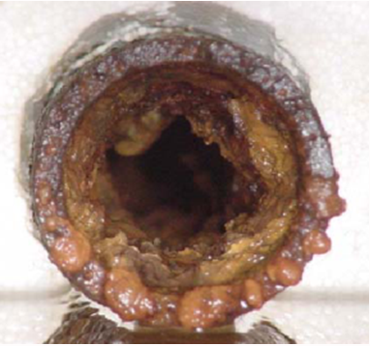
The Problem
Biological and mineral
deposits form on every
wetted surface
The organic matter provides a rich ground for bacteria and biofilms that consume chlorine and chloramine disinfection, lowering residuals, forming DBPs
To maintain residuals, utilities increase chlorine and chloramines that further react with biological matter and form greater levels of DBPs
Eventually, because of the biological interference, residuals cannot be maintained AND DBPs cannot be reduced without distribution system intervention

Slide 8
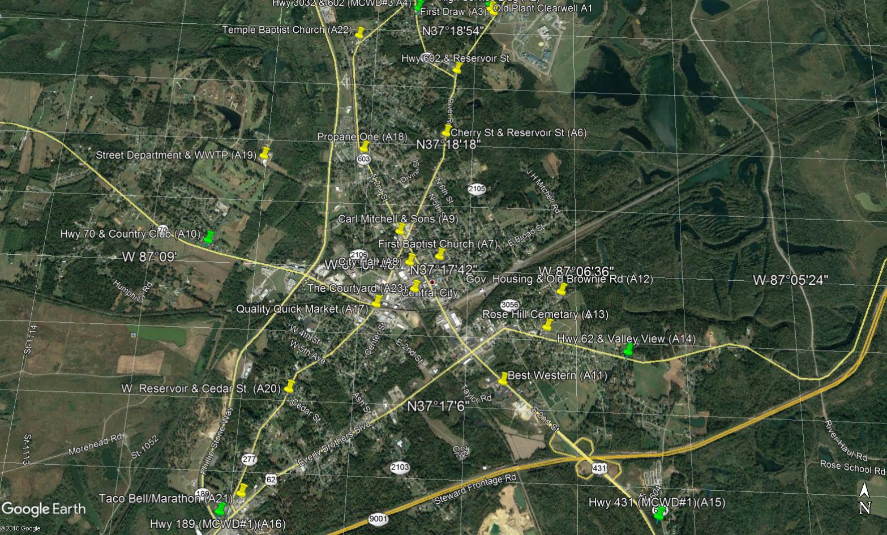
WTP
Master Meters
Sample Sites
Tanks

Slide 9
Equipment Needed
Portable Colorimeter (DR850, 890, 900)
Fluoride SPADNS Reagent
GPS (Smart Phone)
Detailed Sampling Plan, SOP
Sample Site Flushing (Time?)
Stop Watch
Sample Bottles
Adequate Man Power

Slide 10
Goals
Determine what you want to accomplish?
Determine what other analytical tests you want to run?

Slide 11
How to ask for approval?
Notify your Regional KY-DOW compliance assistance
Notify your Fluoride Inspector
Do this in writing
Notify the public if necessary, especially if sample sites are located in/around housing

Slide 12
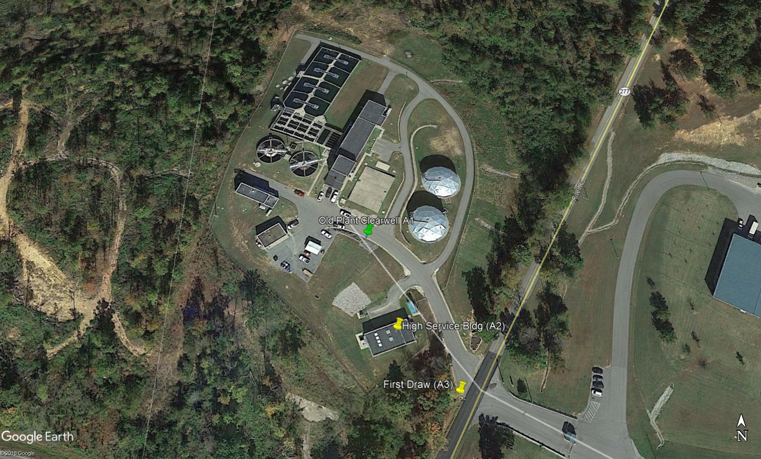
Water Plant
Direction of Flow

Slide 13
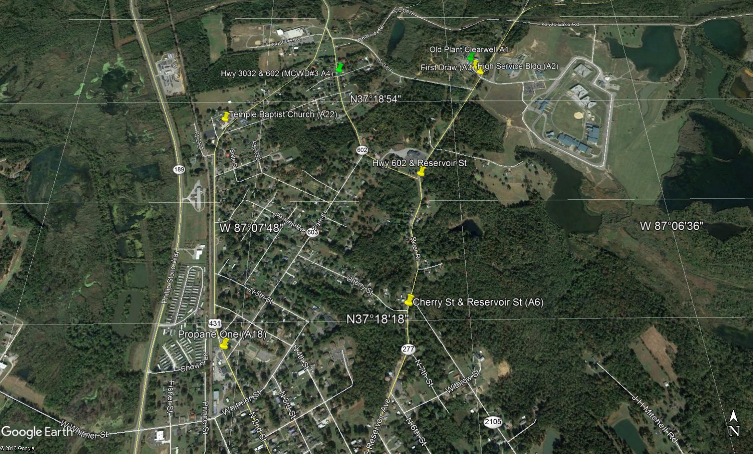
North Portion of City

Slide 14
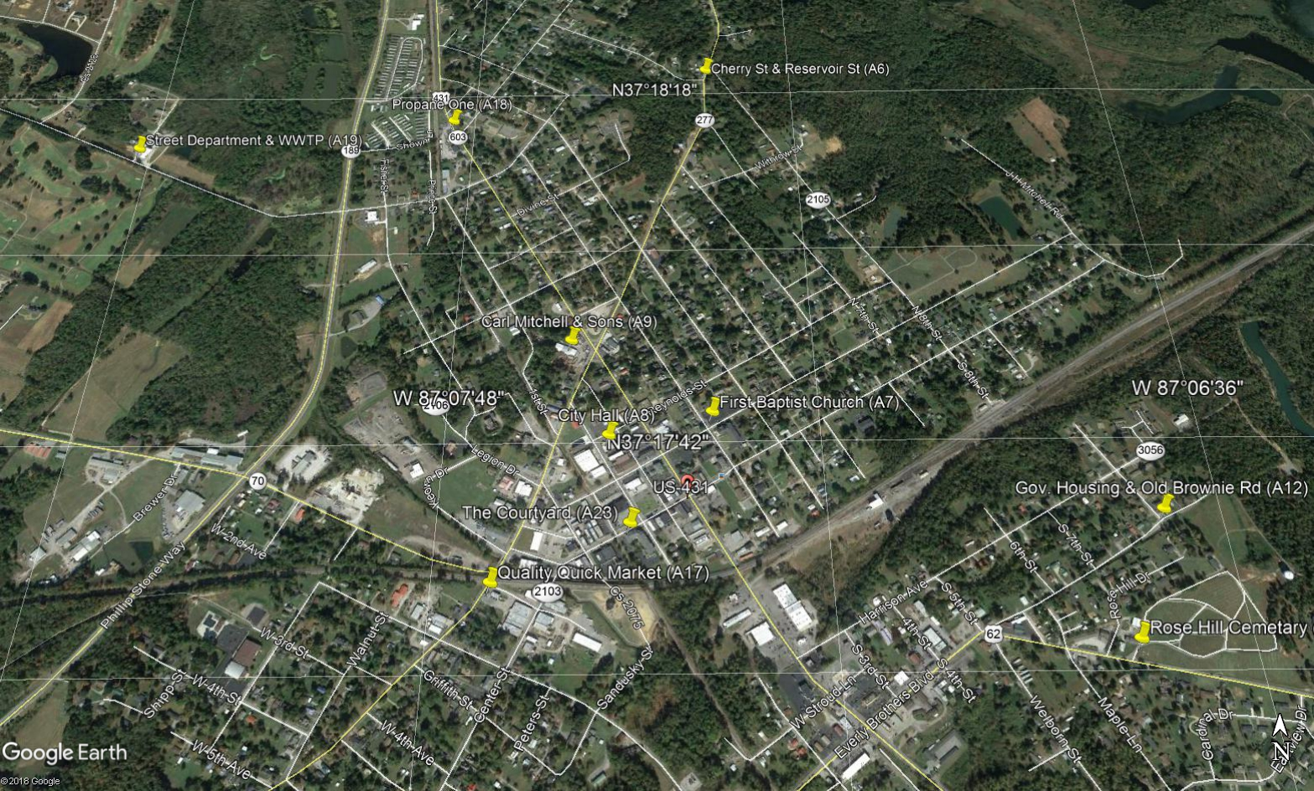
Central Portion of City

Slide 15
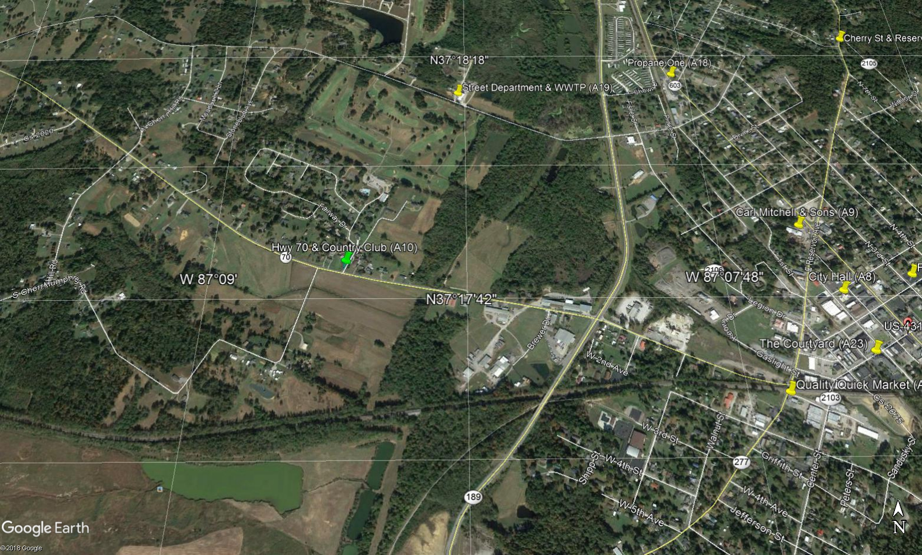
West Portion of City

Slide 16
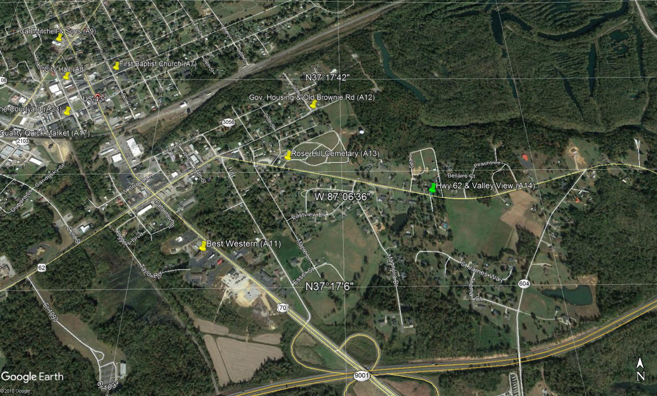
East Portion of City

Slide 17
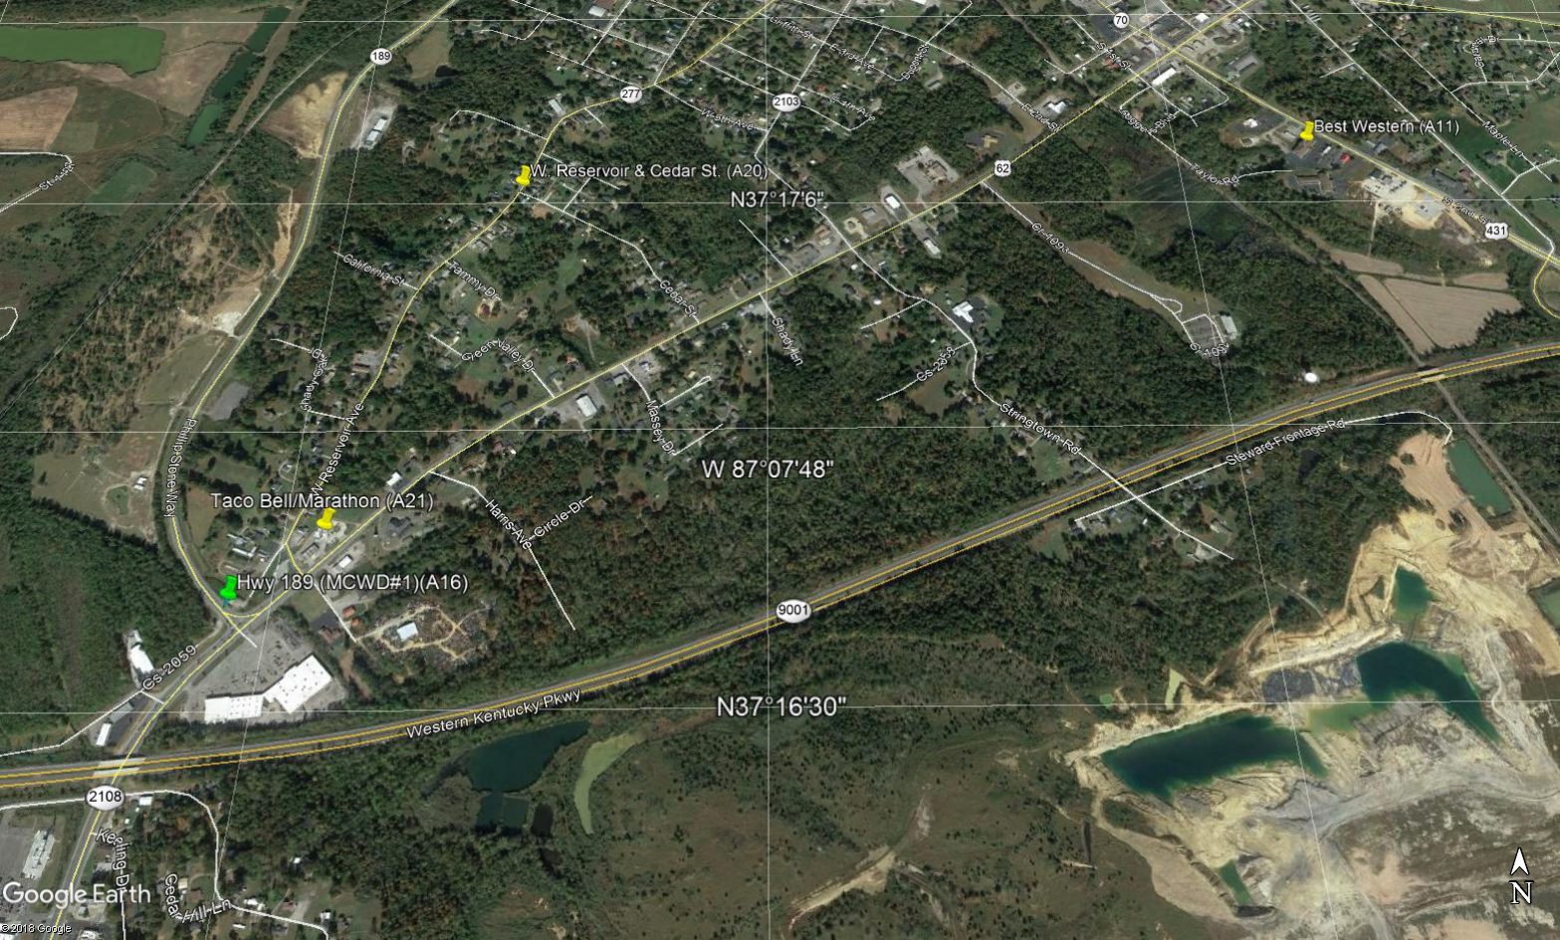
South Portion of City

Slide 18
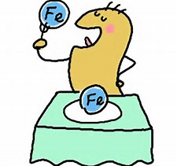
Biological Aspects of Corrosion
BART’s Testing
Iron Bacteria

Slide 19
QUESTIONS???????
“A Team”
Contact information:
Bob Cashion 270-790-2726
RKCashion @S4Water.net
" It's not what you know, it's knowing where to find what you need. "
The information included in this presentation is proprietary and/or confidential, and protected from disclosure. Do not disseminate, distribute or copy this presentation without the express consent of S4 Water Sales & Service, LLC

